Slide 1
North American Plant Protection Organization (NAPPO) Expert Group (EG) on Transit
Progress Report
Brendon Reardon, USDA-APHIS-PPQ, EG Chair
46th NAPPO Annual Meeting
December 2023

Slide 2
What is a consignment in transit?
A consignment which passes through a country without being imported, and that may be subject to phytosanitary measures (International Standard for Phytosanitary Measures 5 (ISPM 5) - Glossary of phytosanitary terms)

Slide 3
Transit Expert Group Members
Servicio Nacional de Sanidad, Inocuidad y Calidad Agroalimentaria (SENASICA)
Neftalí Reyes Carranza (Vice-Chair)
USDA-APHIS Plant Protection and Quarantine
Brendon Reardon (Chair)
Erin Stiers
Fan Wang-Cahill
U.S. Customs and Border Protection
Annaliese Blecha
Industry
Greg Yielding (National Onion Association)
John Ercolani (J&K Fresh)
Evan Moss (J&K Fresh)
Canadian Food Inspection Agency (CFIA)
Christine Villegas (Vice-Chair)
Wendy Asbil
Canada Border Services Agency
Everett Harper
Helen Gerson
Industry
Allan Schepens (Canadian Pacific Railway)
Jeffrey Parsons (Canadian National Railway)

Slide 4
Objective
To standardize responsibilities and actions for safeguarding consignments in transit among NAPPO countries

Slide 5
Benefits
Streamline and harmonize regional approach and communication for responding to non-compliant shipments, re-exporting shipments, and reducing NAPPO region’s exposure to pests and diseases

Slide 6
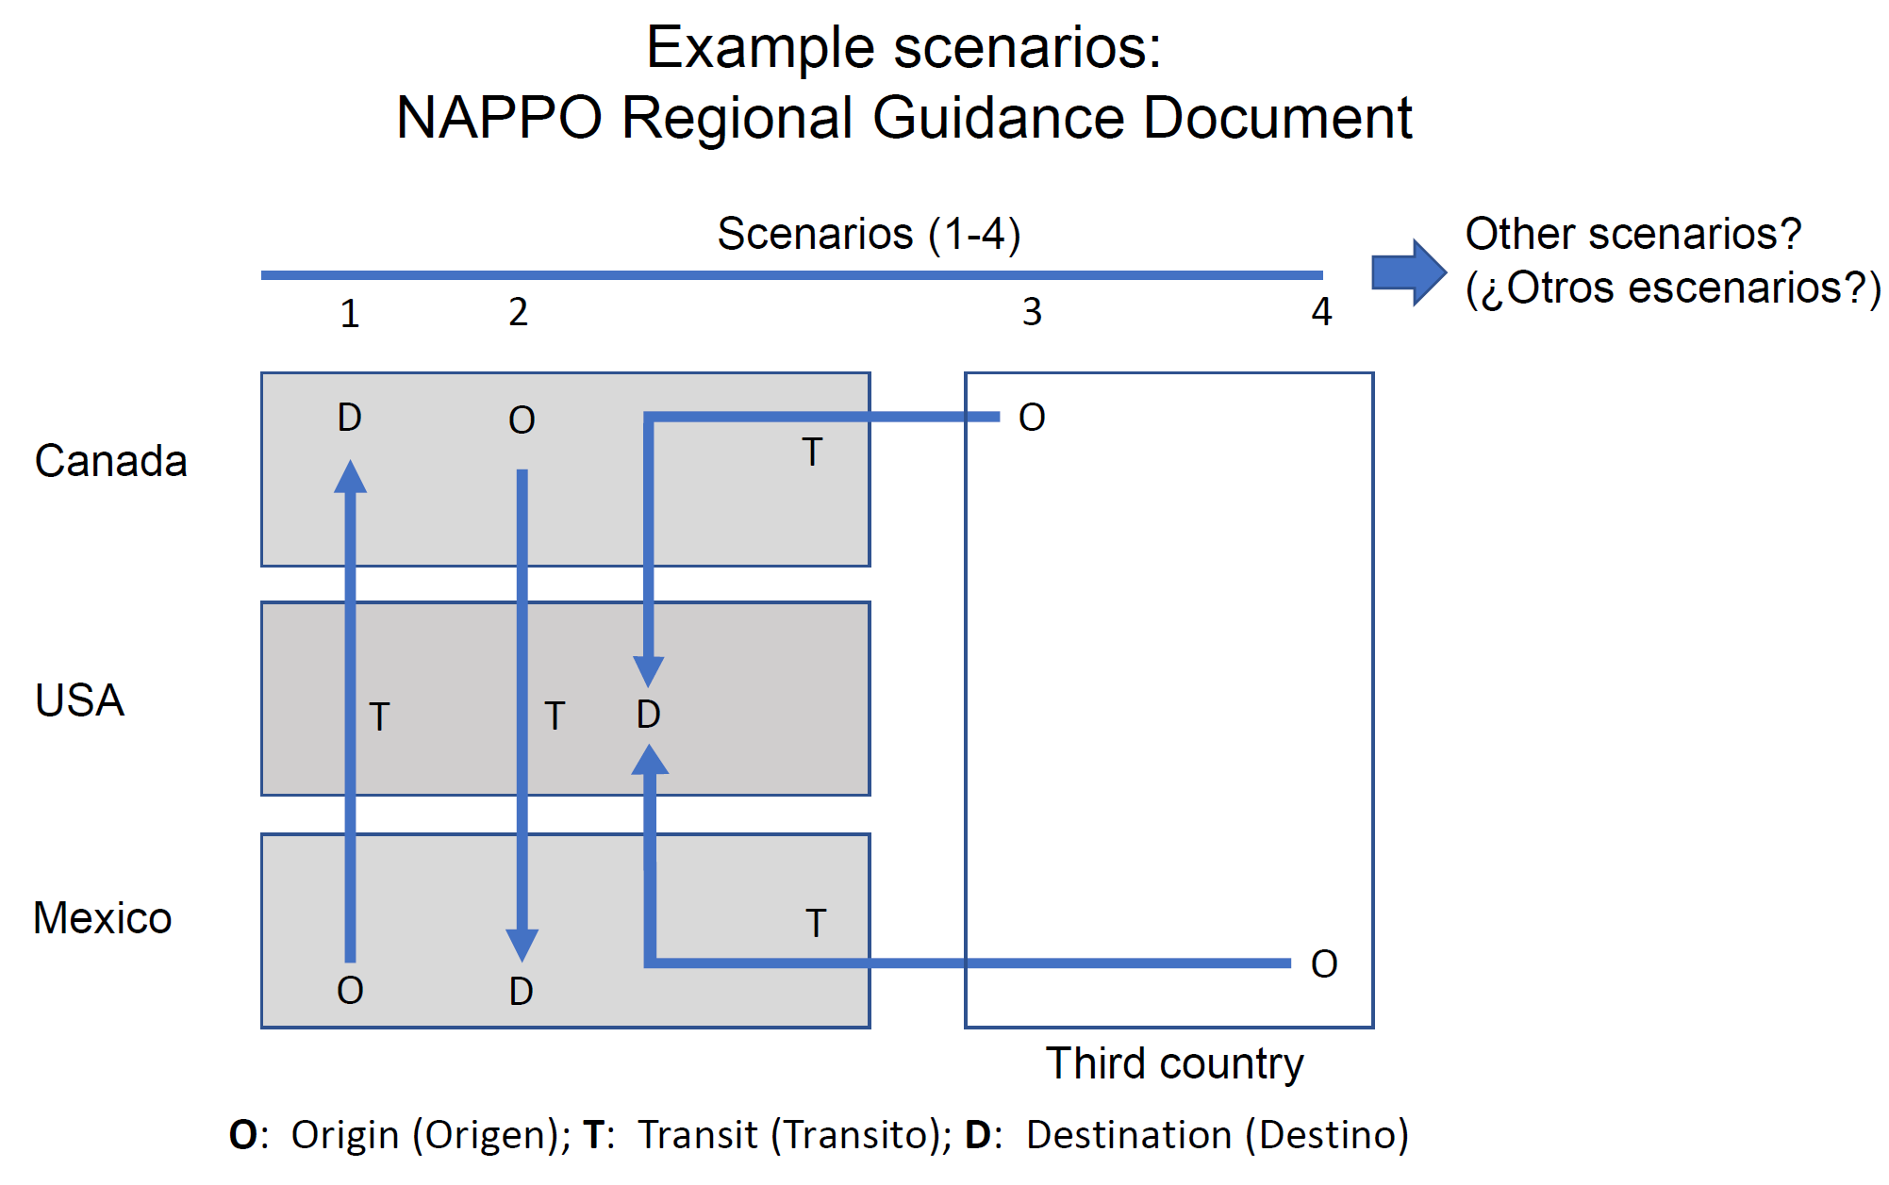

Slide 7
Supporting Guidance
International Plant Protection Convention (IPPC) International Standard for Phytosanitary Measures 25 (ISPM 25) - Consignments in transit
IPPC transit manual “Transit: Phytosanitary issues of consignments in transit: a guide for national plant protection organizations”
NAPPO Regional Standard for Phytosanitary Measures 23 (RSPM 23) - Guidelines for Consignments in Transit (archived)

Slide 8
Accomplishments
Identified and prioritized possible transit scenarios
Identified stakeholders in transit process
Identified stakeholder general roles and responsibilities in transit scenarios
Drafted regional guidance document
Published regional guidance document for country consultation

Slide 9
Moving Forward: Deliverables
Finalize regional guidance document on NAPPO website with approval of NAPPO
Explore opportunities for following-up with recommendations

Slide 10
Acknowledgements: Stephanie Bloem, Executive Director Nedelka Marín-Martínez Alonso Suazo Eva Sofía Báez THANK YOU!

