Slide 1
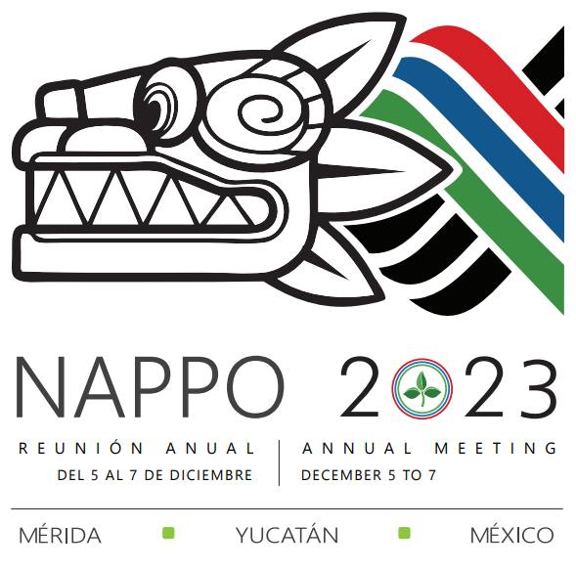
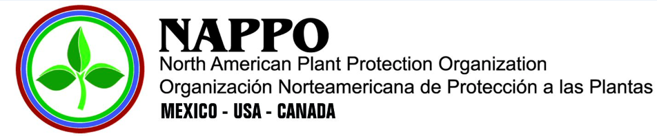
Progress Report 2022-2023
PAS Expert Group
Phytosanitary Alert System (PAS)
Ignacio Baez
USDA-APHIS-PPQ
Chairperson | Presidente
46th NAPPO Annual Meeting, December 6, 2023
46ª Reunión Anual de la NAPPO, 6 de diciembre del 2023
Notes:
Good day, my name is Ignacio Baez and I am the chair for the expert group that works on the NAPPO Phytosanitary Alert System
I will be presenting to you and update on the activities that the expert group conducted throughout this past year.

Slide 2



NAPPO Expert Group Members
Canada (CFIA)
Alexandre Blain
Rajesh Ramarathnam
United States (USDA)
Ignacio Baez (Chair)
Amanda Kaye
Mexico (DGSV)
Ana Lilia Montealegre
Expert Group oversees the system’s information
Composed of members from each NAPPO country NPPO
System platform housed at NAPPO Secretariat
Notes:
The PAS expert group is made up comprised of members of the National Plant Protection Organizations of the three NAPPO countries.
These members are: Alexandre Blain, and Rajesh Ramarathnam for Canada; Myself and Amanda Kaye for the United States, and Ana Lilia Montealegre for Mexico.
As a group, we are responsible for overseeing and updating information on the Phytosanitary Alert System on an ongoing basis
Housing of the system platform, oversight, support and translations are provided by the NAPPO Secretariat.

Slide 3
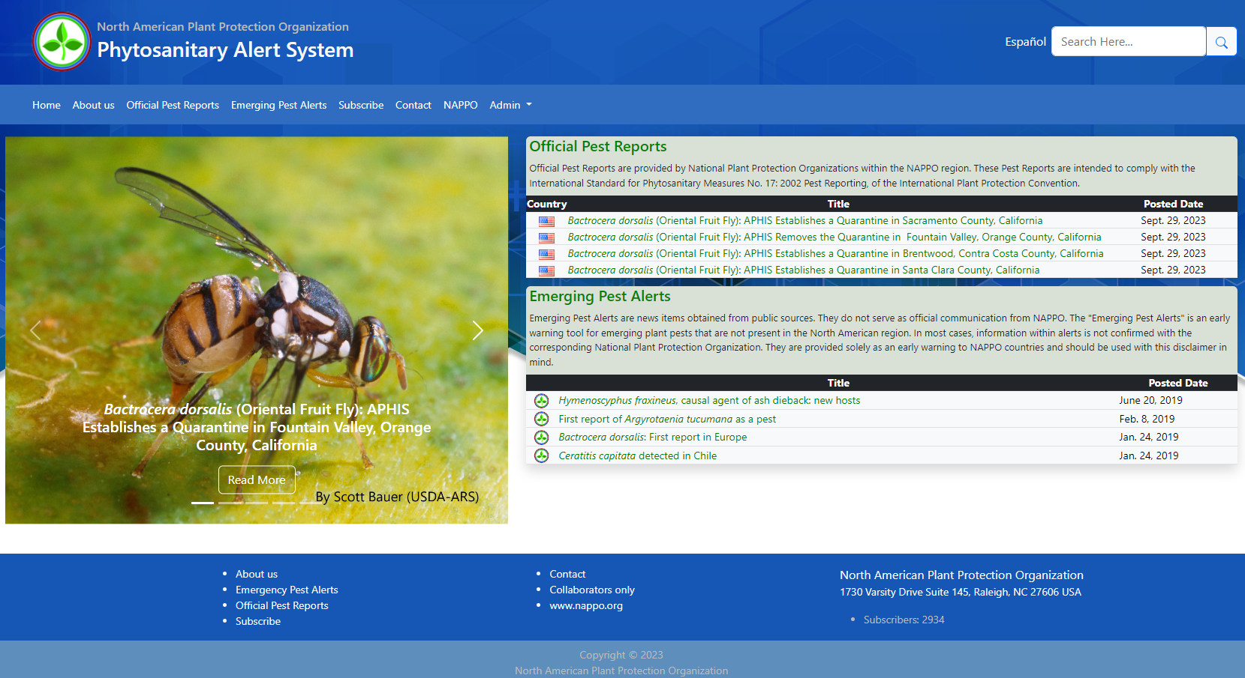
NAPPO Phytosanitary Alert System Overview
(www.pestalerts.org)
Notes:
So, what is the Phytosanitary Alert System or PAS?
The NAPPO Phytosanitary Alert System is a bilingual (English and Spanish), publicly accessible, web-based notification system that was launched in April 2000.
The system provides a mechanism that allows Canada, the United States, and Mexico to share pest information, both official and scientific about emerging plant pests, to better facilitate their detection, prevention and management through the exchange of information on these pests.
The information shared on the system is focused on plant pest of quarantine significance that might pose a significant threat to North American agriculture, forests or natural habitats.

Slide 4
Objectives and Deliverables
Objective
Meet pest reporting obligations under the IPPC and facilitate information of non-indigenous plant pest species within North America.
Deliverables
Official pest reports – comply with IPPC Standard on Pest Reporting (ISPM 17)
Emerging pest alerts – news items of pest threats not present in NAPPO Region
Alert
Detection
Pest
Emerging plant pests
Prevention
Pest reporting
Exchange of information
Surveillance
Notes:
According to the NAPPO Work Program, this is an ongoing project and the objective for this system is to meet the pest reporting obligations under the IPPC and
Facilitates getting information to the NAPPO countries for awareness on detection, prevention, and management of non-indigenous plant pest species within North America.
Two products can be provided through this system: "Official Pest Reports" and "Emerging Pest Alerts".
I will go into further detail in the next slides.

Slide 5
Project Benefits
 | NPPOs | Industry | Globally
meet IPPC reporting obligations | ✓ |  | ✓
communicate official pest information | ✓ | ✓ | ✓
raise awareness on emerging plant pests | ✓ | ✓ | ✓
Notes:
But before I do so, what are the benefits of this project for the National Plant Protection Organizations (or NPPOs) of the region, industry, and globally?
This project benefits the NPPOs of the region and Globally by having a platform, which they can provide official communications on pest of regulatory concern, and meet the IPPC National Reporting “pest” Obligations as required in the convention.
The industry benefits from this project by having a platform where official information is communicated about immediate or potential danger of a quarantine pest.
But also, for NPPOs and Industry, the platform provides pest information intended as an early warning of emerging plant pests that may be of interest to the region or agricultural sectors.

Slide 6
Official Pest Reports
Official Pest Reports
Official Pest Report (OPR)
Official communication performed by the NPPO
Communicates potential danger of a quarantine pest
May include reports of implemented phytosanitary measures
“Cydalima perspectalis: APHIS Confirms Box Tree Moth and Takes Action to Contain and Eradicate the Pest”
“Anoplophora glabripennis - Asian longhorned beetle (ALHB) eradicated from Canada.”
“Eradicated Mediterranean fruit fly Ceratitis capitata (Wiedemann) in Manzanillo, Colima, Mexico.”
Notes:
As mentioned before, the system provides two products and one of them is the Official Pest Report.
So, what is an official pest report?
An Official Pest Report (OPR) is a communication performed by a National Plant Protection Organization (NPPO)
And the purpose is to communicate immediate or potential danger from the occurrence, outbreak or spread of a pest that is a quarantine pest in the country in which it is detected, or a quarantine pest for neighboring countries and trading partners.
Also, may include reports of phytosanitary measures implemented to manage pest risk - such as a successful eradication, the establishment of pest free areas, and other pest information.
Titles on the right of my slide are some examples of these official pest reports..

Slide 7
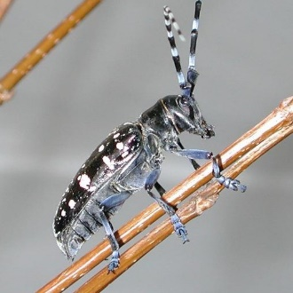


Official Pest Reports
Intended to comply with IPPC Standard on Pest Reporting (ISPM 17)
OPR on PAS manually linked to IPPC’s International Phytosanitary Portal
“Anoplophora glabripennis (Asian Longhorned Beetle): APHIS Removes the Remaining Regulated Area in Brooklyn and Queens, New York”
Photo: M. Keena
Notes:
How do OPR get generated?
The Official Pest Reports posted on the NAPPO PAS are provided by the NPPOs of Canada, the United States, and Mexico.
They serve as official communication by the NAPPO country, reporting the pest status and are intended to comply with the IPPC’s International Standard on Phytosanitary Measures (ISPM) number 17: on Pest Reporting.
The same official pest reports posted on the PAS are manually linked on the IPPC ‘s International Phytosanitary Portal (IPP).
The information posted on the IPP includes the title of the report and a link to the specific OPR that is posted on the PAS. This method helps retain the value of posts on PAS, as well as distributing the information to the international audience of the International Phytosanitary Portal.

Slide 8
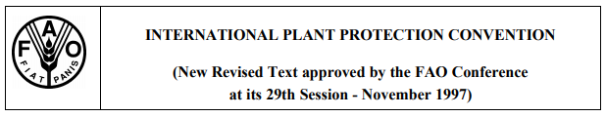
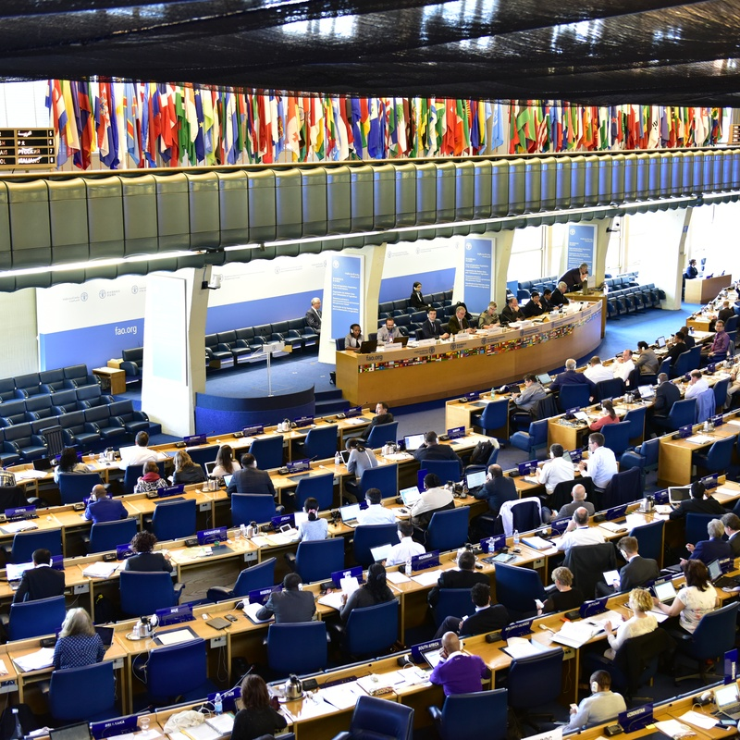
OPRs and Reporting Obligations
Why provide OPRs?
NAPPO countries are signatories to the IPPC.
Timely information essential to protect territories from harmful pests.
Timely communication, and meeting phytosanitary requirements allows trade to continue.
IPPC’s Commission on Phytosanitary Measures
Photo: IPPC
Notes:
Why should the NAPPO countries provide OPRs?
Because the three NAPPO countries are signatories to the International Plant Protection Convention (IPPC) and as a contracting party to the IPPC, Canada, U.S., and Mexico accept the rights and obligations of the convention, including article VIII 1a, ... which essentially agrees in the exchange of information on plant pests, particularly the reporting of the occurrence, outbreak or spread of pests that may be of immediate or potential danger.
The accurate and timely exchange of information, both official and scientific, is essential for countries to determine, - establish - and update - the phytosanitary measures needed to protect their territories from harmful plant pests (Devorshak and Griffin, 2002).
Communicating where a quarantine pest is and what official actions are being taken for the pest, allows for safe trade to continue as long as phytosanitary requirements of the importing country are met.

Slide 9


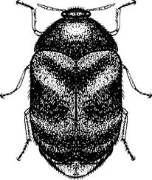
Emerging Pest Alert
“Hymenoscyphus fraxineus, causal agent of ash dieback: new hosts”
Information from records and public sources
Not official communications
Provided as early warning information
“First report of Argyrotaenia tucumana as a pest”
“Tuta absoluta: new distribution and detection”
“Mexico intercepts Trogoderma granarium on international consignments”
Notes:
In addition to posting official notifications, expert group members may gather information on plant pests of importance to the NAPPO countries and disseminate that information through the website in the form of alerts. These products can be found in the PAS system as “Emerging Pest Alerts”.
Pest information may come from a variety of sources, including records from port of entry interceptions, domestic plant pest surveys, the internet, published literature ( such as journals, newsletters, popular press), and submissions from users or readers.
They do not serve as official communication from NAPPO.
The Emerging Pest Alert is intended as an early warning tool for emerging plant pests that are not present in the North American region. And in most cases, information within alerts is not confirmed with the corresponding National Plant Protection Organization.

Slide 10
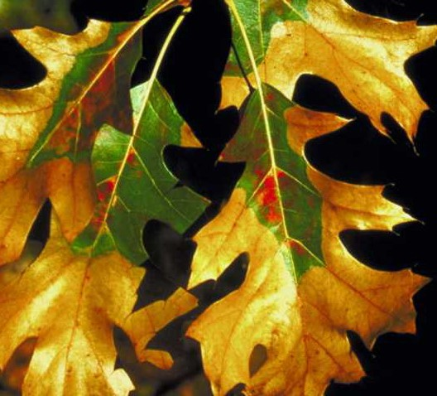
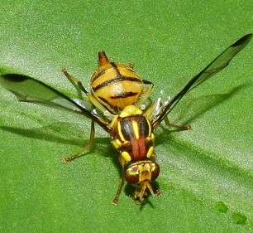
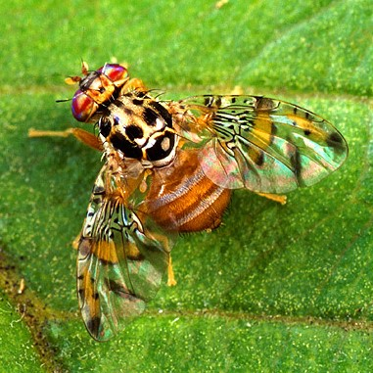
Progress during 2022-2023
Posted 38 official pest reports
Upgraded software and platform
Participated at EPPO webinar on pest reporting
“Report of oak wilt (Bretziella fagacearum) in Niagara Falls, Ontario, Canada”
Photo: F. A. Baker, Utah State University
“APHIS Establishes a Zeugodacus tau Fruit Fly Quarantine in Stevenson Ranch Area, Los Angeles County, California”
Photo: aerobird, naturalista.mx
“Detection of a male specimen of Mediterranean fruit fly Ceratitis capitata (Wiedemann) in urban areas in Cancun, municipality of Benito Juárez in Quintana Roo”
Photo: S. Bauer
Notes:
Now the latest updates:
Over the past year (that is from July 2022 to September 2023), the Phytosanitary Alert System (PAS) expert group:
Posted 38 official pest reports to the PAS website. [CA: 3, US: 33, MX: 2]
Worked with NAPPO Secretariat’s contractor, to upgrade the software and code of the platform to have a stable and secure system.
On June 6th, 2023, the PAS EG was invited to present at a webinar on Pest Reporting organized by the European and Mediterranean Plant Protection Organization (EPPO). Myself and NAPPO’s Executive Director Stephanie Bloem, presented details on how pest reporting is managed in our region and how the NAPPO PAS platform operates.

Slide 11
Progress during 2022-2023
Updated PAS subscribers monthly
Reports linked to International Phytosanitary Portal
2934 subscribers: 15 additional users for the year
Organization Type | Total | 22-23*
Personal | 1259 | 10
Government | 558 | 2
Academia | 176 | 1
NPPO | 206 | 2
Industry | 39 | 0
NGO | 10 | 0
RPPO | 5 | 0
Unknown | 681 | 0
*Include records from July 2022 to September 2023.
Notes:
Additionally, we provided a monthly notification to all NAPPO PAS subscribers with the latest pest reports posted.
Linked pertinent pest reports on the IPPC.
To date, we have almost 3000 thousand [2934] people that are subscribed to the NAPPO PAS notification system from around the world, of which 15 subscribed from July 2022 to September 2023.
We have a general sense of what countries and organizations are visiting and subscribing to the PAS. As seen on the right side of the slide, the pie chart shows a snap shot of the percent of subscribers by country, and on the table the total number of subscribers by type of organization

Slide 12
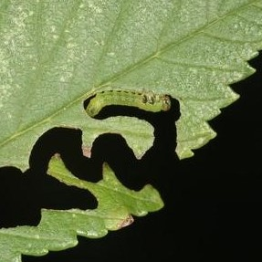
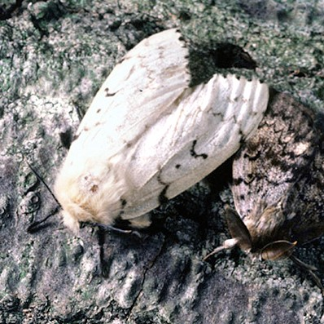
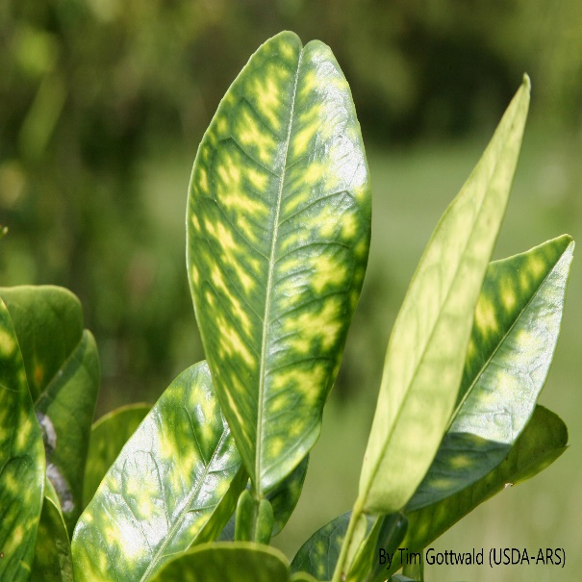
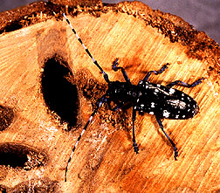
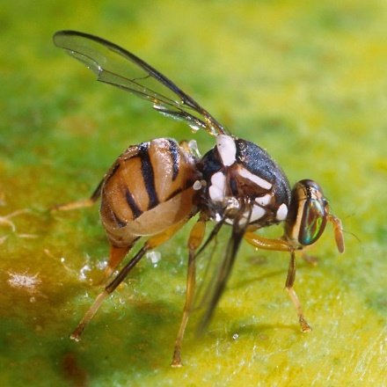
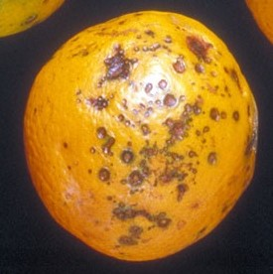
Conclusions
Continue posting reports to meet pest reporting obligations under the IPPC.
Continue facilitating awareness of non-indigenous plant pest species.
T. McCabe
G. Csoka
T. Gottwald
S. Bauer
P. Barkley
C. Harrington
Notes:
In closing, The PAS expert group will continue with its responsibility of overseeing and updating information on the Phytosanitary Alert System on an ongoing basis by continuing posting reports to meet with reporting obligations under the IPPC and
facilitate awareness of non-indigenous plant pest species of interest to North America.

Slide 13
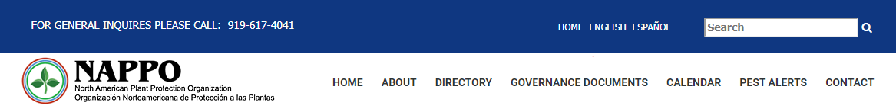
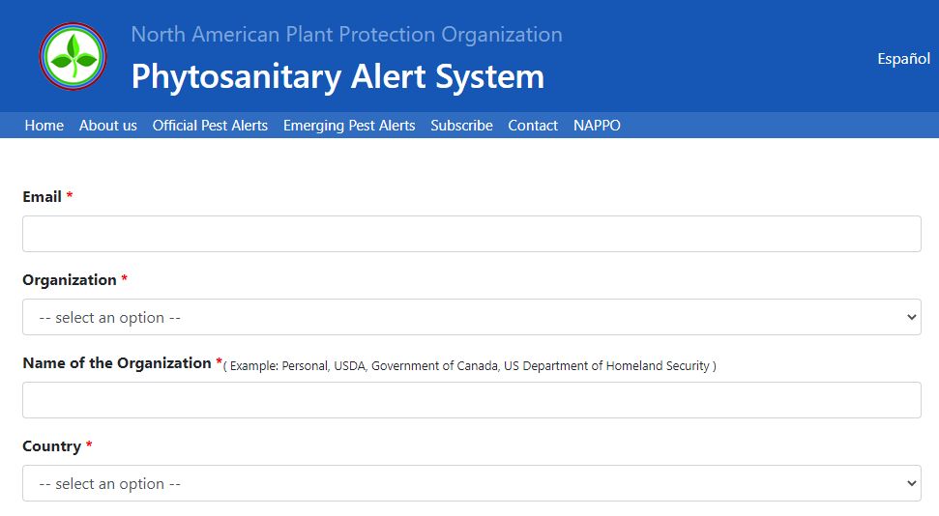
Subscribe to the PAS!
For latest postings:
Visit the NAPPO site
Click on ‘pest alerts’ tab
On PAS, click on ‘Subscribe’
For further information: Contact ignacio.baez@usda.gov
Notes:
For the latest Official Pest Reports and emerging pest alerts please visit the NAPPO site and click on the ‘pest alerts’ or ‘alertas de plagas’ for the Spanish version.
If you would like to receive the alerts and monthly notification on all postings, please subscribe by visiting the NAPPO site, clicking on ‘pest alerts’ and then on ‘Subscribe’ and fill in the required information.
If you have any question please feel free to contact me.
Thank you!

