Slide 1
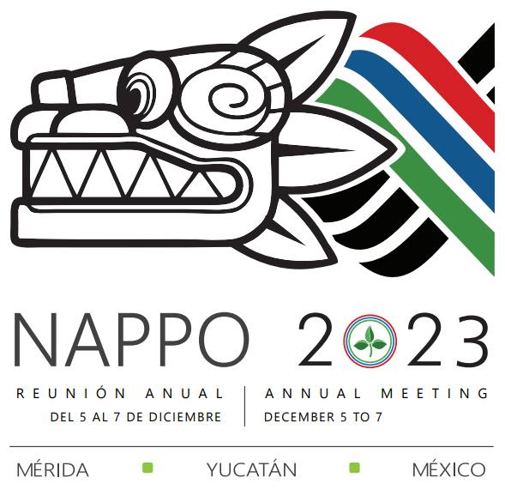
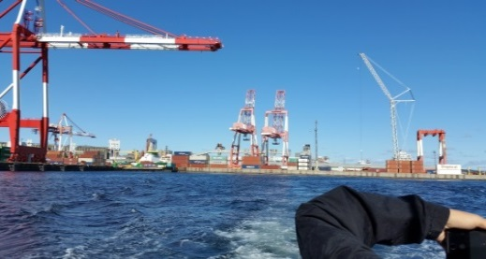
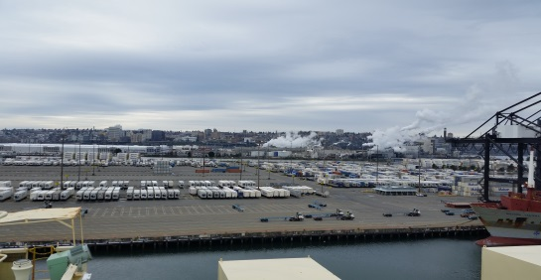
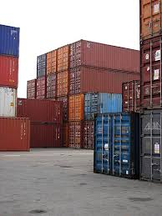
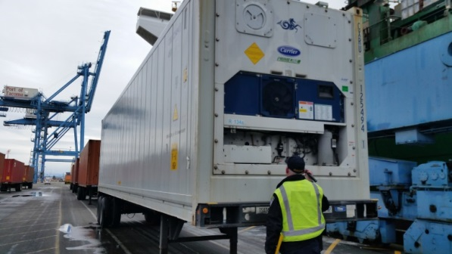
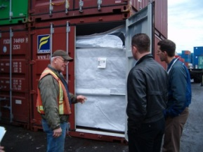
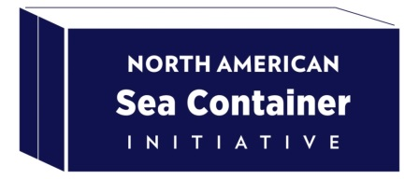
Sea Container and Cargo Cleanliness:
Update on Global and North American Work
  46th NAPPO Annual Meeting
  Mérida, Mexico
  December 6, 2023
Wendy Asbil
National Manager,
Invasive Alien Species and Domestic Programs
Plant Protection Division
Canadian Food Inspection Agency
  Wendy Beltz
  Field Operations Director,
  Plant Protection and Quarantine
  Animal and Plant Health Inspection Service
  United States Department of Agriculture

Slide 2
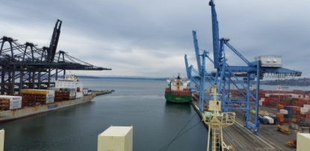

“The number and range of stakeholders involved is global in scale and extremely diverse, and the pathway itself is a non-agricultural pathway, resulting in important engagement and communications considerations.”
Global Concern
International Plant Protection Convention (IPPC)

Slide 3
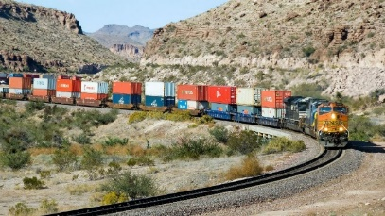
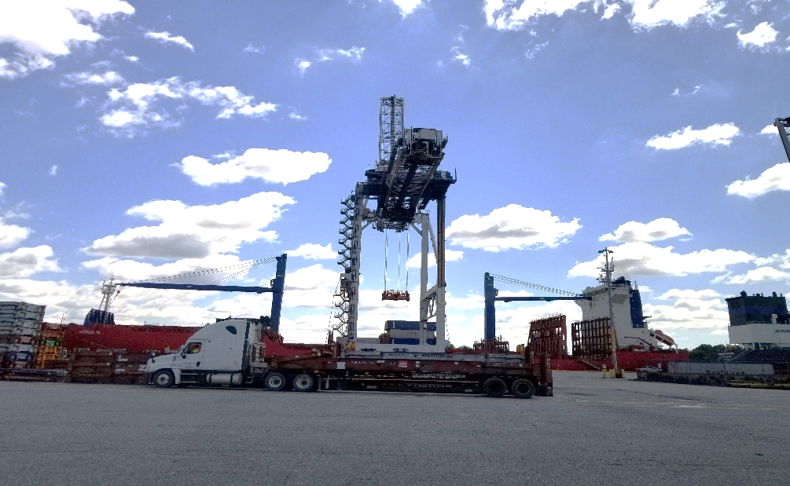
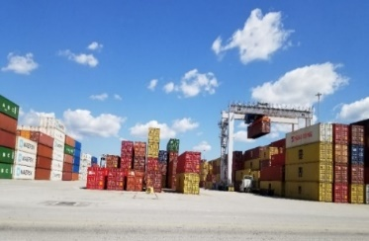
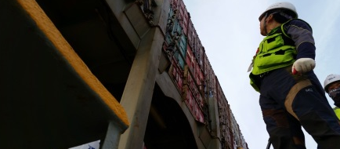
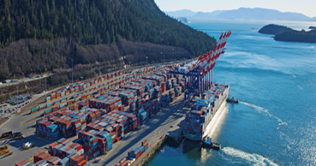
Global Concern
International Plant Protection Convention (IPPC)
IPPC assembled a Sea Container Task Force (SCTF) to look at this issue at a global level (2017-2021)
IPPC Sea Container Focus Group (2022-2024)
two international workshops
  London, UK September 2022
  Brisbane, AU July 2023
general recommendation to CPM 2024
specific measures to be analyzed and recommended

Slide 4
Global Concern
International Plant Protection Convention (IPPC)
Draft CPM Recommendation (R-006) on minimizing pest risk associated with the sea container pathway (consultation July 1- September 30, 2023)
risks and implications for the international sea container pathway
risks influenced by type of cargo
description of pest contamination
raising awareness
reducing the risk of contamination
visual examination for contamination
methods to remove contamination
seeking input for effective measures and best practices

Slide 5
Potential Measures
Measures under consideration must be:
  Effective at minimizing introduction and spread of plant pests globally
  Practical, flexible, cost-effective
  Able to be adopted and implemented globally
Overall need for cooperation and coordination amongst:
  NPPOs, border control agencies and other government organizations
  industry sectors along supply chain
  NPPOs and industry
Voluntary tools and initiatives | Regulatory approaches | Leveraging existing instruments
Education and outreach (NPPOs and industry) Industry-led programs (e.g. custodial responsibility program) Enhanced container design Technology in ports and containers | Mandatory inspection and certification Mandatory standards (e.g. ISPM) Third Party Authorization and Inspection | Trade facilitation practices (e.g. Authorized Economic Operator; WCO SAFE Framework of Standards) that have cleanliness component CTU Code with phytosanitary cleanliness components

Slide 6

Voluntary Canada-United States-Mexico government-industry initiative

Slide 7
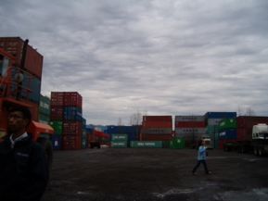
North American Sea Container Initiative
  NASCI continues to conduct outreach and education with partners and stakeholders to better understand challenges and develop opportunities for mitigating pest risks in the sea container pathway throughout the supply chain
    We have learned:
    existing practices
    identified phytosanitary risks in/on containers/cargo
    obstacles and opportunities regarding phytosanitary examinations or cleaning
    suggested measures to mitigate plant health risks depending on role in the supply chain
  Using what we have learned to:
    consider all points along supply chain to determine what measures are practical, feasible, effective and economical
    contribute to work of IPPC Sea Container Focus Group
  Key points:
Need to use networks of networks to engage broadly
Education and awareness is paramount to success
Need outreach materials for many audiences and purposes Need to integrate phytosanitary measures into existing activities
Need for training, branding, incentives
Shared risk, shared responsibility – everyone has a part to play in global success in minimizing phytosanitary risks in this pathway

Slide 8

Thank you
Comments, Questions, Discussion

