Slide 1
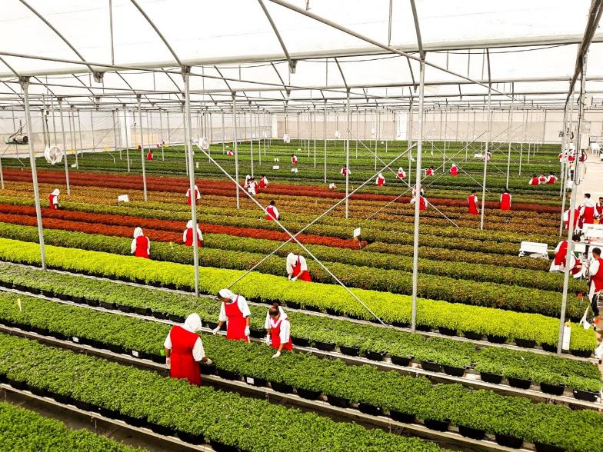


Tobamoviruses and the Horticulture Industry
Mike Klopmeyer, Ph.D.
Ball FloraPlant
West Chicago, IL

Slide 2
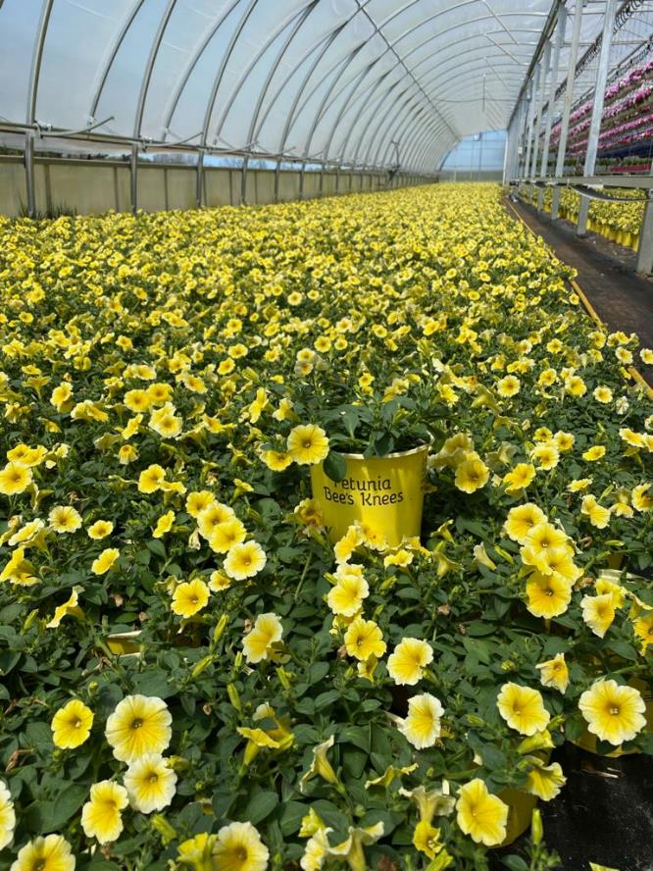
Topics to Cover
Defining horticulture industry in this context
Impact of tobamoviruses on key crops
Identification/characterization of tobamoviruses
Industry tactics to prevent introduction, spread and movement of tobamoviruses
Points to Consider in Future

Slide 3
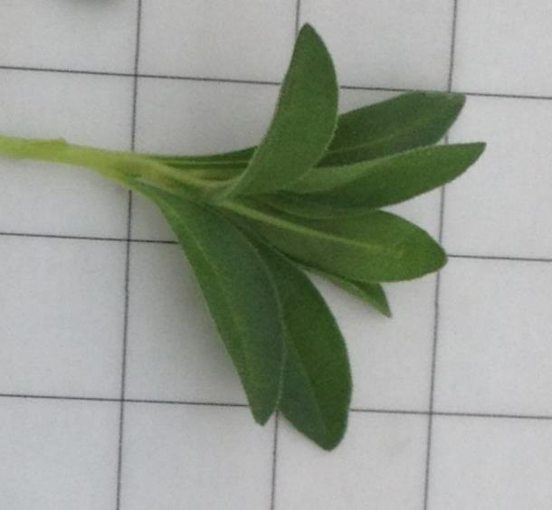
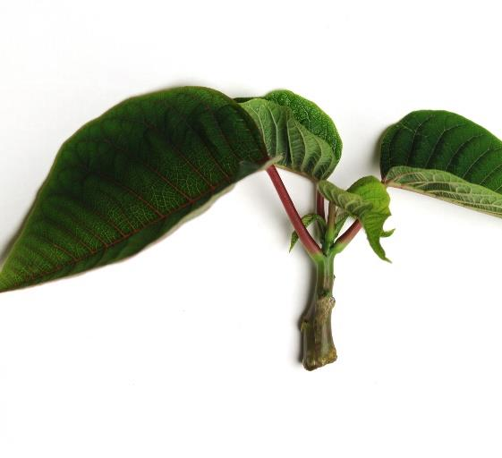
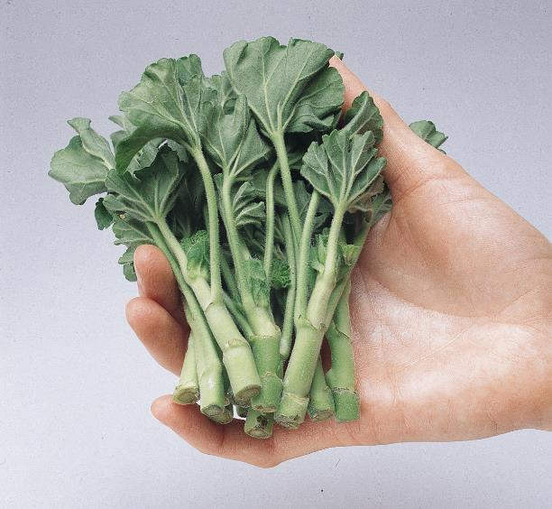
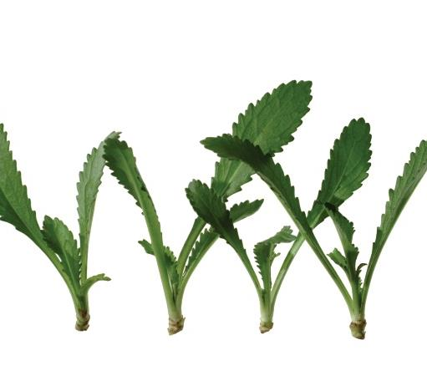
Horticulture Industry in Scope
Vegetative (propagated by cuttings/esquejes)
Annuals and perennials
Shipped into USA and Canada as unrooted cuttings
>1 Billion cuttings imported annually
Shipped to greenhouse growers for rooting>transplanting>finish to flowering>retail

Slide 4

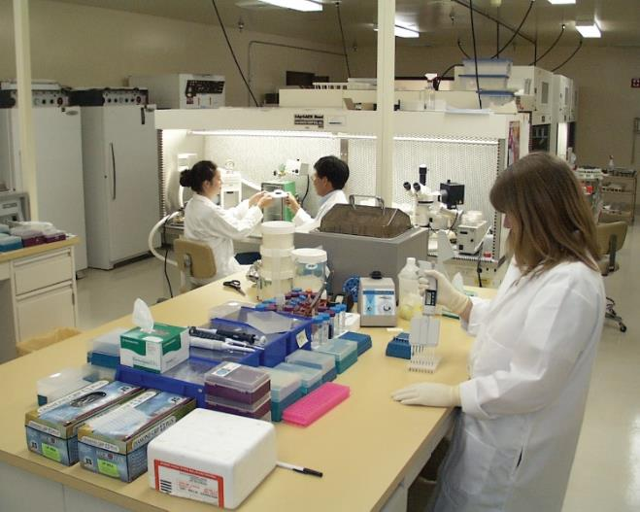
Vegetative Production Flow Chart
Breeding
Selections
Tissue Culture
Initiation
Pathogen Testing

Slide 5
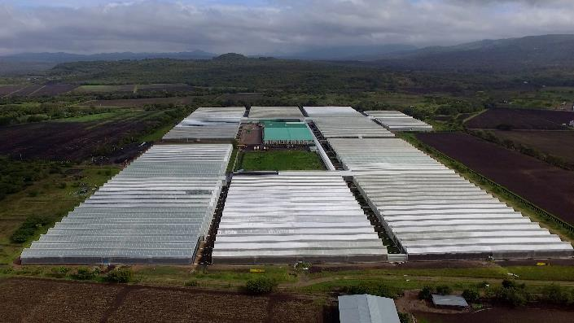
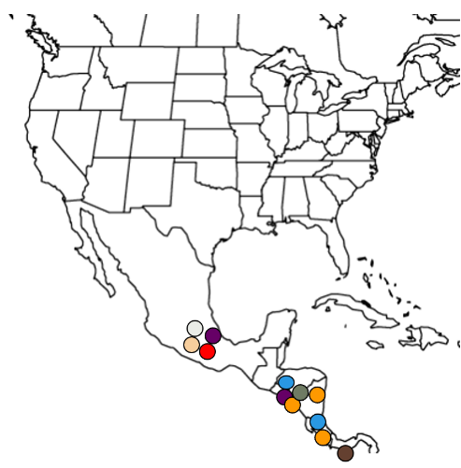
Off-Shore Farms Supplying Cuttings
Main Countries: Mexico, Guatemala, Nicaragua, Costa Rica, El Salvador, Colombia, Kenya, Ethiopia
Optimal climate and labor supply and close to market
Protected Greenhouse production (no outdoor production)
Raised benches, drip irrigation

Slide 6

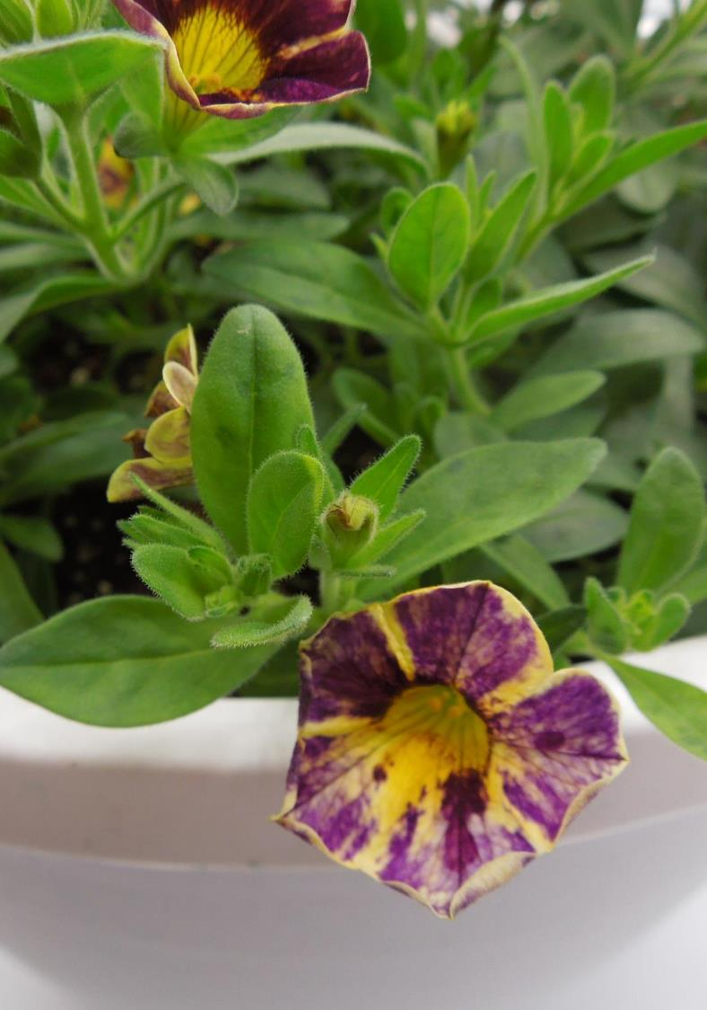
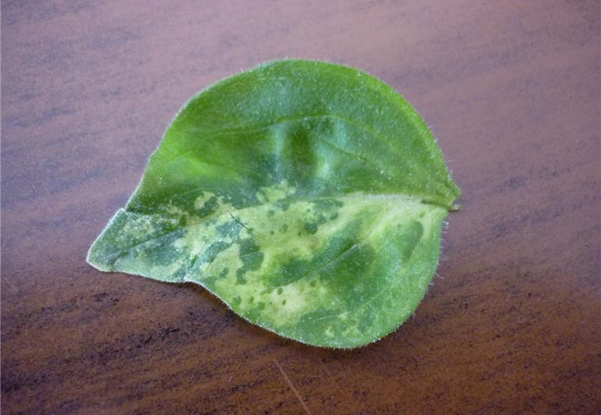
Impact of Tobamoviruses in Ornamentals
Wide host range and varying symptoms
Solanaceous crops like Petunias and Calibrachoas are most impacted
Easily spread mechanically
Impacts plant quality affecting sales

Slide 7

Identification of Tobamoviruses on Ornamentals
Immunostrips (quick test: generic for most tobamoviruses)
ELISA (some specificity for strain)
PCR (allows for specific strain identification)
Strain identification used for tracing/tracking
Multiple strains have occurred in industry through the years.
Some Tobamovirus Strains Identified
Tobacco Mosaic Virus-Common
Tobacco Mild Green Mosaic Virus
Turnip Vein Clearing Virus
Chili Pepper Mild Mottle Virus
Ribgrass Mosaic Virus
Tomato Mosaic Virus

Slide 8
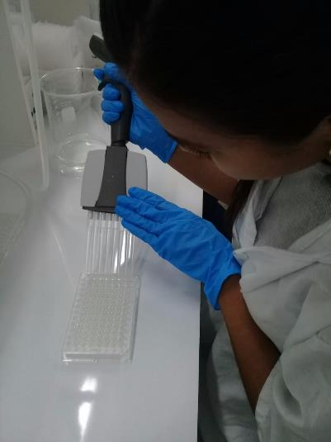
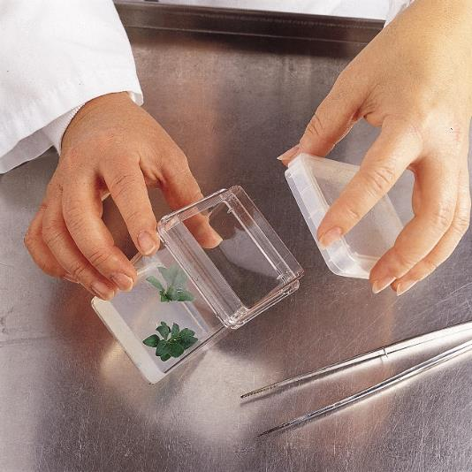
Preventing Tobamoviruses in Production
Start Clean…Stay Clean
Elite stock (Tissue culture maintained, tested virus free)
Annual renewal of stock
Strict sanitation practices in production to prevent introduction
Weekly testing (ELISA)
Advanced testing (PCR) and sequencing if positive discovered
On Farm Testing Lab

Slide 9
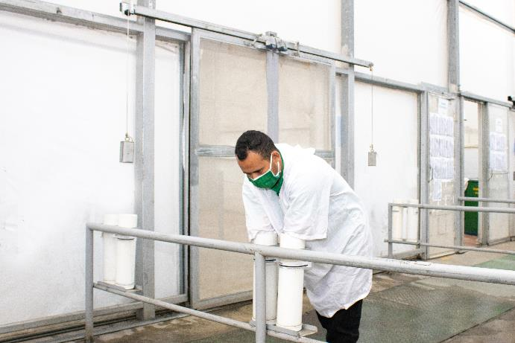
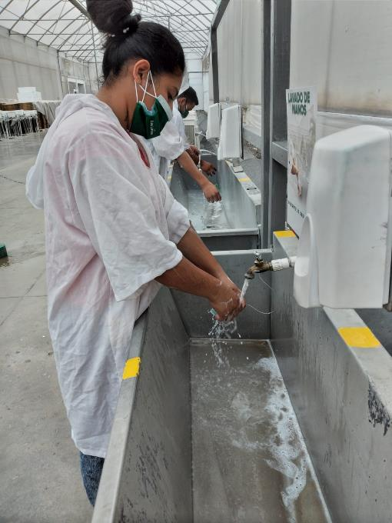
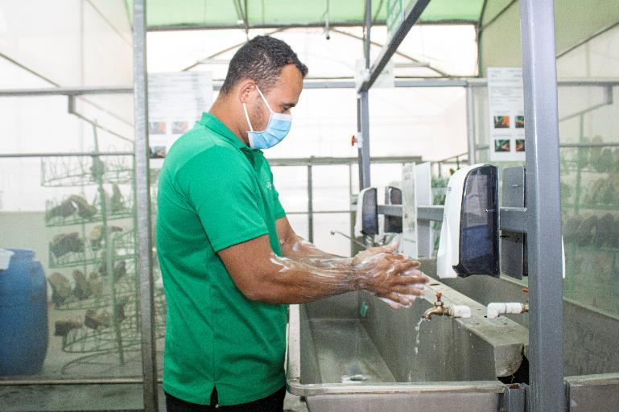
Sanitation is IMPORTANT!
Prevent introduction of plant pathogens such as viruses & bacteria
Washing hands in soap & water
Lab coats and vinyl gloves
Regular disinfection of harvest tools

Slide 10
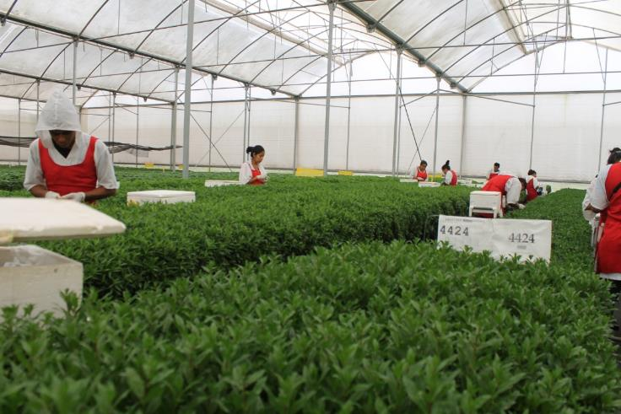
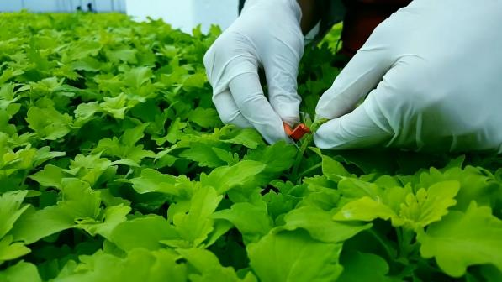
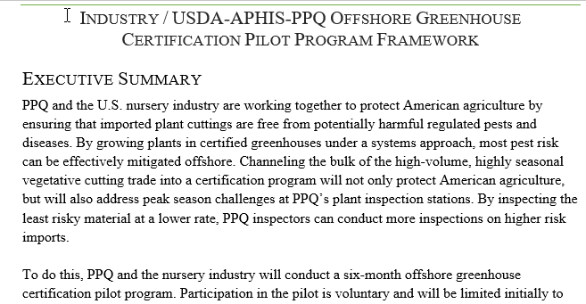

Sanitation Protocols
Training harvesters
Wearing vinyl gloves in sensitive crops
Regular hand and knife disinfection
Controlled people movement within benches & greenhouses
Systems-Based Approach (OGCP)

Slide 11
Managing Tobamovirus Outbreaks
More of a rare occurrence
Speed to react is vital
Communication to customers on varieties affected and sanitation guidelines
Testing and disposal of stock at farm and plants at customers
High $ impact to production companies on claims

Slide 12
Points to Consider
Clean stock programs and delivery of clean cuttings are “Ticket to Play”
Ornamental floriculture industry ‘self-regulates’ for tobamovirus infections
$ impact is significant in the event of outbreak. Rapid response is the norm.
Advancement in virus identification via genome sequencing has created confusion for regulatory action
Are tobamovirus outbreaks in ornamental plants (annuals which do not overwinter) a threat to commercial vegetable production?

Slide 13
QUESTIONS?

Slide 14
Thank You
NAPPO Annual Meeting
Merida Yucatan Mexico
November 2023

