Slide 1

Looking back at 2023 and looking ahead to 2024
Stephanie Bloem
NAPPO Executive Director

Slide 2

2023 accomplishments
NAPPO Dispute Resolution Process (2004) updated
NAPPO Executive Director Position Description and Vacancy Announcement completed and posted; interviews conducted 10/30-31
2023 Work Program
NAPPO Organized and Chaired the 35th Technical Consultation among RPPOs
Organized and delivered NAPPO 46!

Slide 3
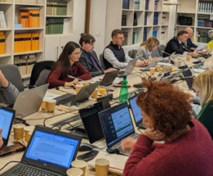
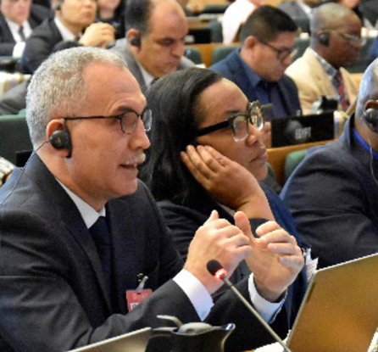
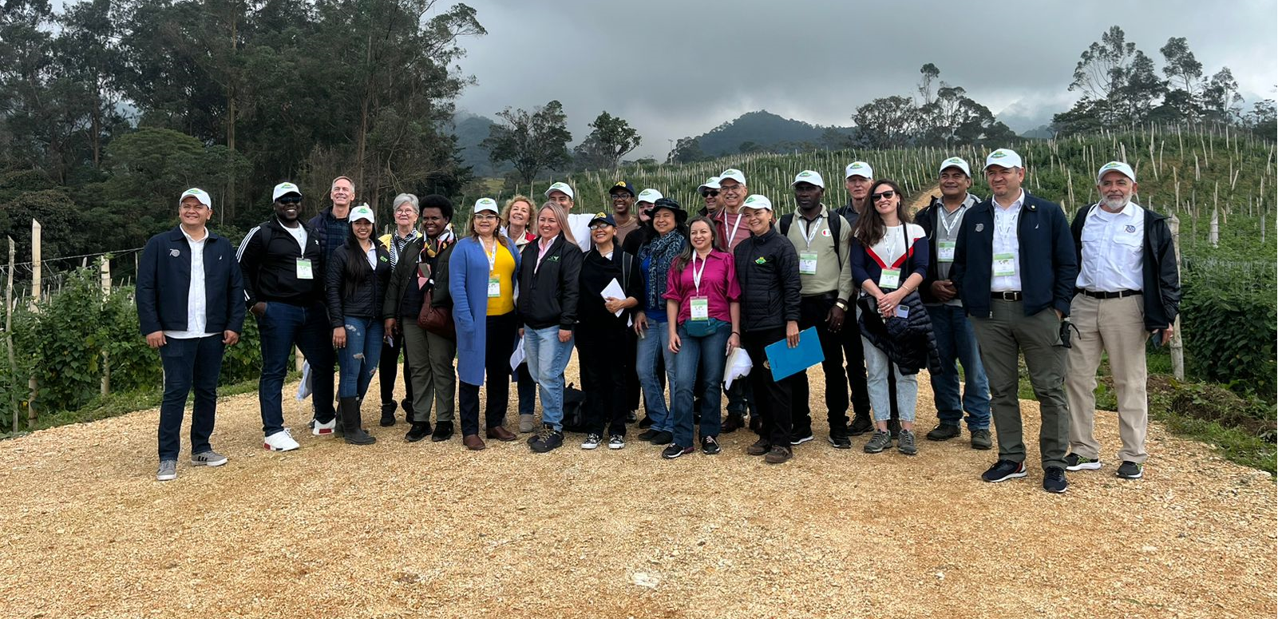
2023 NAPPO travel – to meet regional and international commitments
EPPO-NAPPO Strategic Engagement Meeting
17th Session of the Commission on Phytosanitary Measures
ePhyto workshop - Argentina
IPPC Implementation and Capacity Development Committee
National Plant Board
IPPC Strategic Planning Group
35th Technical Consultation among RPPOs

Slide 4

2023 - finalized several projects
RSPM 35 Guidelines for movement of Stone and Pome Fruit Trees and Grapevines – completed arthropod pest tables
Risk-Based Sampling training module for inspectors translated into Spanish
Harmonization of diagnostic protocols for seed pests focused on ToBRFV
  Ring test finalized
  Scientific publication in preparation
  EC Decision Document recommending protocols for use in NA - soon
Update of DD 05 on Management of Huanglongbing and its vector, Diaphorina citri
  Completed; Country Consultation
Regional guidance to improve implementation of ISPM 25
  Completed; Country Consultation

Slide 5

2023 - progressed key
projects
NAPPO Phytosanitary Alert System
ePhyto
Hemispheric collaboration via the GICSV
Collaboration on transboundary pests
Update RSPM 26 - Certification of commercial arthropod BCAs or non-Apis pollinators moving into NAPPO member countries
Forestry quarantine research group
Stakeholder engagement
NAPPO Foundational Documents

Slide 6

2023 - launched new projects
Harmonization of North American approaches to a future incursion of Tuta absoluta
Sharing information on alternatives to Methyl Bromide

Slide 7

Open the call for new project proposals 05-06/2024
Welcome a new NAPPO Executive Director 05-06/2024
New IAG representative for the USA
New format for NAPPO newsletters
2024 Work Program – already a few new projects
47th Annual Meeting
Looking ahead to
2024

Slide 8


thaaaanks
for
the memories …
until we meet
again!

