Slide 1
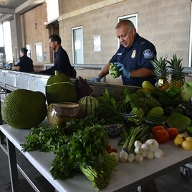
Phytosanitary Safeguarding meAsures at U.S. ports of entry
Agriculture programs & Trade liaison
Office of field operations
Notes:
46th NAPPO Annual Meeting, International Convention Center, Mérida, Yucatán, Mexico, Dec. 4-8, 2023.

Slide 2


2
Notes:
As of July 21, 2023, CBP employs 25,835 CBP Officers and 2,668 CBP Agriculture Specialists

Slide 3

PORTS OF ENTRY
Air Cargo and Passenger
Sea Cargo and Cruise Terminals
Northern and Southern Land Borders
Express Consignment
International Mail

Slide 4

PARTNERSHIPS
Assist Partner Government Agencies enforce regulatory requirements
United States Department of Agriculture,
Animal and Plant Health Inspection Service
Centers for Disease Control and Prevention
U.S. Food and Drug Administration
U.S. Fish and Wildlife
Notes:
CBP Agriculture Specialists with Title 7 and Title 9 authorities

Slide 5
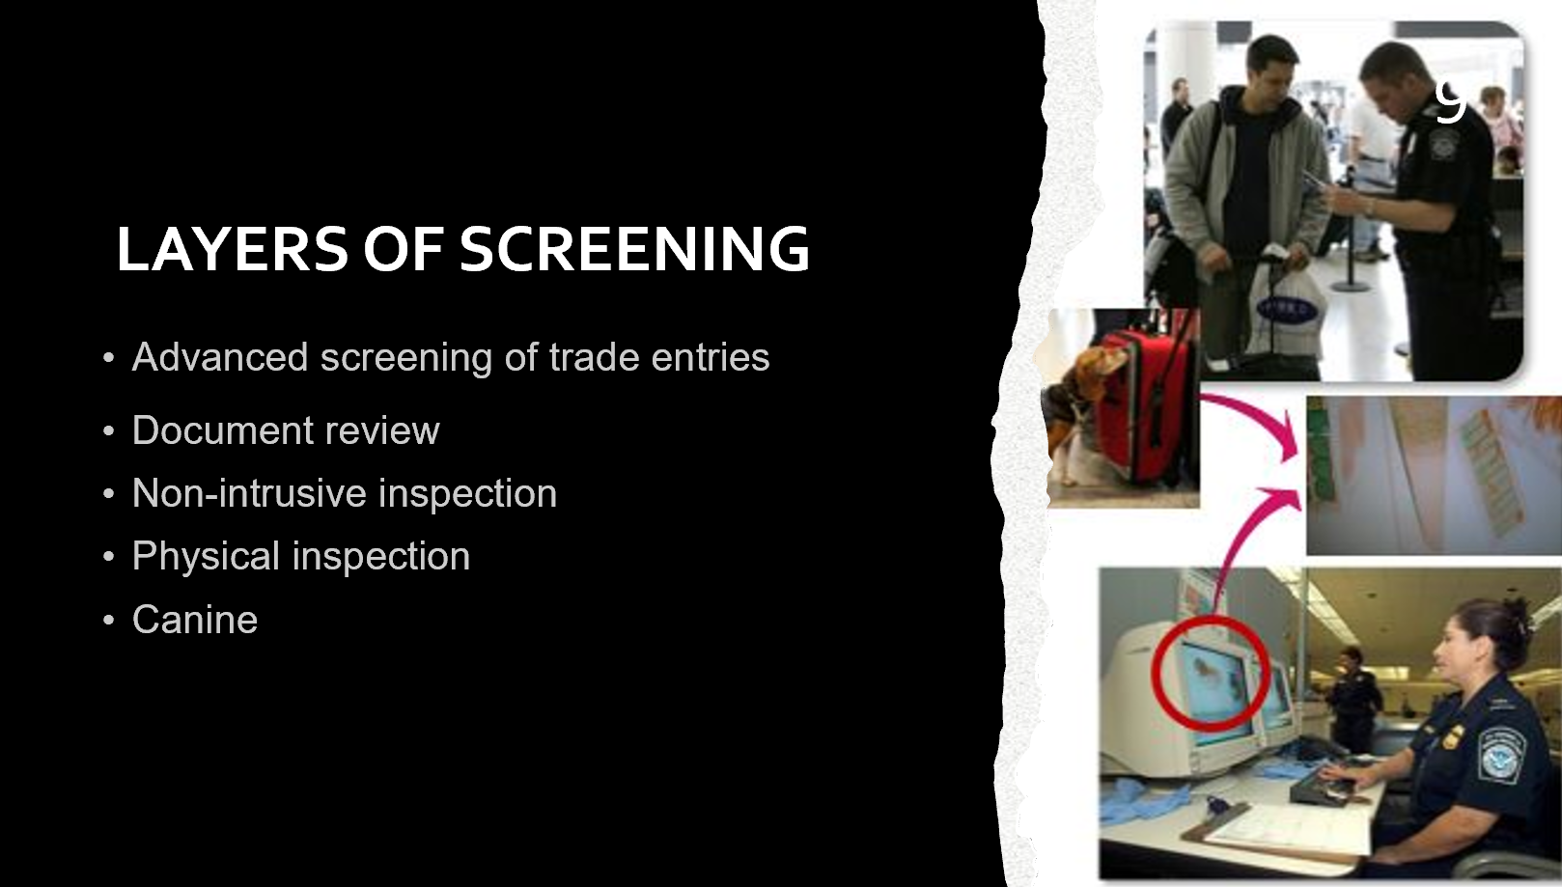
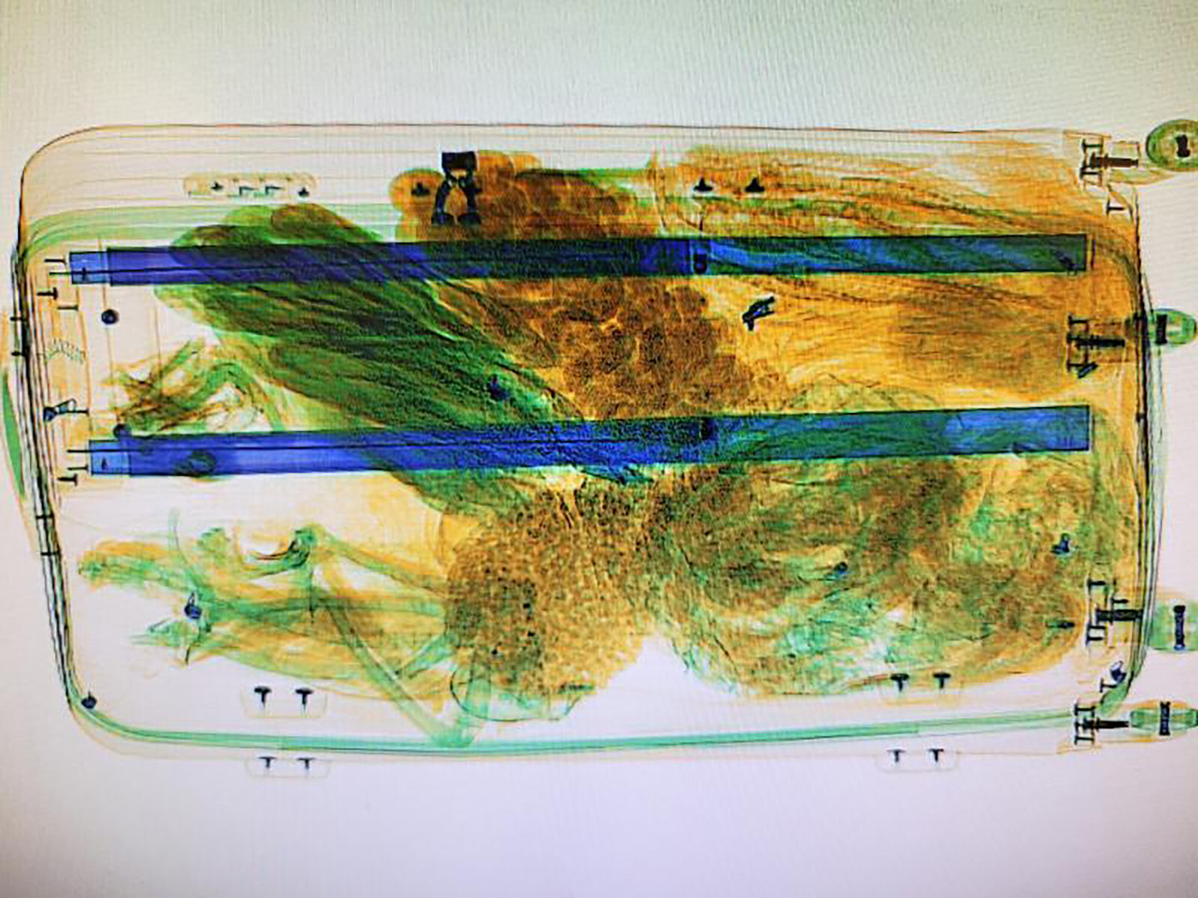

Slide 6

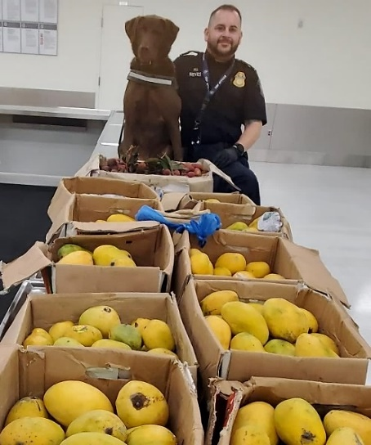
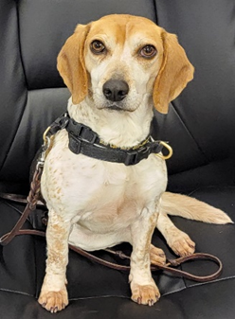
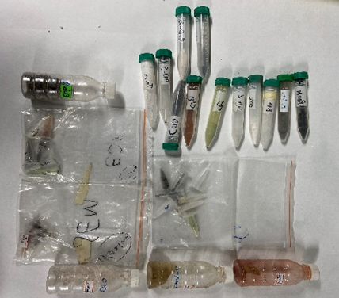
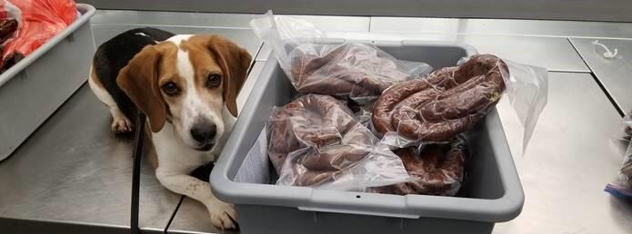
PARTNERS AT WORK

Slide 7
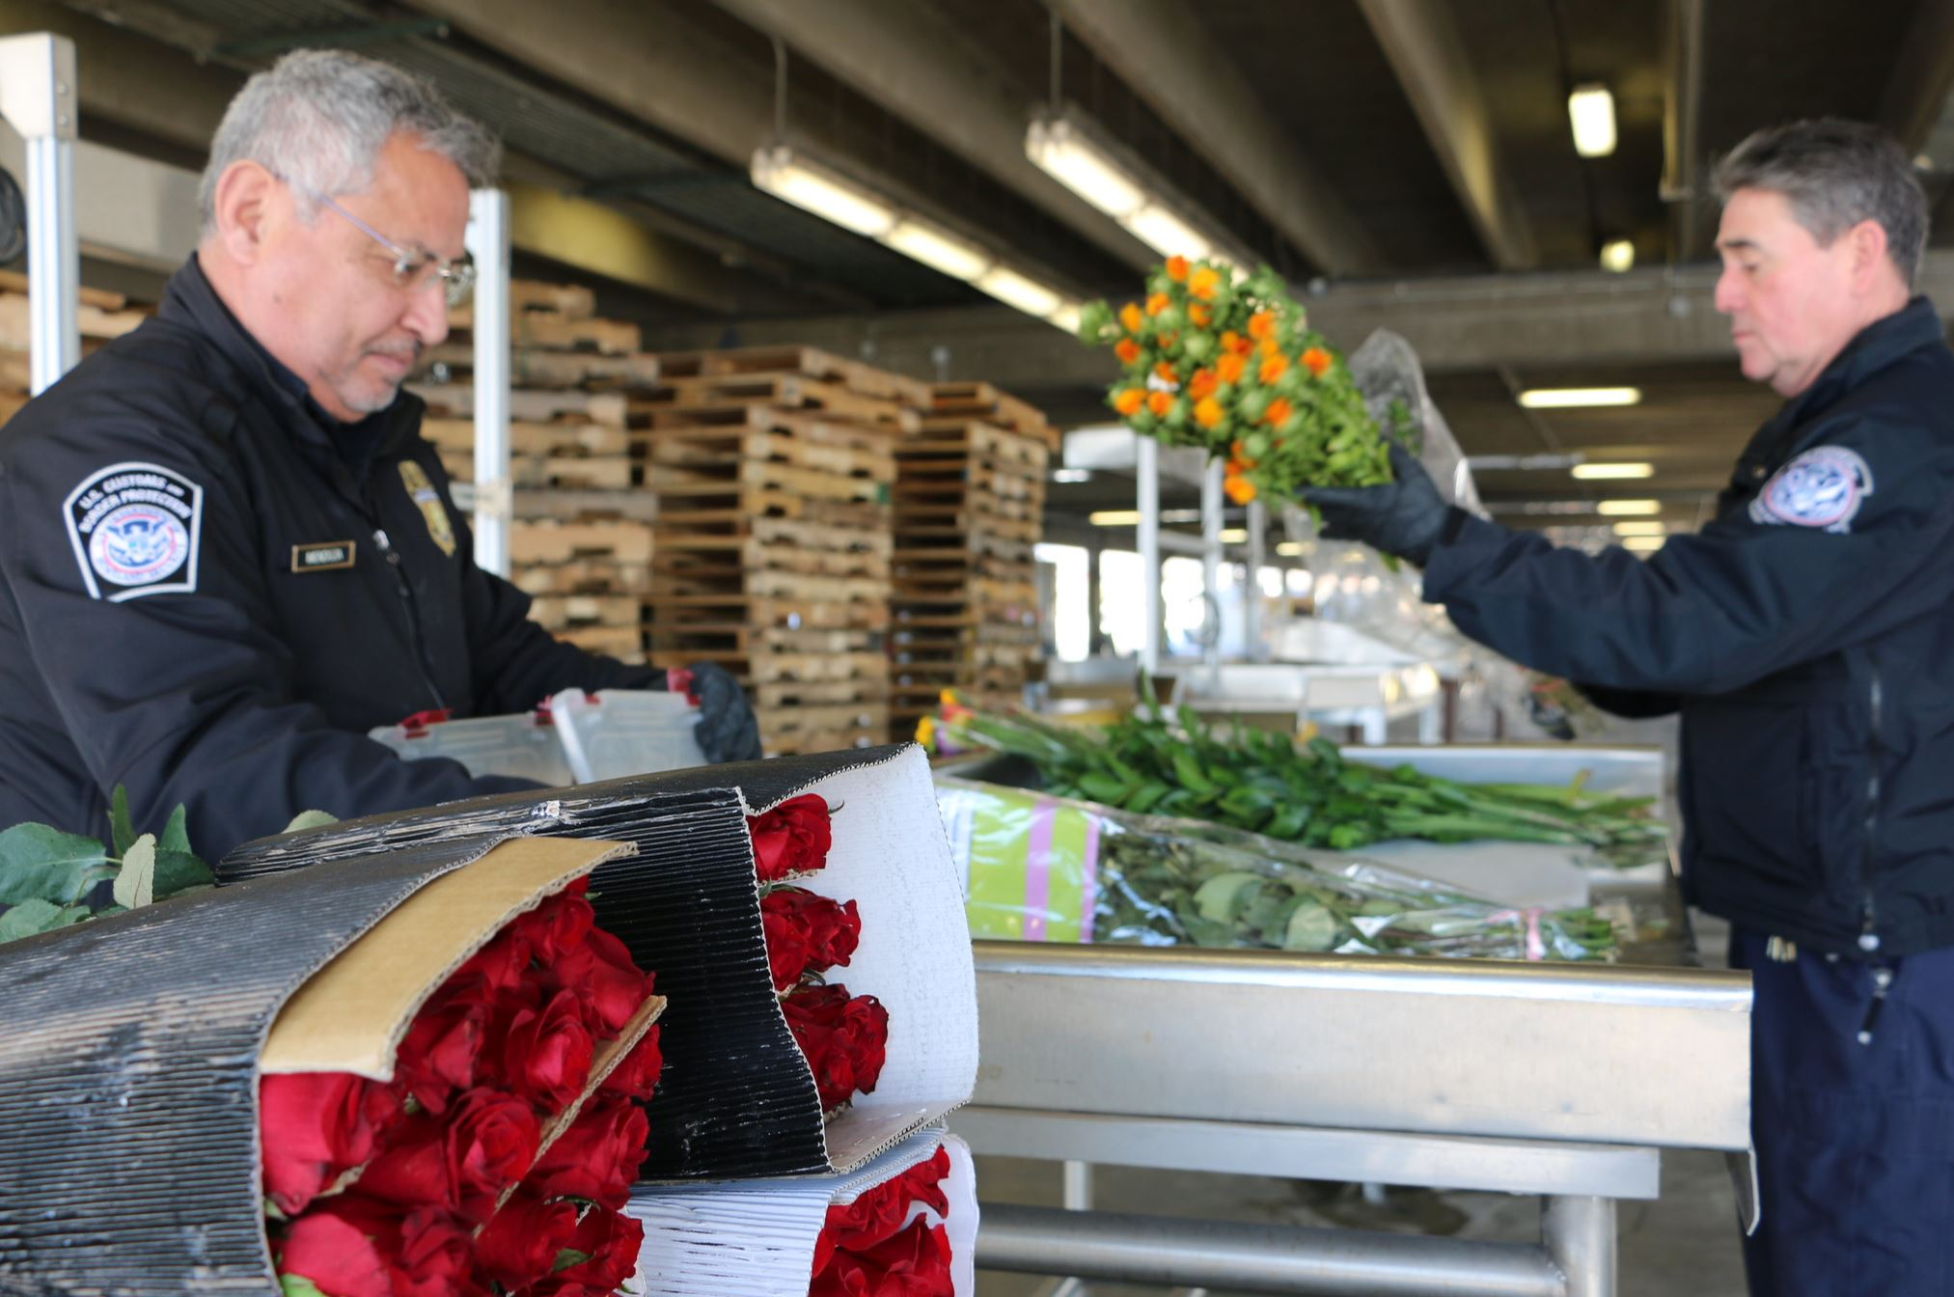
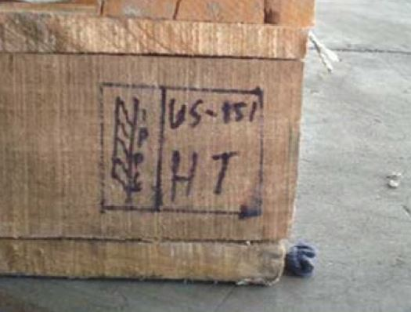
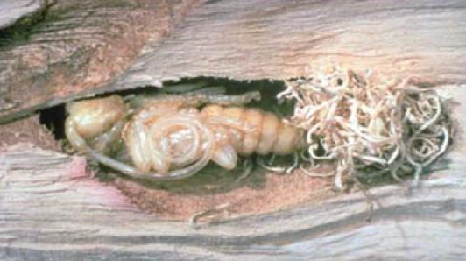
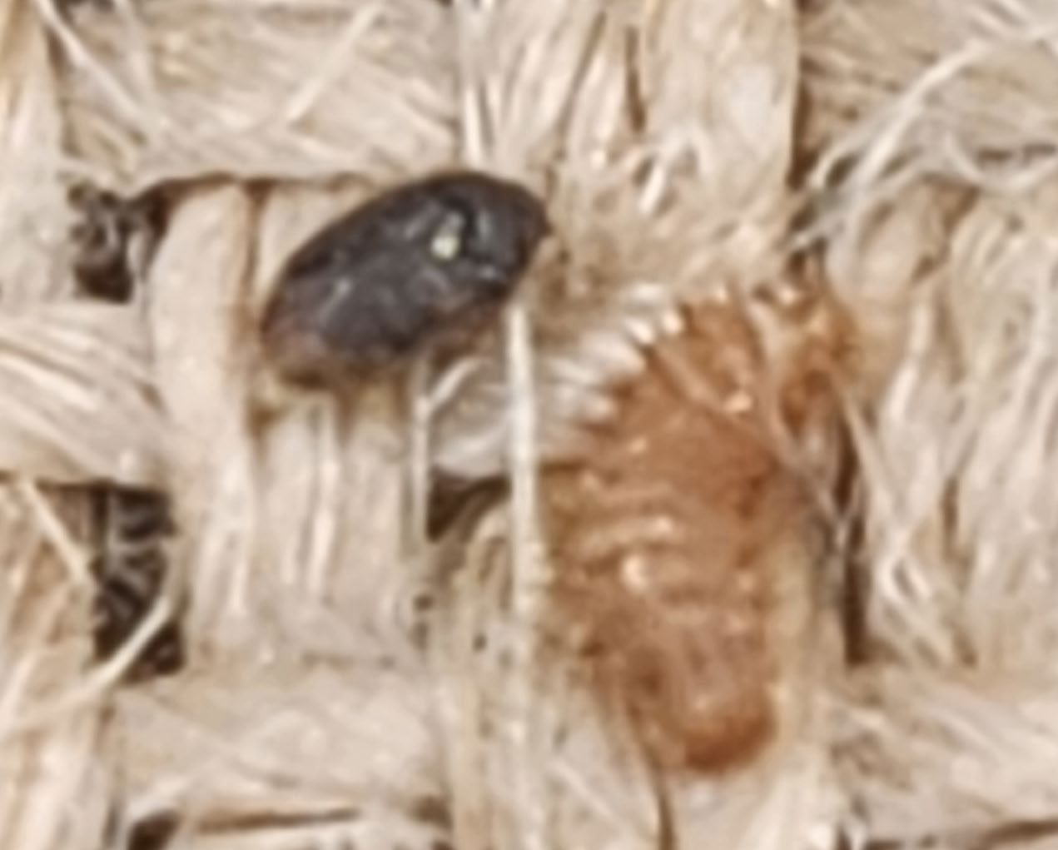
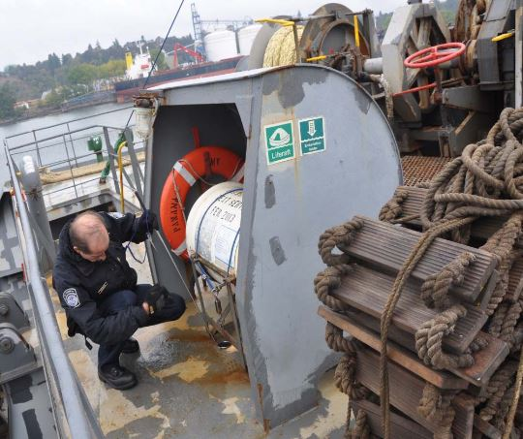
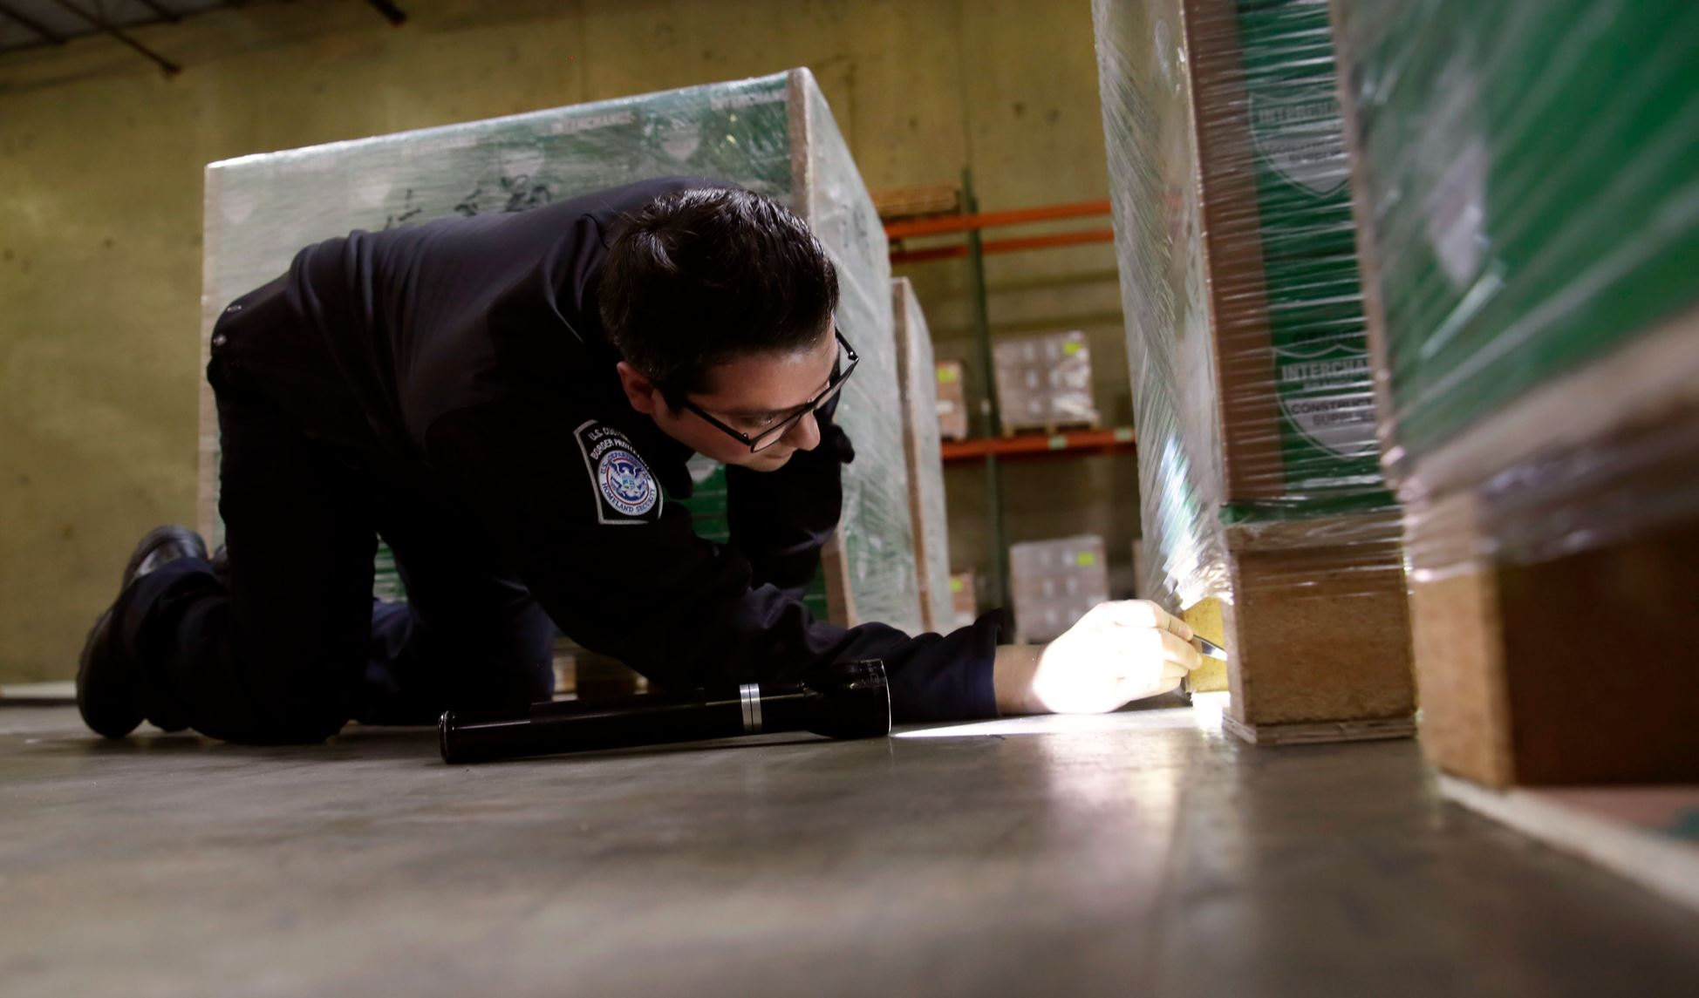
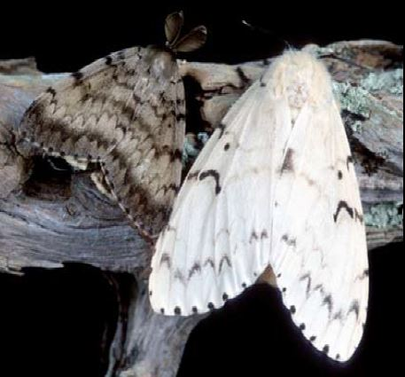
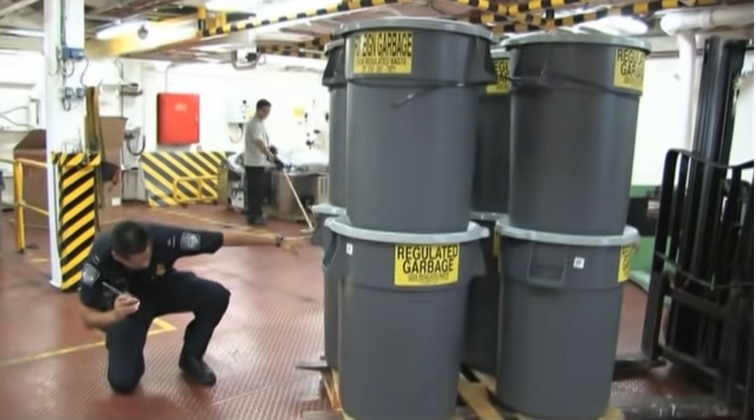
CARGO INSPECTION
Entry regulatory compliance
Pests and diseases
Contraband
Soil contamination
Wood packing materials
Regulated garbage
Hitchhikers
 | FY2024 - to date | FY2023 Total | FY2022 Total
EANs | 9,181 | 70,129 | 73,263
Notes:
Data as of November 17, 2023

Slide 8
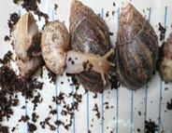
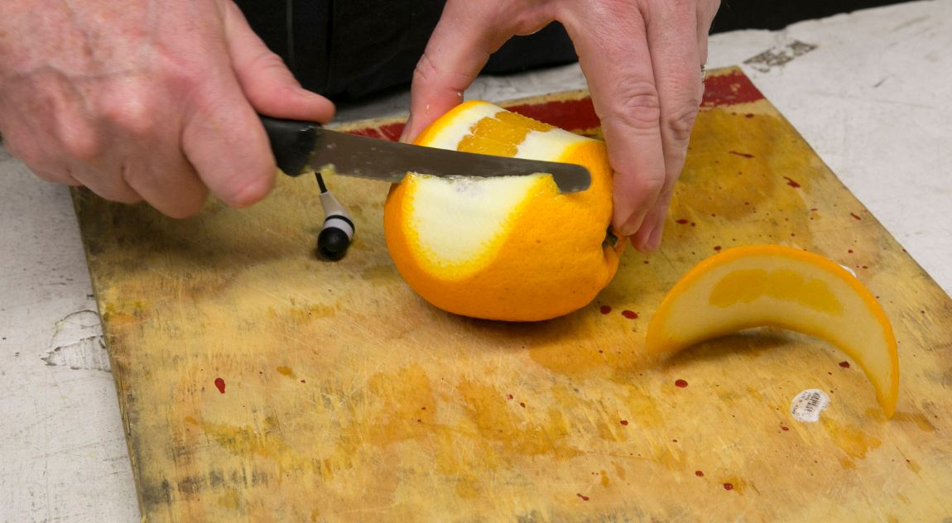
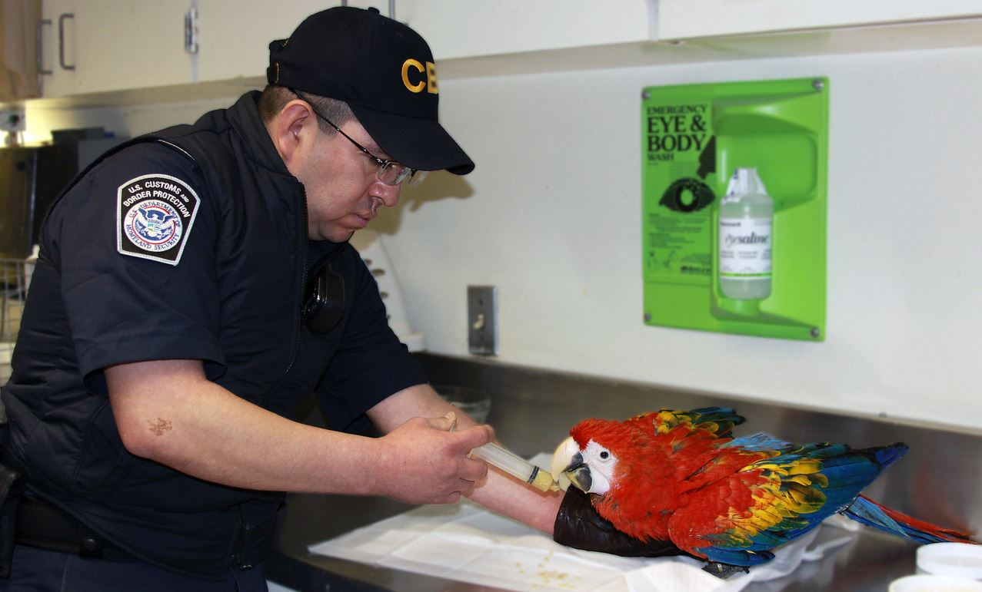
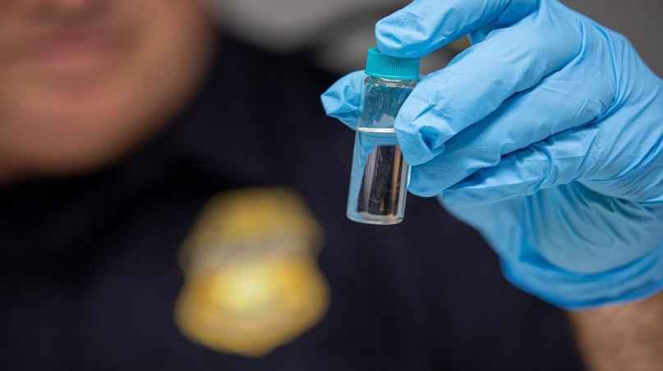
PASSENGER INSPECTION
Entry regulatory compliance
Prohibited agricultural and food products
Quarantine materials
Pests and diseases
Soil contamination
Biological materials
Live animals
CITES materials
 | FY2024 - to date | FY2023 Total | FY2022 Total
Positive PAX Inspections | 141,429 | 1,127,085 | 934,991
Notes:
Data as of November 17, 2023

Slide 9

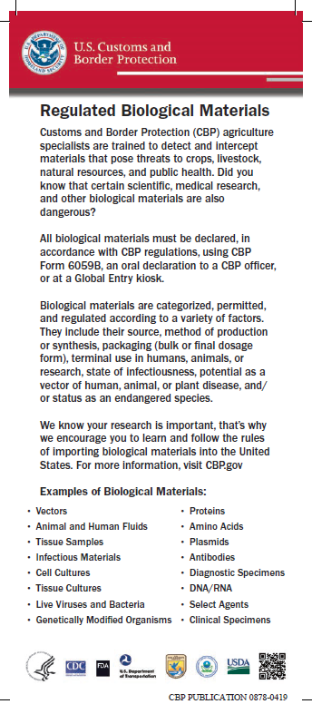
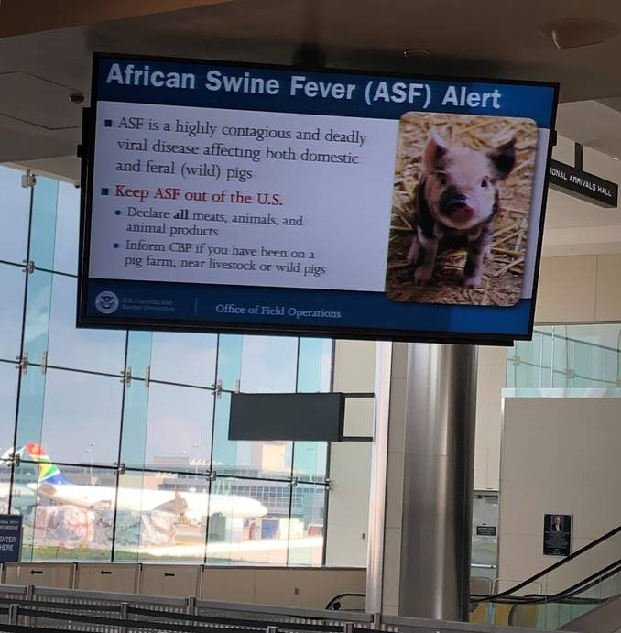
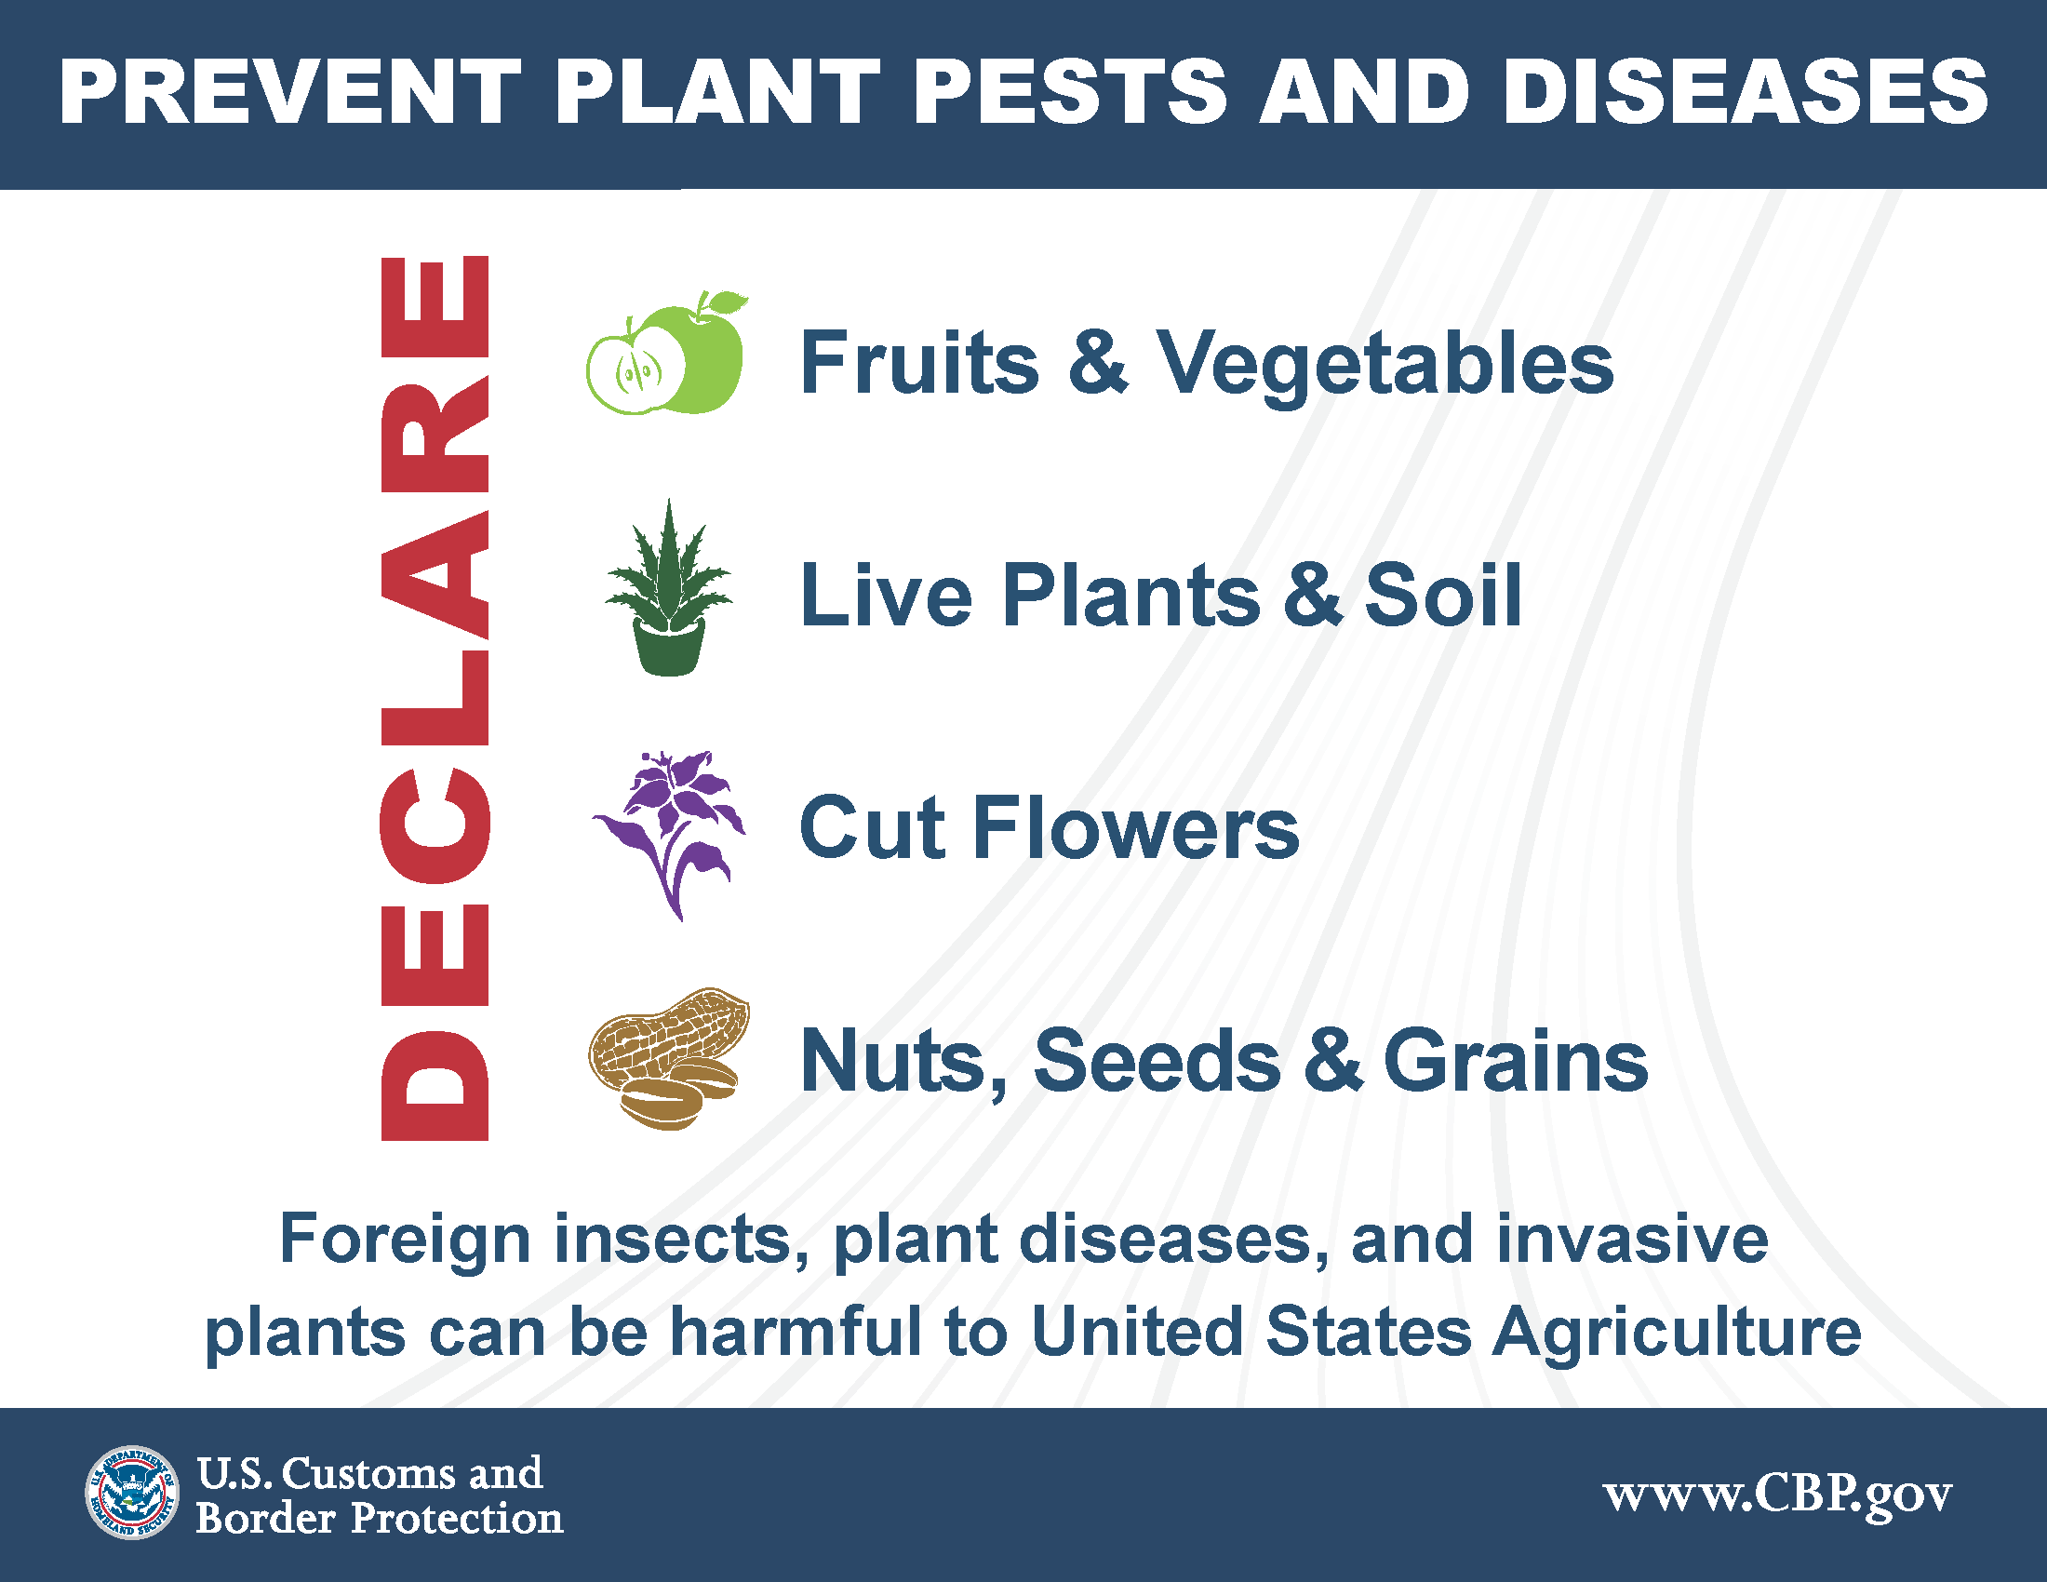

PUBLIC AND TRADE OUTREACH
Ports of entry signage and video
Workshops
Information materials
Webinars in trade events and scientific meetings
Public-facing websites
- www.cbp.gov
CBPOneTM Mobile Scheduling Application

Slide 10
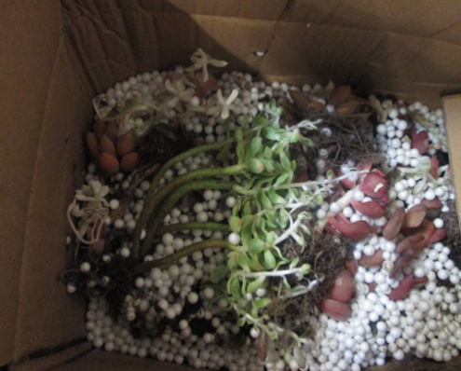
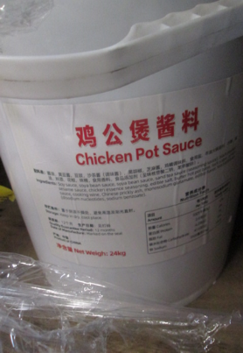
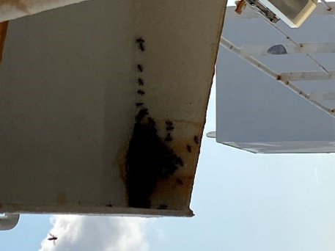
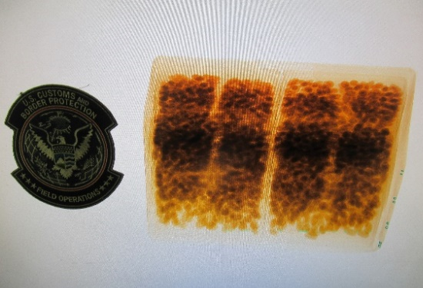
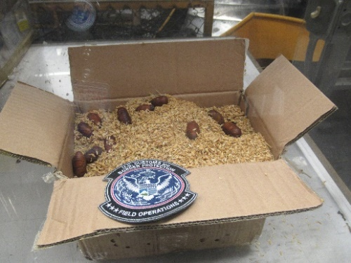
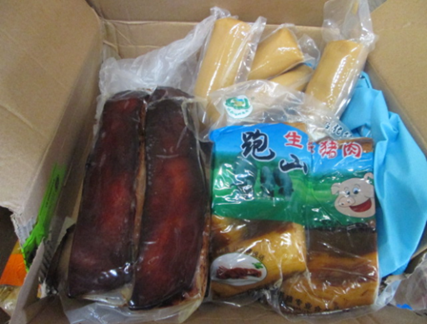
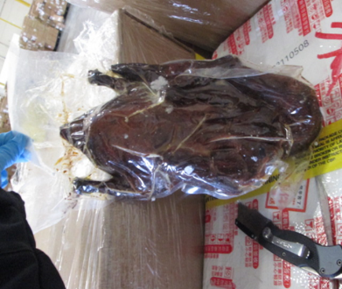
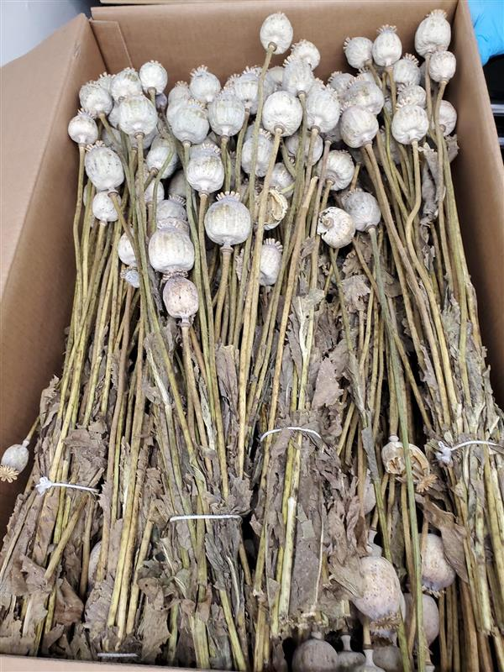
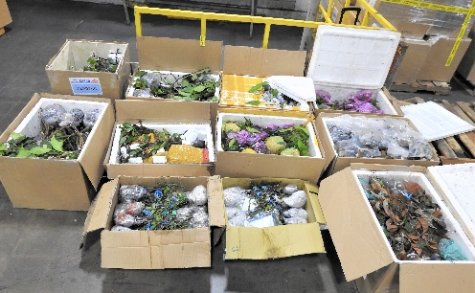
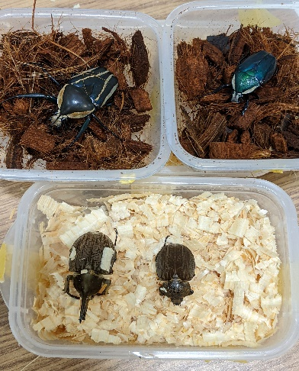
INTERCEPTION HIGHLIGHTS
Express Consignment
Sea Vessel
eCommerce
Air Cargo
International Mail

Slide 11

Thank you !
Romelito Lapitan, ABTC Director, romelito.lapitan@cbp.dhs.gov
Nidhi Singla, AE2 Director, nidhi.singla@cbp.dhs.gov
Suzette Kelly, ASRM Director, suzette.p.kelly@cbp.dhs.gov

Slide 12


