Slide 1
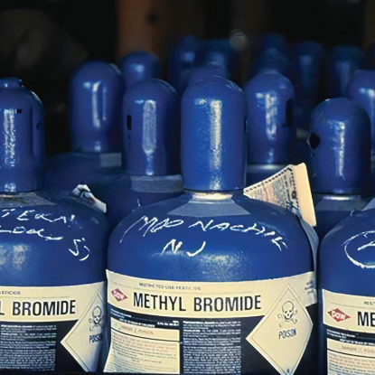
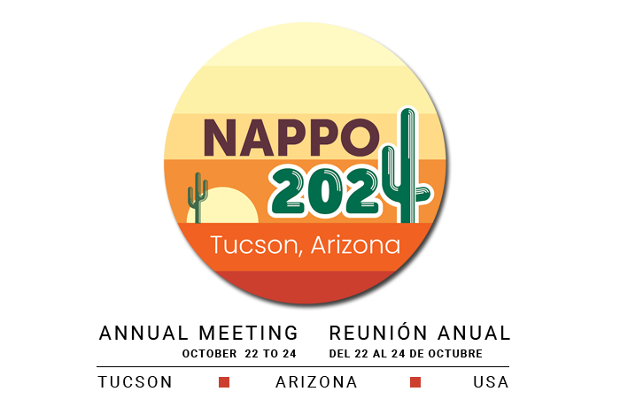
Reducing Methyl Bromide Through a Risk-Based Approach
History, current status , ways forward
Adnan Uzunovic

Slide 2
Pest Management
Phytosanitary treatments are commonly used as part of a pest management strategy (prior to export, during export, or upon commodity arrival).
Fumigation is one of the most convenient treatments, important for trade
  applied to a large variety of commodities, on a large scale, efficiently and economically
  generally does not affect the treated commodity.
Historically, methyl bromide (MeBr) was the fumigant of choice followed by Phosphine (PH3)- for grains especially , Sulfuryl fluoride (SF) and few other, minor use fumigants.

Slide 3
Methyl Bromide; Restrictions on use
Used commercially since 1930s: broad spectrum (insects, nematodes, pathogens, rodents..) , versatile, penetrative, used over broad range of temperatures, fast acting, airs rapidly….
By 1985 science have understood ozone depletion and its impact to human health. Listed as class I ozone-depleting substance by the Montreal Protocol.
Two treaties that recognized MeBr as significant ozone depleter:
  Wienna Convention for the protection of the Ozone Layer (Signed 1988 , universally ratified 2009)
  Montreal Protocol signed 1987 (requires countries to take action and recommended for gradual phase-out of chemical that deplete ozone For MeBr. Had 6 amendments . Countries should actively seek workable alternatives

Slide 4
Methyl Bromide; Restrictions on use
UN Environment Programme (UNEP) https://ozone.unep.org/; an implementing agency of the protocols fund (1991)
Technology and Economic Assessment Panel (TEAP) https://ozone.unep.org/science/assessment/teap provides technical information relevant to alternative technologies . MeBr Technical options committee (TOC ) is one of the 5 other TOCs
Annex III of the Rotterdam Convention, allowing 165 Parties to influence potential tracking and importation of MeBr under the Prior Informed Consent procedure. If adopted there, this could influence (and probably limit), how MeBr is distributed and used worldwide.

Slide 5
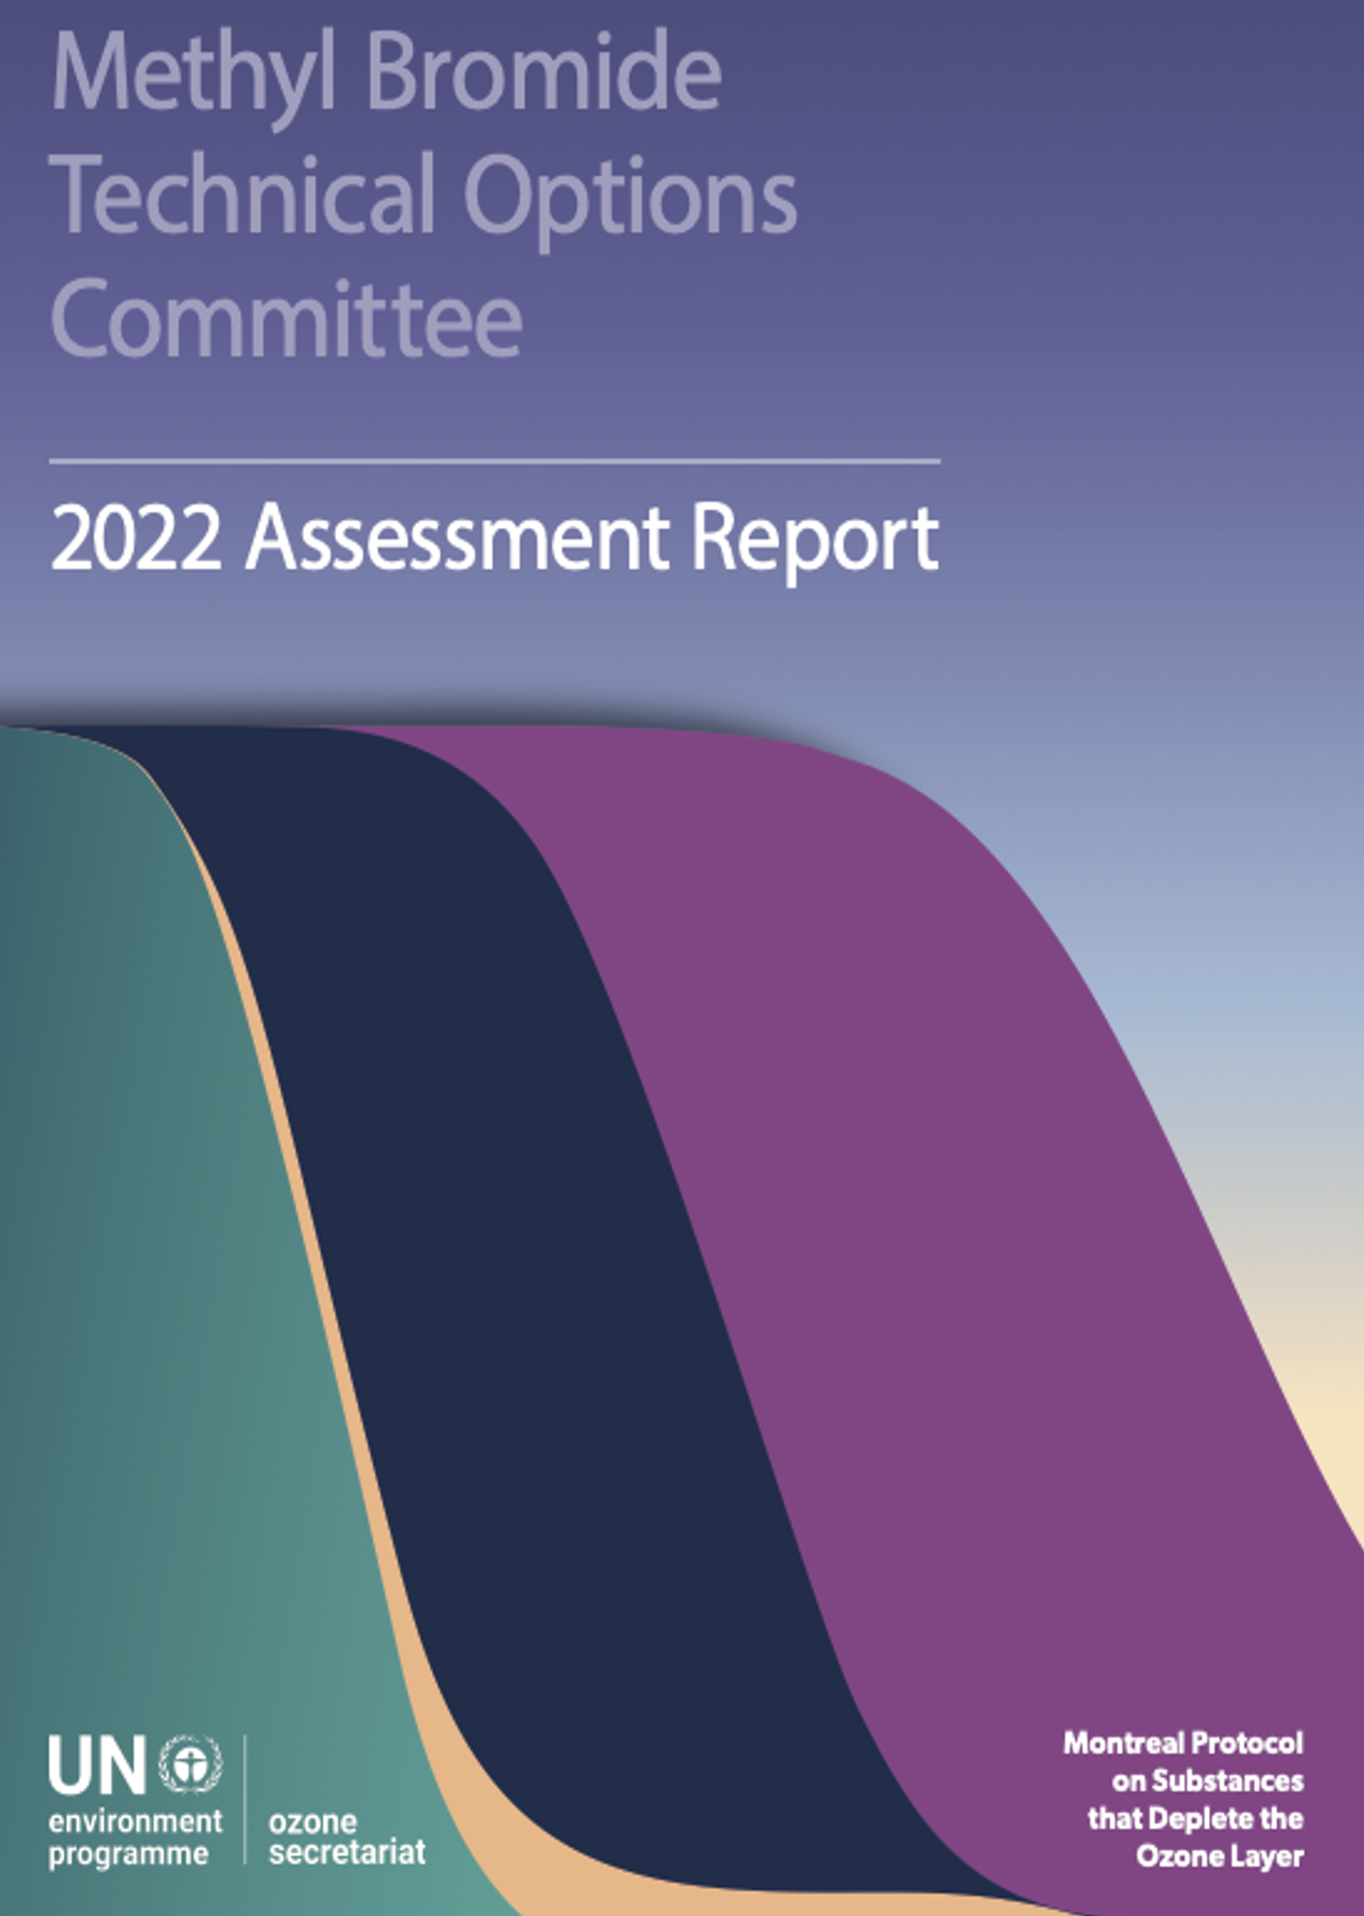
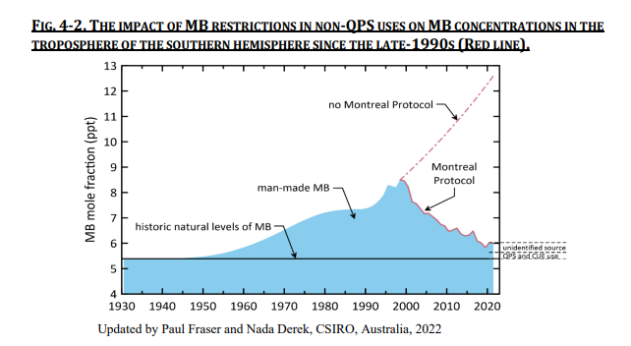
Notes:
Contact insecticides and fumigants for stored products, but also other commodities that can carry pests, are either used for non-quarantine and pre-shipment (non-QPS) uses (non-QPS), such as the protection of commodities from insect attack during storage (applied directly onto the commodities [protectants] or storage structures [structural treatments] at the time of storage), or as a quarantine and pre-shipment (QPS) treatment (QPS) to reduce the risk of dangerous pests being transported between countries or regions.
UN Environment programme, ozone secretariat; Montreal Protocol on Substances that Deplete the Ozone Layer
Phaseout of controlled uses is hugely successful and is virtually complete. Greater than 99.8% of the baseline consumption of 66,428 tonnes has been phased out by 1 Jan 2023.
Complete elimination of emissions from QPS use of MB (one of the very few measures available) , could result in a further significant (i.e. ~10%) and rapid reduction
In 2021, MB consumption for non QPS uses was still around 40 tones. No MB production for controlled uses since 2018 while 100% of MB production was for QPS purposes
A moratorium on MB use by some countries posed additional challenge and trade imbalance pointing to urgent need for suitable alternatives
MBTOC reinforces that alternatives are available for most preshipment uses and if adopted could result in replacing 30-40% (i.e. 3,000-4,000 tonnes) of the total QPS MB.

Slide 6
MeBr QPS and Non-QPS Uses
(QPS = Quarantine and Pre Shipment Uses)
Source: Ozone Secretariat Data Access Centre 2023
Notes:
Non-QPS uses –protection of commodities during storage or in storage structures
QPS-quarantine and pre shipment uses-to reduce the risk of pest being transported between countries or regions; critical importance in preventing movement of critical and dangerous invasive and quarantine speces.
MB is an ozone depleting substance and it has been heavily used as fumigant for years until restrictions towards complete phase out for non-QPS (controlled) uses were imposed through the Montreal Protocol.
Annual consumption of MB for QPS purposes, an exempted use, has remained relatively constant over more than 20 years, at around 10,000 tonnes

Slide 7
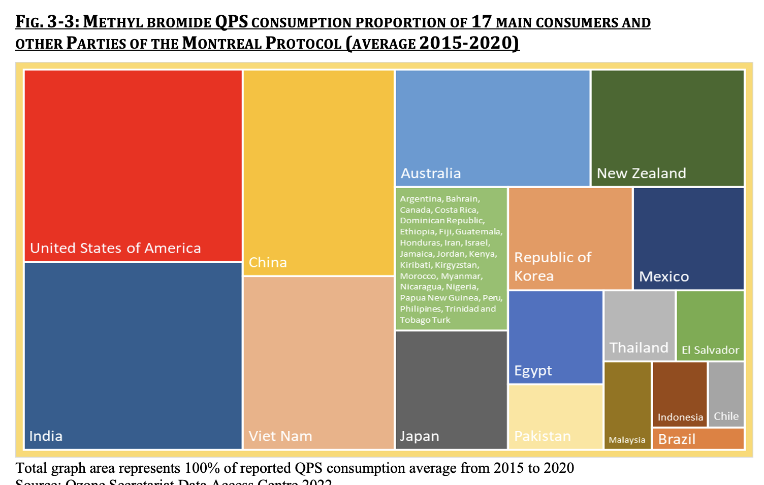
17 countries use about 94% of the reported QPS consumption
Notes:
Some reports suggest even an increase while others say that it remains constant while trade is increasing so in essence it is decreasing.

Slide 8
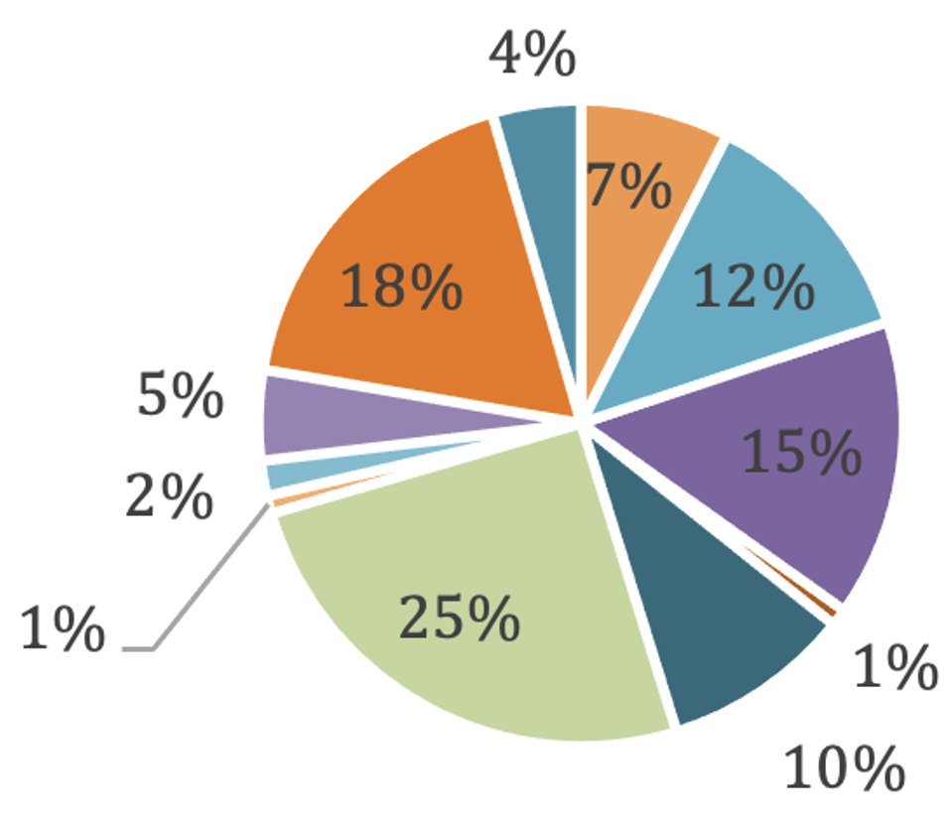
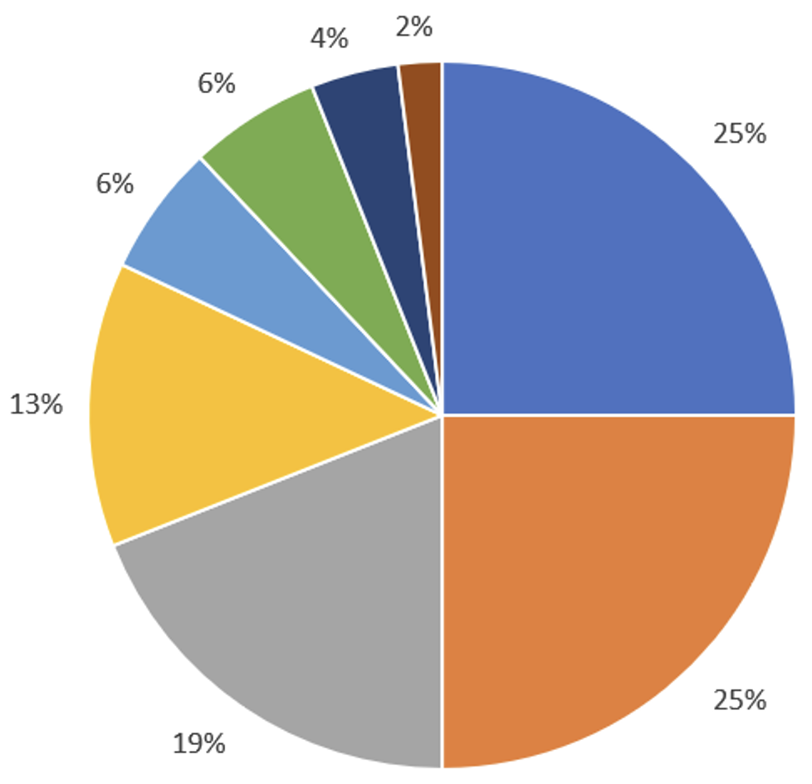
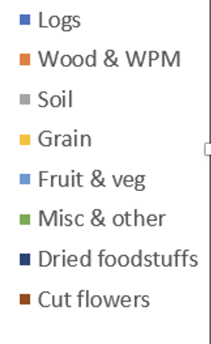
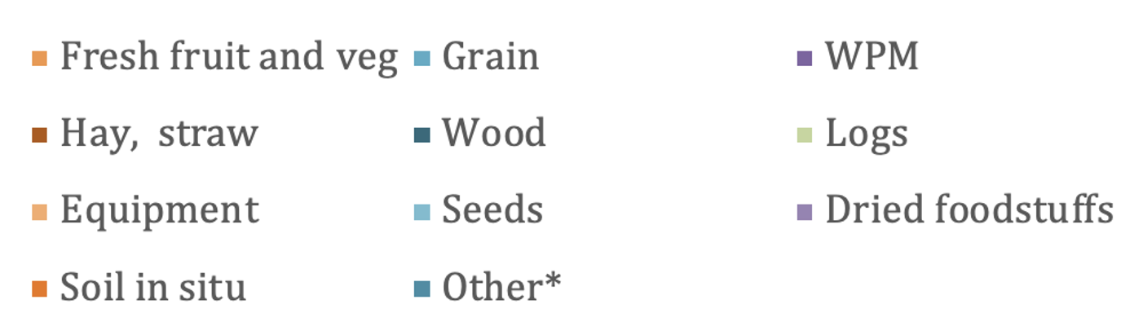
Estimated global categories of QPS use
In 2017
In 2021
Source: MBTOC assessment report 2018 and 2022
logs (25%) + other wood (10%) +Wood packaging (15%) = 50% wood products
Notes:
5 MBTOC assessment report 2018 - https://ozone.unep.org/sites/default/files/2019-04/MBTOC-assessment-report-2018_1.pdf

Slide 9
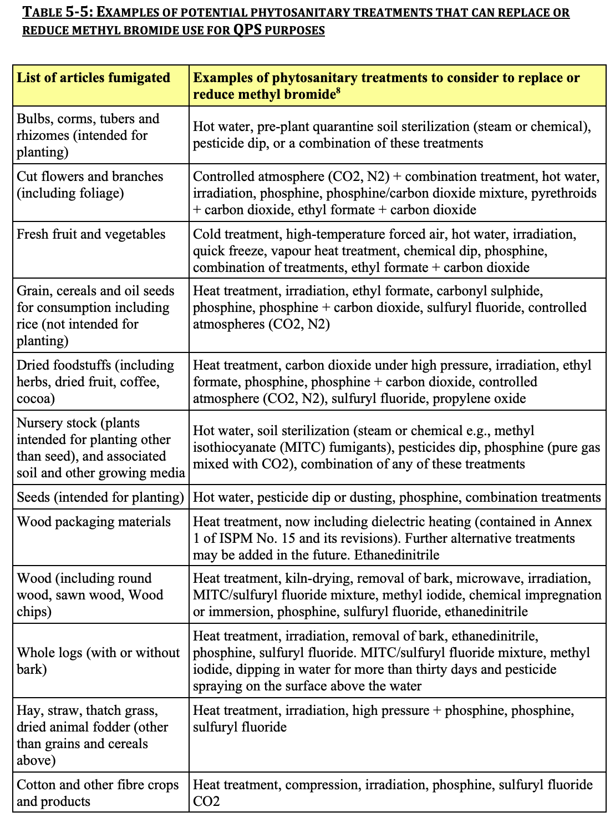
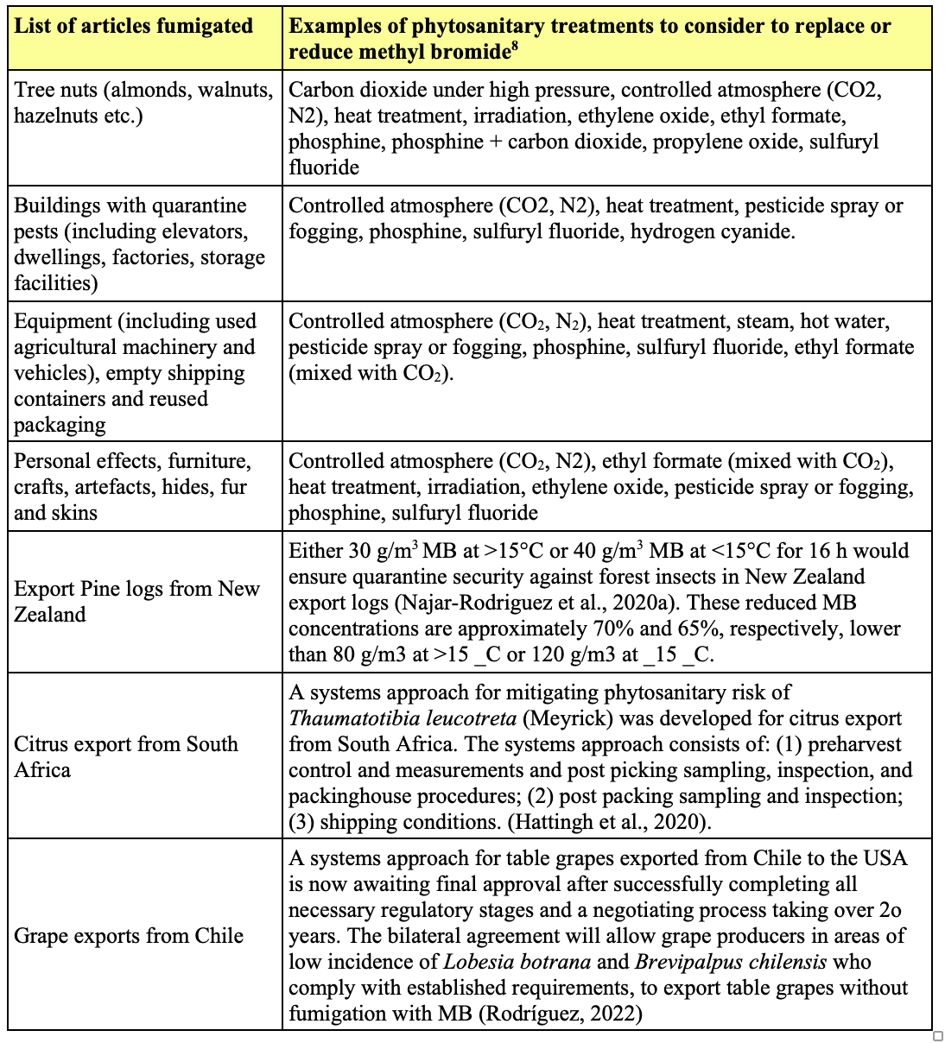
Notes:
Non Fumigant and fumigant alternatives:
Target Substrates/Commodities: Wood products, Soil and substrates, bulbs, tubers, rhizomes, cut flowers, branches, fresh fruit, vegetable, grain, cereals, oil seeds, rice, dried foodstuff, herbs, coffee, hay, straw, cotton, bamboo, nuts, buildings with quarantine pests, equipment, personal stuff (furniture, artifacts, fur etc)
Alternatives include:
Cold treatments, quick freeze, hot water/air/steam, dielectric heating, chemical pesticides, dry air, controlled atmosphere (CO2, N2), irradiation, combination of few treatments, Systems approach ..
Other limited use fumigants (e.g. Methyl isothiocyanate (MTIC) Ethyl formate, Sulfuryl fluoride (SF) , Hydrogen cyanide (HC) , Methyl Iodide (MI) , Nitric oxide (NO) , Phosphine(PH3) are also considered
Examples are given that are generally applicable and likely to meet prevailing standards for treatment or disinfestation. Some alternatives may not be appropriate on particular commodities within the general category or in specific situations

Slide 10
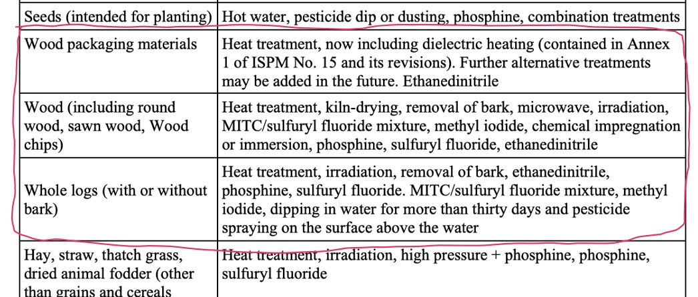
Notes:
Examples are given that are generally applicable and likely to meet prevailing standards for treatment or disinfestation. Some alternatives may not be appropriate on particular commodities within the general category or in specific situations

Slide 11
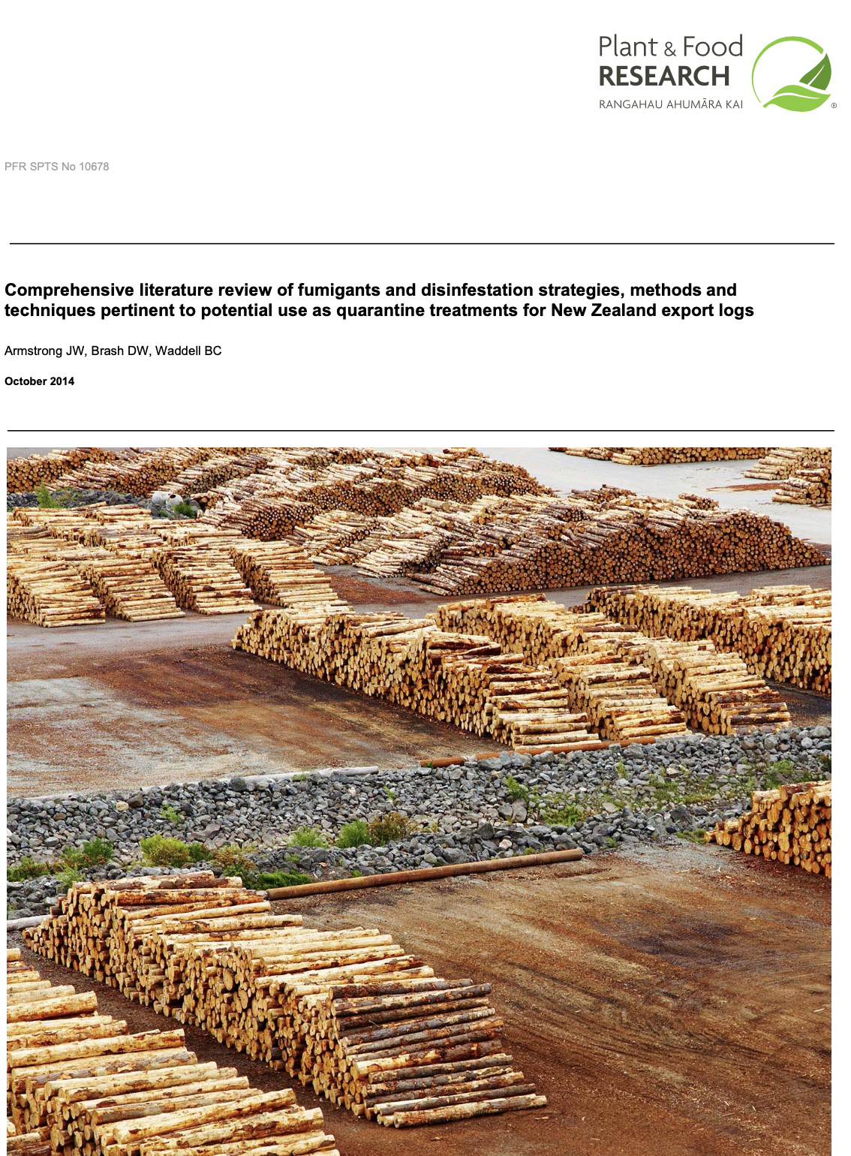
A need for a Fumigant substitute for MeBr
Lowering doses of MeBr and MeBr recapture efforts (NZ especially)
Several great reviews of fumigants (Armstrong et al 2014). EDN top choice followed remotely by SF
Numerous alternatives and combinations have been tested for wood over years (Carbonyl sulphide, Chloropicrin, Methyl iodide, PH3, SF, Ethyl formate, EDN, hydrogen cyanide, ...)
Phosphine and Sulfuryl fluoride (SF) , familiar and registered worldwide, have been evaluated and used as the most promising general alternatives
Notes:
As we said at the beginning fumigation is essential, most convenient treatment: easy, fast, flexible, efficient, typically not affecting commodity
A main goal, in an ideal situation, is to find one fumigant to replace MeBr and where it does not work…then other options
That report from 2014 labelled SF as top choice replacement …EDN was still in development phase for quarantine use……. SF is recently recognized as potent green gass

Slide 12
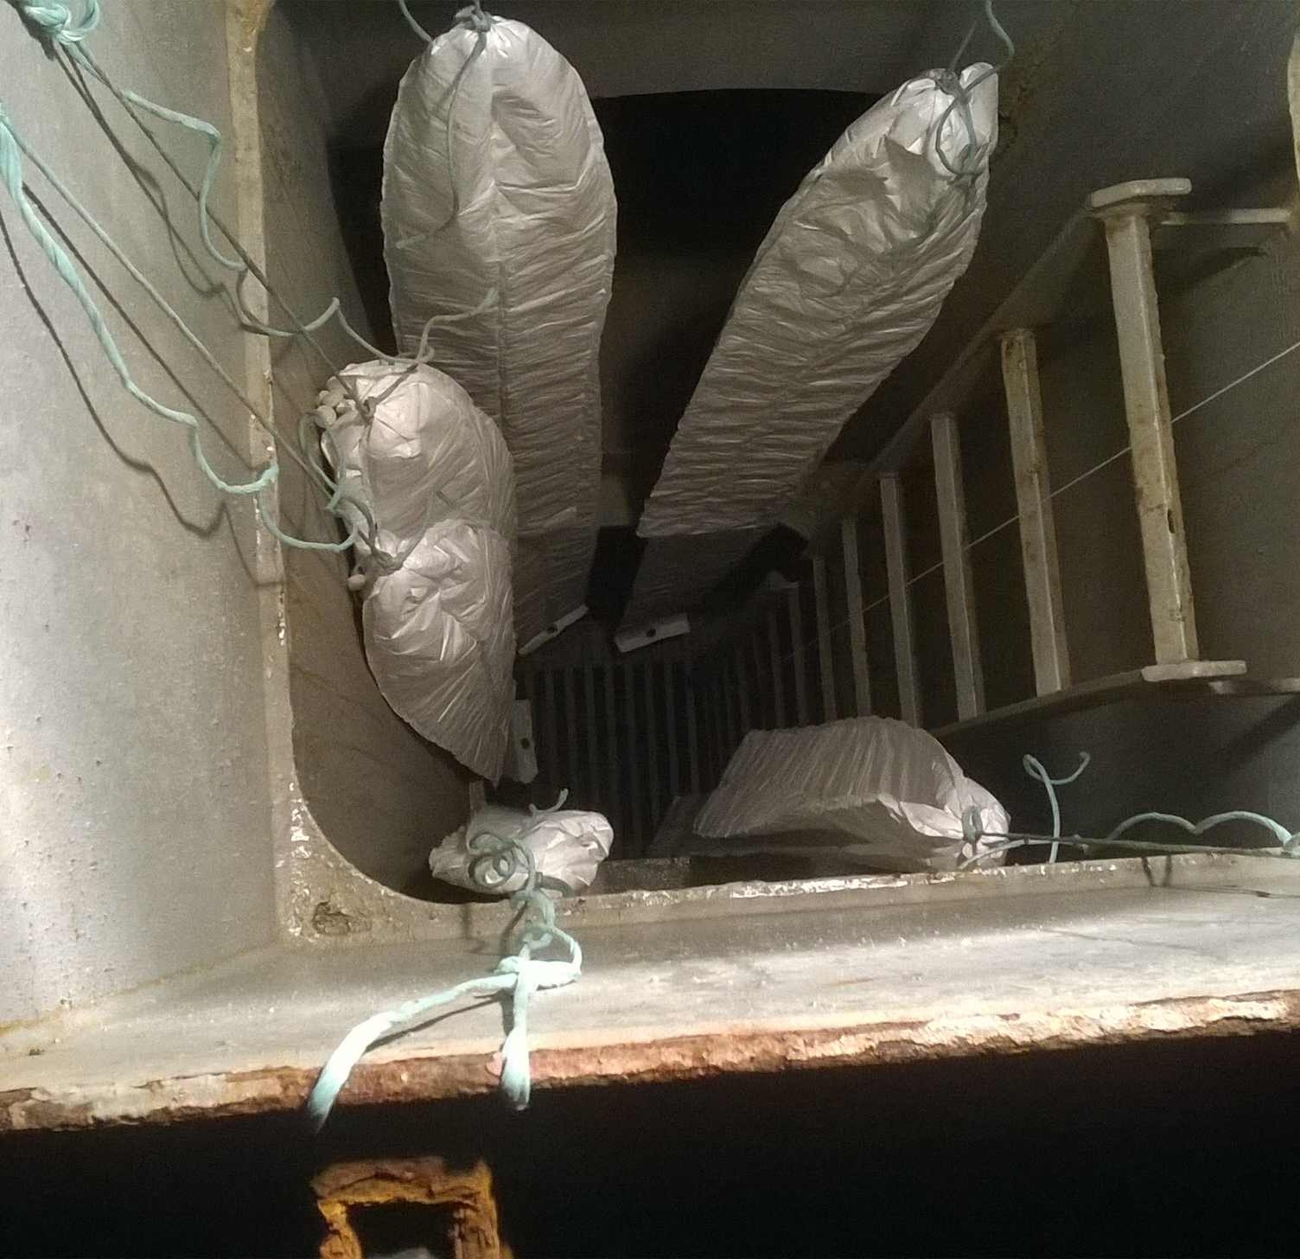
Phosphine
Cheap and easy to apply (tablets , cylindered) in range of applications and structures, residue-free, familiar, registered worldwide
Mostly used on grain (effective against range and all life stages of grain pests). Developed schedules applied on other commodities. NZ uses it on logs in ship holds in transit. Other limited bilateral agreements and uses on other products
With overuse some grain pests developed resistance
Slow acting 10 to 15 days (NZ logs), needs temperature above 15C
Highly corrosive. Can cause explosions at high ppm (18,000 ppm and fires from residues if exposed to water
Evaluation data for forest pest are limited; Indication of inefficiency against some important wood pest (pathogens, nematodes…) thus unlikely to be efficient for wood products pests as general treatments
The use expected to continue by the grain industry and perhaps under specific scenarios, for specific commodities, pest, or in combo with other measures
Notes:
A very rough summary on phoshipne…there is detailed review of phosphine as fumigant for wood products coming soon…
Current labels recommend PH₃ fumigations at temperatures above 15°C, with the best results expected at temperatures of 25-35°C.

Slide 13
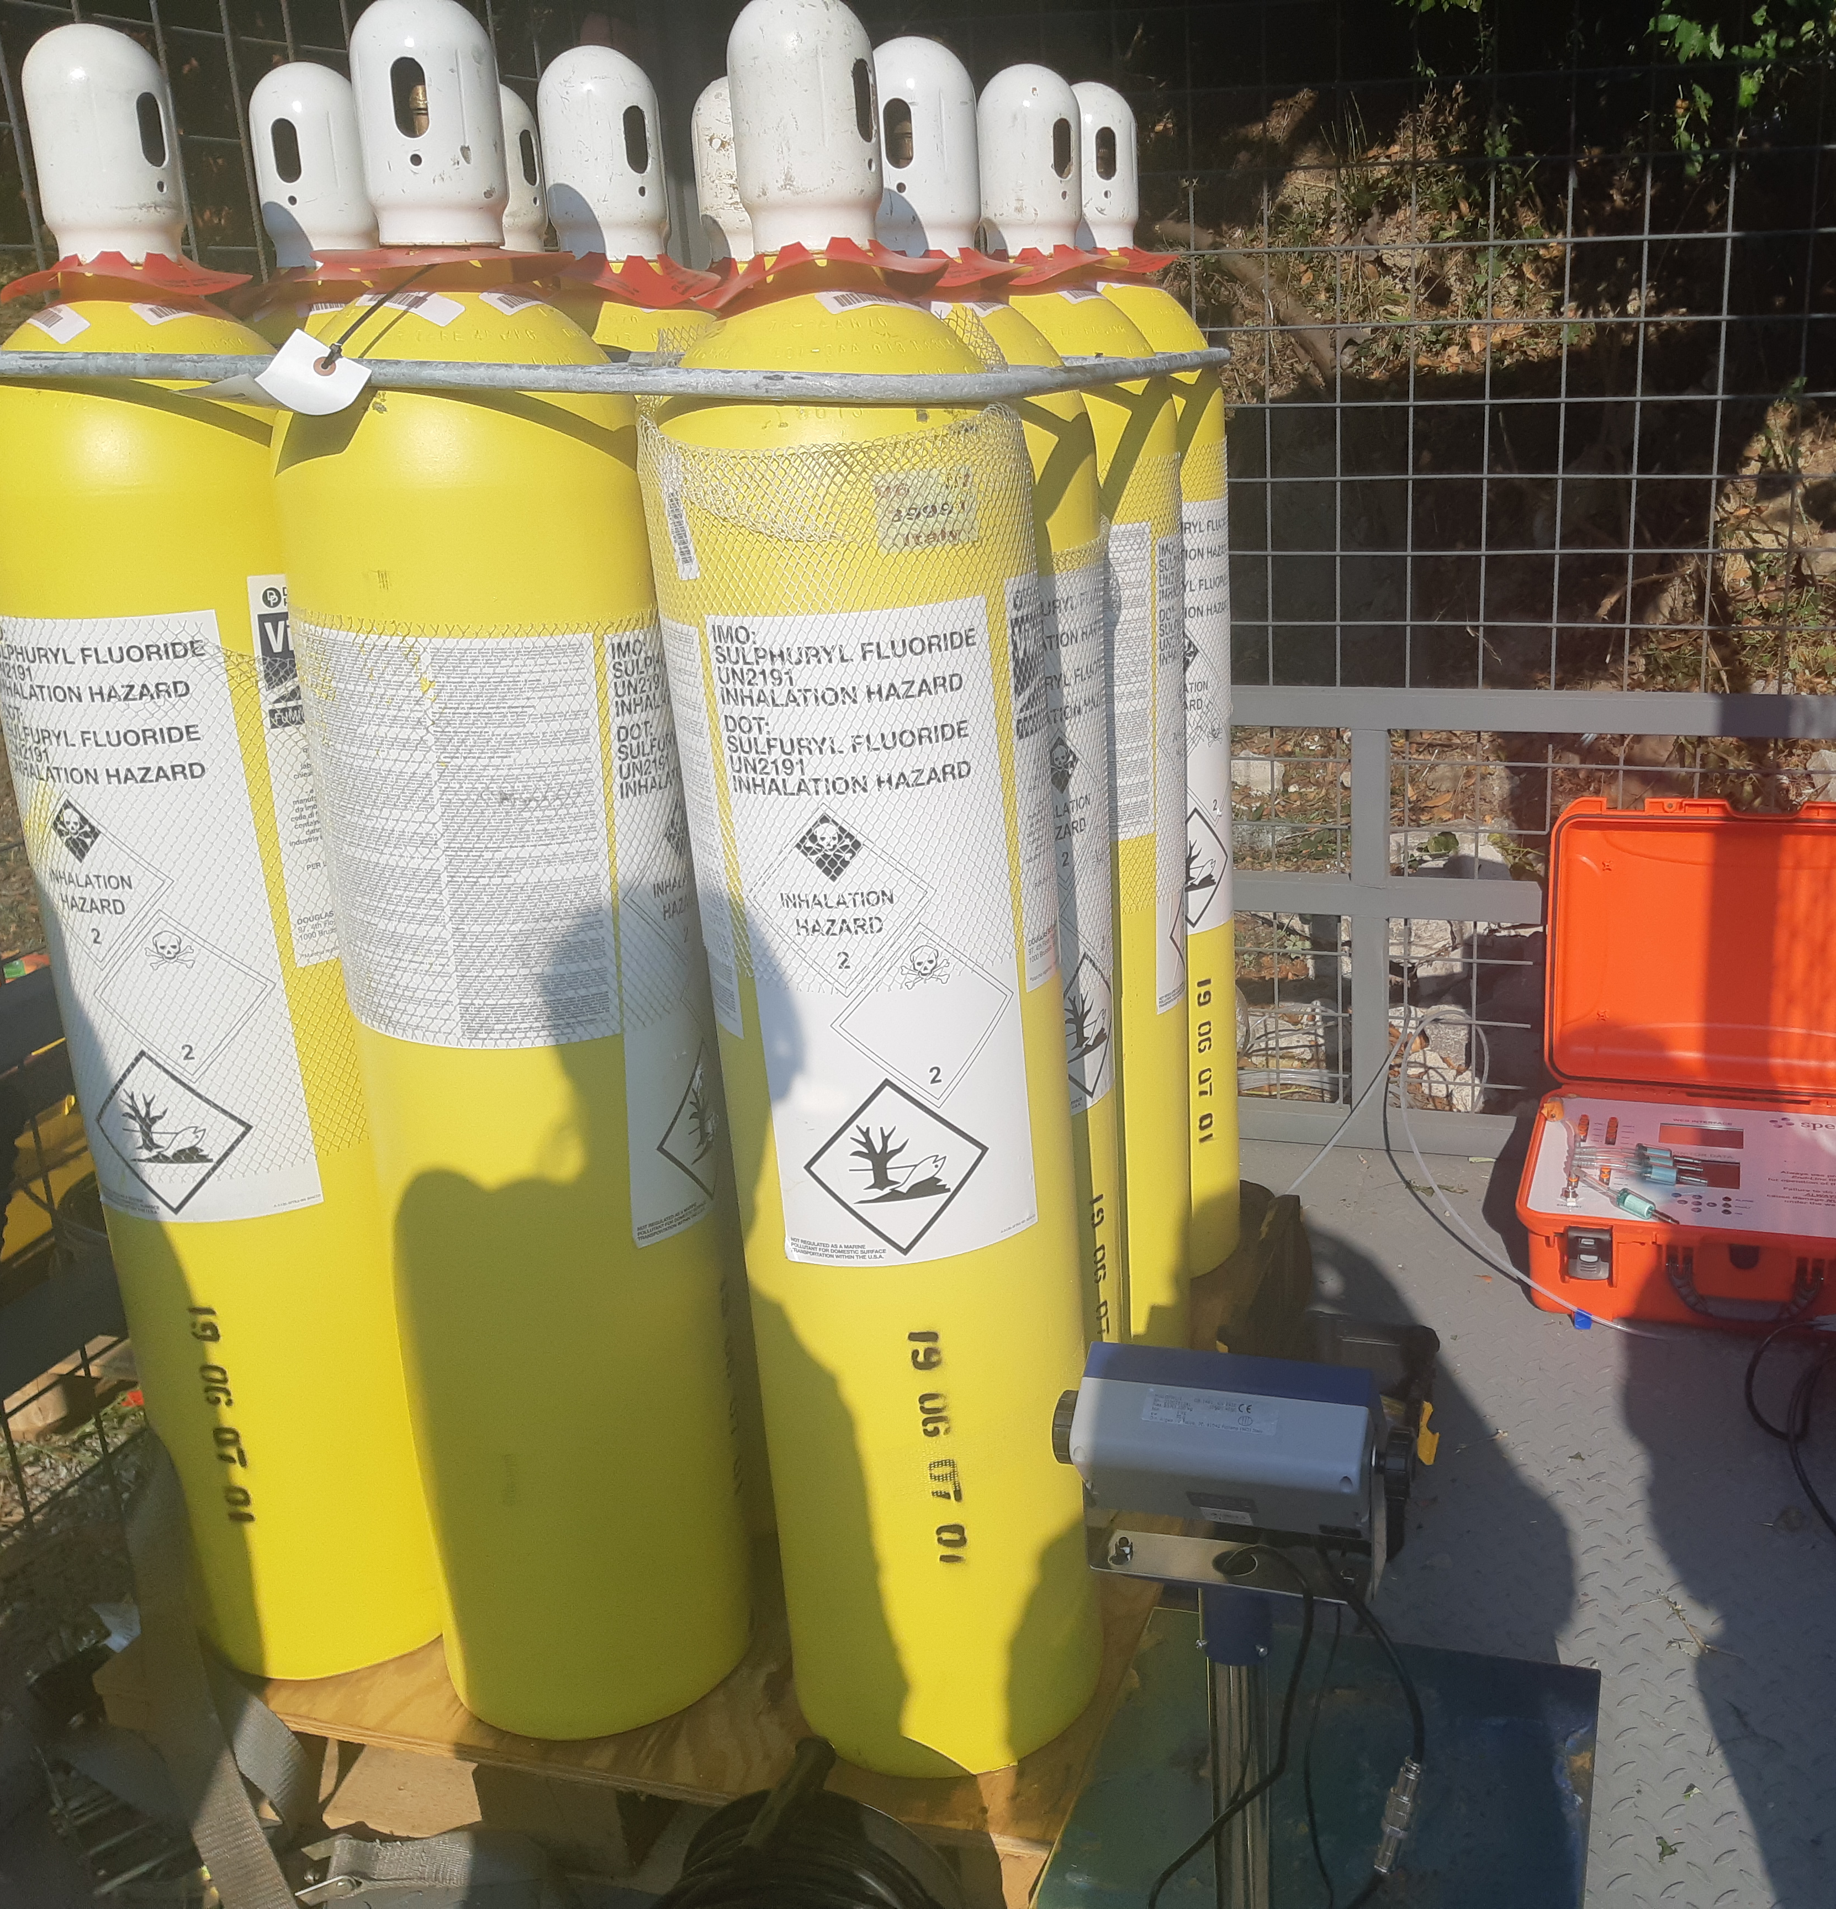
Sulfuryl Fluoride
Better penetration than MeBr
Egg life stage requires a higher dose and warmer temperature than MeBr e.g. ISPM 15
Greenhouse gas with a global warming potential (GWP) over a 100-year time horizon of ∼4,780 (Papadimitriou et al., 2008).
A 40ft container treated @ 20C @ 120g/m³ = 9.36kg of SF x 4,780 GWP = 44.7 Tonnes of CO₂ @ * € 50 offset carbon tax = €2237/container or a Corolla driving 340,000kms
EU will apply carbon tax to imports in 2030, carbon price expected to get to € 100/tonne
Recapture is challenging. It doesn’t stick to carbon like MeBr but can be recaptured with other solutions
Not a VOC so hard to detect, need specialist equipment
Registered as a treatment under ISPM 28 (Annex 22, 23; insects and nematodes in debarked wood)
Notes:
The use of SF is growing as replacement for MeBr. Using SF one introduces lot of CO2 so there is a need for offset emissions which increases cost . The GWP of SF is 4,780, therefore, for each container fumigation approx. 5,178 kg CO2e is released into the atmosphere Global use of SF is ~3,000 tones per year; To offset these emissions would cost around AUD 335M/year; This will make SF unavailable for most situations
Benefits of registration under ISPM 28
That is why government sgo towards it to replace MeBr
Registered against all wood borne life stages…..

Slide 14
Fumigant substitutes for MeBr
Ethyl formate (EF) appears to be as a great option for surface pests
Ethane dinitrile (EDN), backed up by significant efficacy research in the last decade and growing registration points it to be the only economically viable and environmentally benign true single gas alternative to MeBr and SF

Slide 15
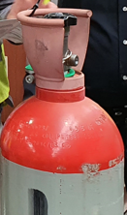
Ethyl formate
Being successfully used on some fruit (grapes) with CO₂ for surface pest treatment, can damage fruit
Used on cereal grains, oilseeds (with moisture content ≤ 12%), flours (with moisture content ≤ 14.5%), dried fruits, nuts, dates in sealed storage. Grain storage premises, vehicles, machinery and equipment.
Works well on the Brown Marmorated Stink Bug adults and ants (contaminant pests)
Natural compound, low toxicity to humans compared to MeBr, flammable hence the CO₂
GRAS generally regarded as safe - 100ppm WES, rum smell
Not tested on timber but not so good at penetration
Registered in AU, NZ, Jamaica, South Africa, S. Korea, research in USA

Slide 16
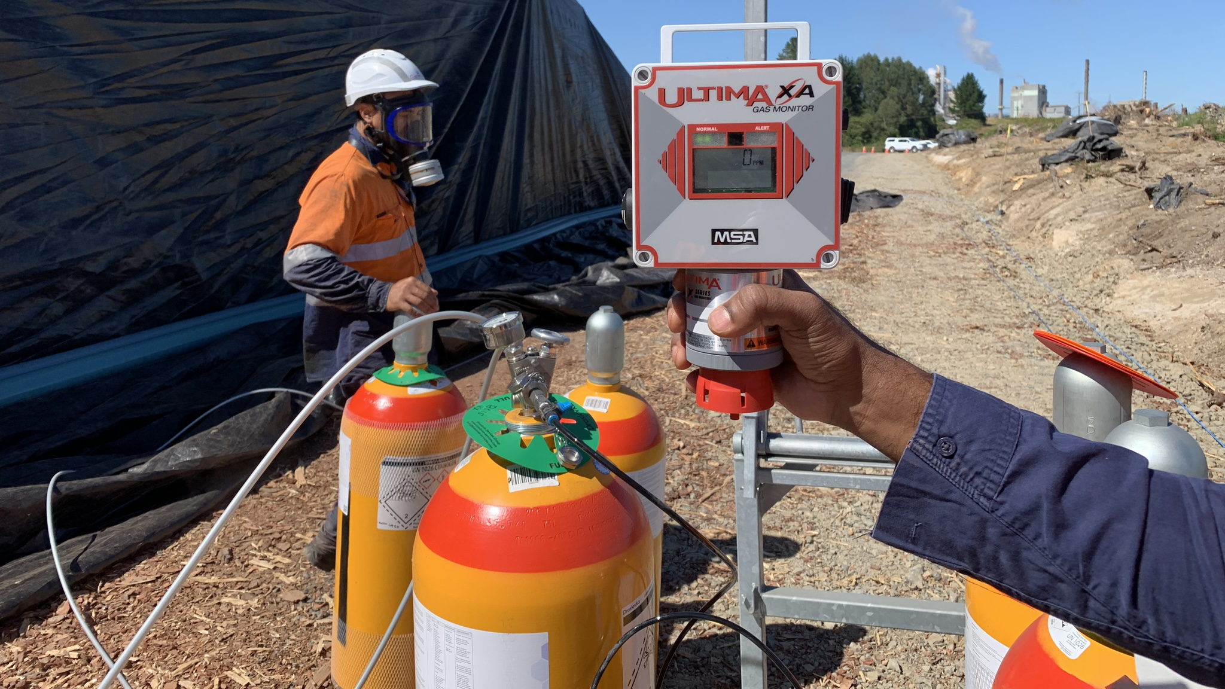
EDN versus Methyl Bromide
Properties | EDN™ | Methyl bromide | Advantages of EDN™
Boiling point | -21°C | 3.6°C | EDN can be applied as a gas without a vaporiser
Vapour pressure | 515 kPa (21°C) | 214 kPa (21°C) | EDN has a higher vapour pressure, hence, it will penetrate and distribute better than MeBr
Density in air | 2.2 kg/m³ | 3.27 kg/m³ | Both fumigants are heavier than air, but EDN™ is lighter than MeBr which means ventilation is quicker for EDN™
Specific volume (@ 25°C and 1 atm) | 462 l/kg | 256 l/kg | EDN creates much more gas per kg
Molecular weight | 52.04 g/mol | 94.94 g/mol | EDN ½ of MeBr weight; smaller molecule and lower weight means it can move quickly from areas of high concentration to low concentration and achieve equilibrium faster
End point concentration | < 1% | 50% | Less EDN is released into the environment at the end of the fumigation compared with MeBr. Hence, EDN™ ventilation is much quicker with small buffer zone than MeBr
Notes:
Report to Australian Government 2020 on EDN as alterantive to MB for Phyto treatments : Conclusions, based on 26 reports reviewed in detail
Using only the ISPM 28 as a method of evaluating efficacy, EDN was compared to methyl bromide. In all, eight reports provided for the efficacy review included comparative testing of methyl bromide and included different life stages of several different priority pests. Where less than 100% control was achieved, EDN out performed MB in every study.

Slide 17
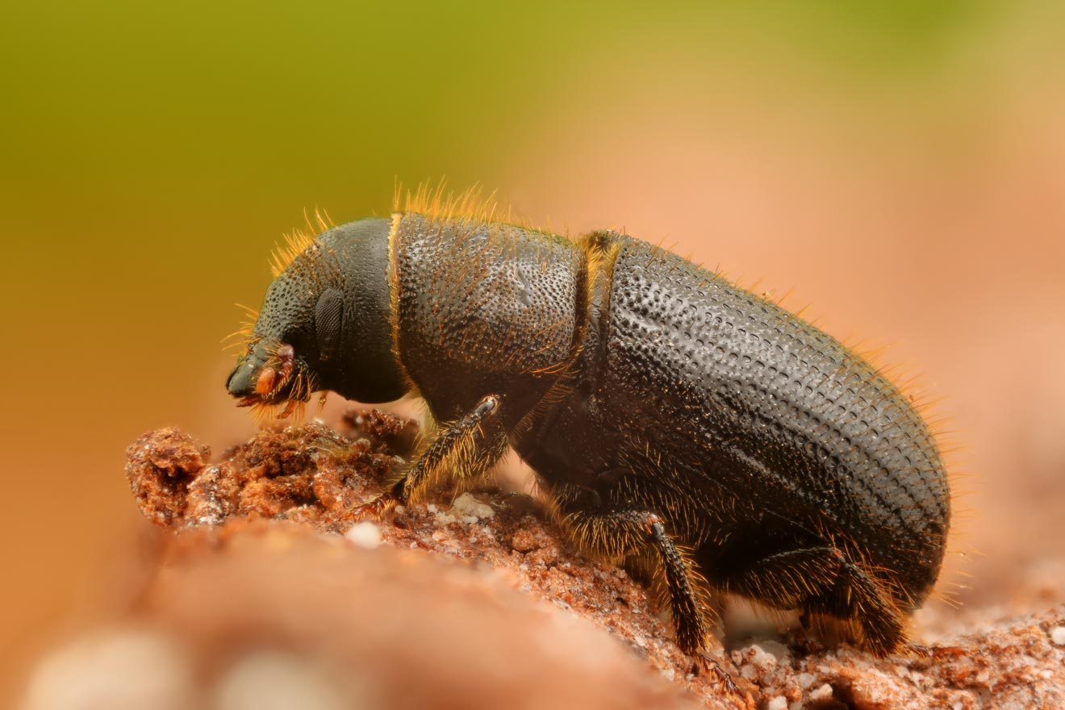
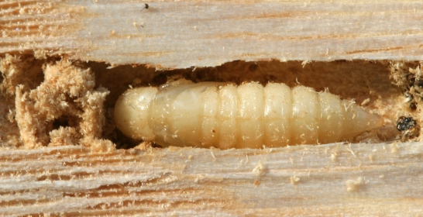
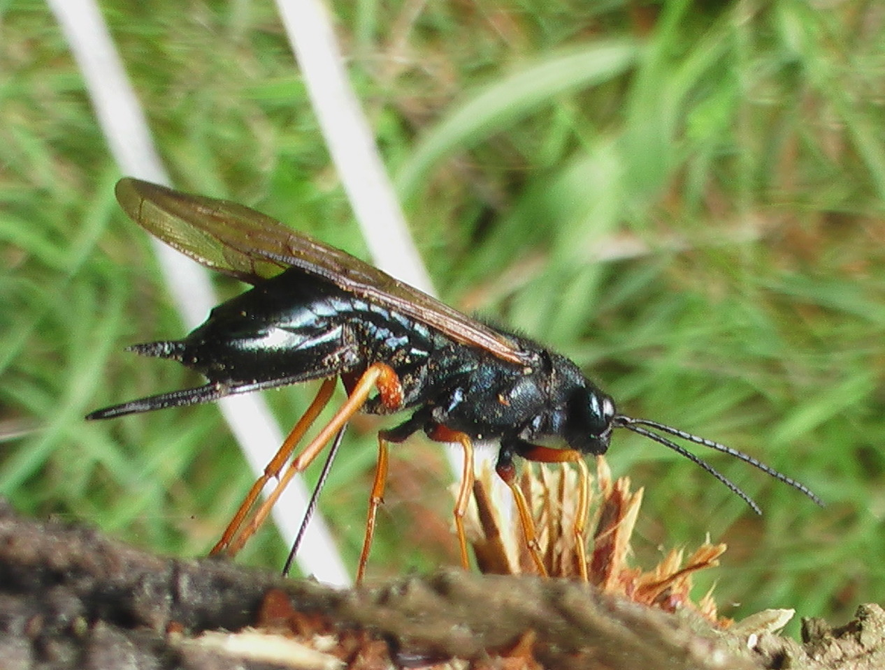
High-level overview of efficacy data
Insects: 11 families & 28 species
Type | Family | Scientific name | Common name | Refs
Insect | Bostrichidae | Rhyzopertha dominica | Lesser grain borer | 1,2,3,4
Insect | Cerambycidae | Anoplophora glabripennis | Asian long-horned beetle | 4,5
Insect | Cerambycidae | Arhopalus ferus | Burnt pine longhorn beetle | 6,7,8
Insect | Cerambycidae | Hylotrupes bajulus | House longhorn beetle | 9,10
Insect | Cerambycidae | Monochamus alternatus | Japanese pine sawyer | 11,1213,14
Insect | Cerambycidae | Tetropium fuscum | Brown spruce longhorn beetle | 15
Insect | Curculionidae | Crypahalus fulvus | Minute pine bark beetle | 16,17
Insect | Curculionidae | Dryocoetes autographus | Hairy spruce bark beetle | 15,18
Insect | Curculionidae | Dryocoetes hectographus | - | 18
Insect | Curculionidae | Hylastes ater | Black pine bark beetle | 8,19
Insect | Curculionidae | Hylurgops palliatus | Lesser spruce shoot beetle | 18
Insect | Curculionidae | Hylurgus ligniperda | Golden-haired bark beetle | 8,19
Insect | Curculionidae | Ips typographus | European spruce bark beetle | 15, 18
Insect | Curculionidae | Pityogenes chalcographus | Spruce wood engrave | 15,18
Insect | Curculionidae | Polygraphus poligraphus | - | 15
Insect | Curculionidae | Tomicus piniperda | Common pine shoot beetle | 17,21
Insect | Dermestidae | Trogoderma variabile | Khapra beetle | 2
Insect | Dryophthoridae | Sitophilus granarius | Wheat weevil | 1
Insect | Dryophthoridae | Sitophilus oryzae | Rice weevil | 1,2
Insect | Erebidae | Hyphantria cunea | Fall webworm | 17,21
Type | Family | Scientific name | Common name | Refs
Insect | Kalotermitidae | Cryptotermes brevis | West Indian drywood termite | 4
Insect | Ptinidae | Lasioderma serricorne | Cigarette beetle | 2,3
Insect | Rhinotermitidae | Reticulitermes speratus | Japanese termite | 16,17,21
Insect | Siricidae | Sirex noctilio | Sirex woodwasp | 22
Insect | Siricidae | Sirex juvenus | Steel-blue woodwasp | 23
Insect | Siricidae | Urocerus gigas | Giant woodwasp | 23
Insect | Tenebrionidae | Tribolium castaneum | Red flour beetle | 1,2
Insect | Tenebrionidae | Tribolium confusum | Confused flour beetle | 1
Notes:
Note on quality of data of this research that was conducted in the last decade where researchers followed guidance of emerging evaluation standards , where data are more onerous, bar raised much higher than previous research.
EDN™ has been shown to be effective against a wide range of forestry pests - 60 species across 28 families
No other treatment has been tested to this level

Slide 18
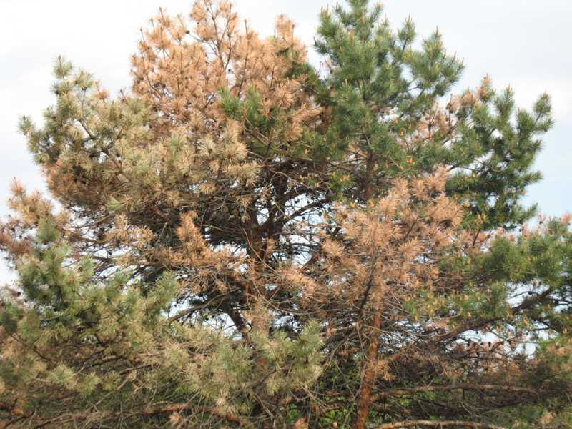
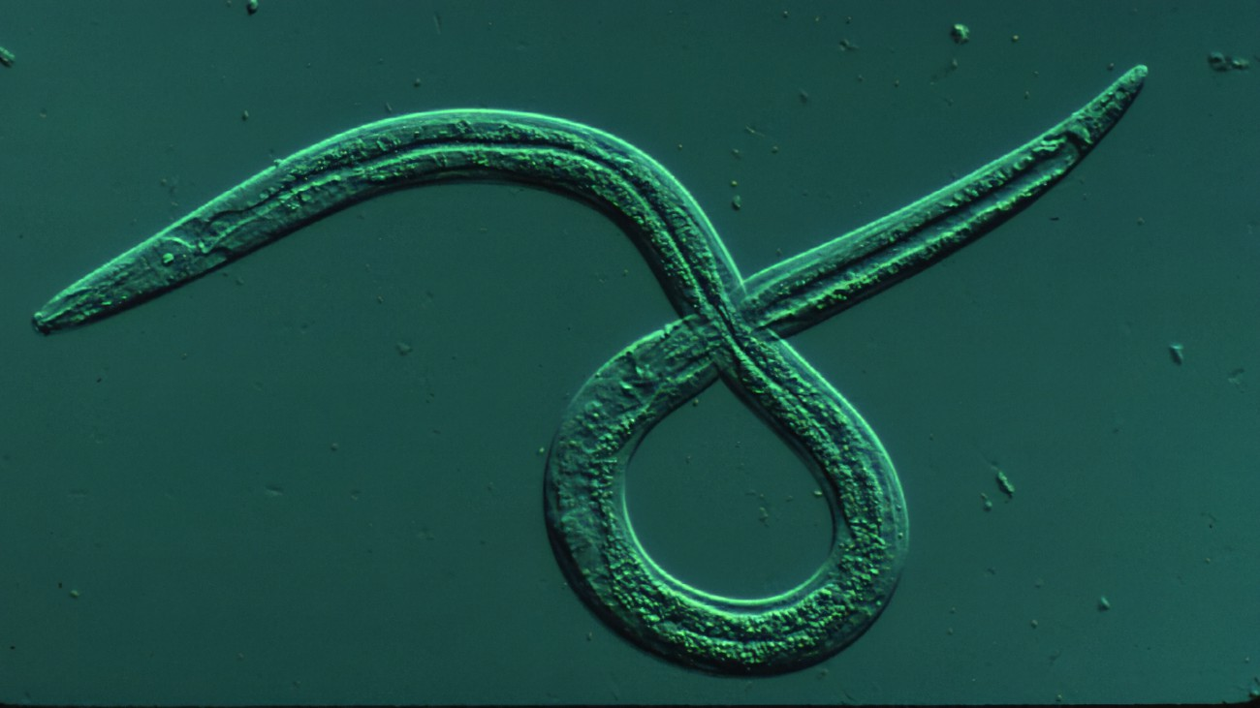
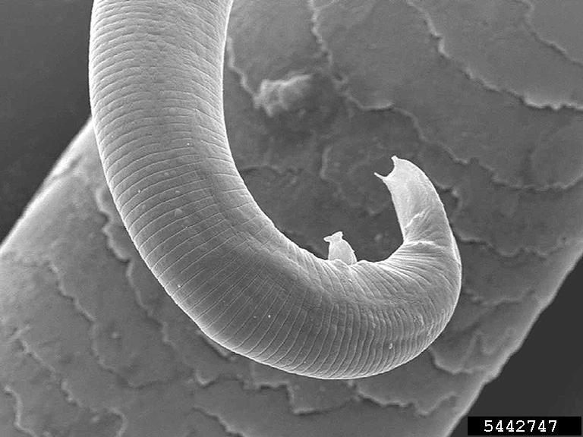
Nematodes: 5 families & 8 species
Type | Family | Scientific name | Common name | Refs
Nematode | Heteroderidae | Meloidogyne incognita | Southern root-knit nematode | 24
Nematode | Hoplolaimidae | Hoplolaimus galeatus | Lance nematode | 24
Nematode | Hoplolaimidae | Helicotylenchus spp. | Spiral nematodes | 24
Nematode | Parasitaphelenchidae | Bursaphelenchus xylophilus | Pine wood nematode | 10, 11, 12, 14, 24, 25, 26, 27, 28
Nematode | Pratylenchidae | Pratylenchus spp. | Lesion nematodes | 24
Nematode | Rhabditidae | Cruznema tripartitum | - | 24
Nematode | Rhabditidae | Oscheius sp. | - | 24
Nematode | Rhabditidae | Rhabditis sp. | - | 24

Slide 19
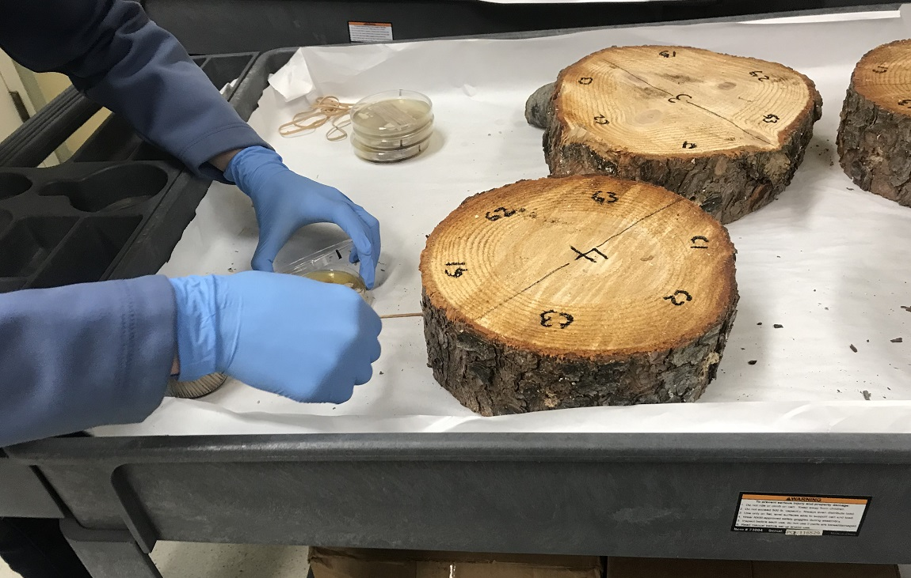
Pathogens: 12 families & 24 species
Type | Family | Scientific name | Common name | Refs
Fungi | Peronosporaceae | Phytophthora kernoviae | - | 30
Fungi | Peronosporaceae | Phytophthora pluvialis | Red needle cast | 30
Fungi | Peronosporaceae | Phytophthora ramorum | Sudden oak death | 25
Fungi | Rhytismataceae | Lophodermium pinastri | Lophodermium needle cast | 30
Type | Family | Scientific name | Common name | Refs
Fungi | Acarosporaceae | Diplodia sapinea | Sphaeropsis blight | 30
Fungi | Amylostereaceae | Amylostereum areolatum | - | 30
Fungi | Bionectriaceae | Geosmithia morbida | Thousand cankers black walnut disease | 25,29
Fungi | Bondarzewiaceae | Heterobasidion annosum | - | 25
Fungi | Bondarzewiaceae | Heterobasidion insulara | - | 30
Fungi | Capnodiales | Teratosphaeria cryptica | Eucalyptus leaf blotch | 30
Fungi | Ceratocystidaceae | Ceratocystis fimbriata | Sweet potato pathogen | 30
Fungi | Fagaceae | Ceratocystis fagacearum | Oak wilt | 25,29
Fungi | Mycosphaerellaceae | Dothistroma septosporum | Red band needle blight | 30
Fungi | Nectriaceae | Thyronectria fuckeliana | Canker | 30
Fungi | Nectriaceae | Thyronectria pinicola | - | 30
Fungi | Ophiostomataceae | Grosmannia huntii | - | 30
Fungi | Ophiostomataceae | Grosmannia radiaticola | - | 30
Fungi | Ophiostomataceae | Leptographium procerum | White pine root decline | 30
Fungi | Ophiostomataceae | Leptographium truncatum | Black stain root disease | 30
Fungi | Ophiostomataceae | Ophiostoma floccosum | - | 30
Fungi | Ophiostomataceae | Ophiostoma piceae | Vascular mycosis of oak | 30
Fungi | Peronosporaceae | Phytophthora aleatoria | - | 30
Fungi | Peronosporaceae | Phytophthora citricola | Black hop root rot | 30
Fungi | Peronosporaceae | Phytophthora cryptogea | Tomato foot rot | 30
Notes:
EDN™ has been shown to be effective against a wide range of forestry pests - 60 species across 28 families
No other treatment has been tested to this level

Slide 20
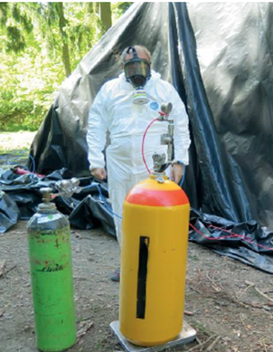
Ethanedinitrile (EDN)
Broad-spectrum fumigant, highly effective against timber insects, nematodes and pathogens, weed seeds & nematodes in soil treatment.
Can be used at low temperatures (5C or less) due to -21C boiling point, with the same dose,
Good penetration, sorbs quickly into logs highly reduced concentration at the end of 24 hours. Shorter time exposure can be efficient
Environmentally friendly, not ozone depleting, nor green house gas, no need for scrubbing, Smaller buffer zones than MB and recapture not required
Drop-in replacement for MeBr on wood ; Quick fumigation period up to 24 h, advanced application methods under tarp, in container or ship holds
Notes:
EDN™ has been shown to be effective against a wide range of forestry pests - 60 species across 28 families
No other treatment has been tested to this level
Also can be flammable and explosive at high concentrations

Slide 21
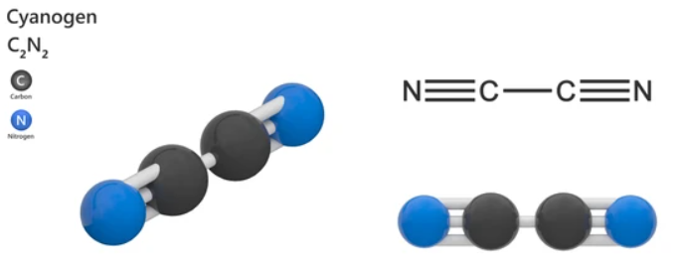
Major Uses
Import and export timber & logs. (Could solve the issue of movement of wood chips, bamboo..)
Pre-plant soil treatment for control of nematodes, pathogens, and weeds in turf grass, sports turf, and golf courses, some horticultural crops such as strawberries, melons, and cut flower production
Notes:
So it all sounds great and why we are already not using it…as we come to administrative hurdles

Slide 22
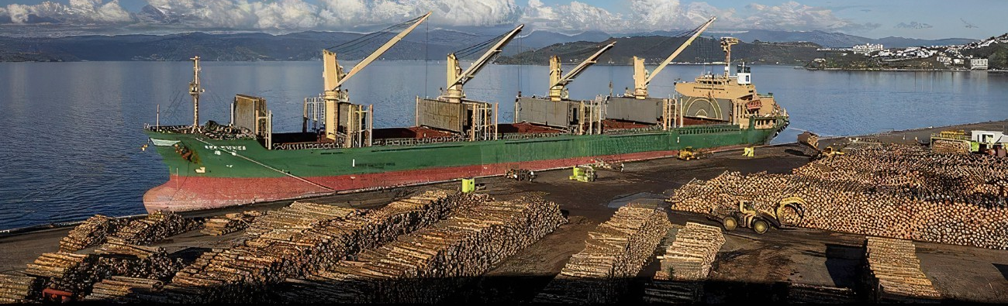
Registration as active within individual countries by their environmental agencies and approved use by importing countries (Most environmental agencies focus on toxicity and other safety issues, but some require efficacy data for specific commodities and pests …)
Acceptance at international level (IPPC), supported by agreed level of confidence in the efficacy data (ISPM 28, ISPM 15) to give base for its acceptance as universal treatment
Administrative hurdles:
Two parallel registration processes for EDN use
Notes:
Exeptance as an universal treatment , mention HT 56/30 that is applied to other products or even in lieu of phytosanitary certification
One is registering it as active with environmental agency but the other is accepting it as efficacious treatment and that is doen as part of environmental agency assessment, or at the international level through processes that exist. ISPM 28 and ISPM 15.
Mention MeBr adopted in past and grandfathered, simplified process of acceptance for Phophine and SF that was adopted under IPSM-15
Most countries environmental agencies focus on toxicity and other safety issues, but some also require efficacy data…
Phytosanitary treatments should have a level of efficacy in killing, inactivating or removing pests, or rendering pests infertile, or for devitalisation that is both feasible and applicable for use primarily I
n international trade.
2022-23 Treatment manual: CPM-4 2009:
When considering phytosanitary treatments for submission to the TPPT, NPPOs and RPPOs should
consider factors such as the effects on human health and safety, the impact on the environment and the
quality and intended use of the regulated article. The scope of phytosanitary treatments does not include
issues associated with product registration or other domestic requirements for approval of treatments.
As appropriate these should be addressed by contracting parties using their normal domestic regulatory
procedures.
Noted that contracting parties should consider the level of efficacy of a phytosanitary treatment
in determining whether the treatment can be used as a phytosanitary measure in a specific
situation. The acceptance of a treatment will depend on factors such as the pest population(s) to
be controlled, the pathway, whether the PT is to be used as part of a systems approach and the
probability of any remaining pests being able to escape from consignments and cause damage.
Encouraged the development of phytosanitary treatments for broad groups of pests or families
or genera that provide appropriate control while maintaining the quality of a wide range of
commodities, where possible.
Provides :7.6.3 Overview of a good research protocol from several authors and (combined with ISPM 28)
For generic treatments, effectiveness of the treatment is tested against the most tolerant species
within the target group.

Slide 23
EDN™ registration status
Registration as an active by environmental agencies
Global registration of EDN™ is progressing and is focused on forestry products. Detailed environmental and toxicological data available and shared with countries. Where efficacy is needed papers available to show EDN™ to be effective against a wide range of forestry pests - 60 species across 28 families
Obtained registrations
Country / Region | Year | Registered Use
Australia | 2013 | Timber & logs and preplant soil treatment
South Korea | 2019 | Timber & logs
Malaysia | 2020 | Timber & logs and preplant soil treatment
Russia | 2021 | Timber & logs
New Zealand | 2022 | Timber & logs
Türkiye | 2022 | Timber & logs & and preplant soil treatment
Uruguay | 2023 | Timber and logs
Pending registrations
Country / Region | Anticipated year of approval | Requested Registered Use
Panama | 2024 | Timber & Logs
USA | 2024 | Timber & Logs
South Africa | 2024 | Timber & Logs
Canada | 2025 | Timber & Logs
India | 2026 | Timber & Preplant
China | 2026 | Timber & Logs
New Zealand: Took six years to register EDN, in April 2022 for export logs and timber only, but it is still not in use.
Canada: requires EDN and HCN residue studies
USA: requires addressing the effect of EDN on endangered species
Mexico: have not started registration process

Slide 24
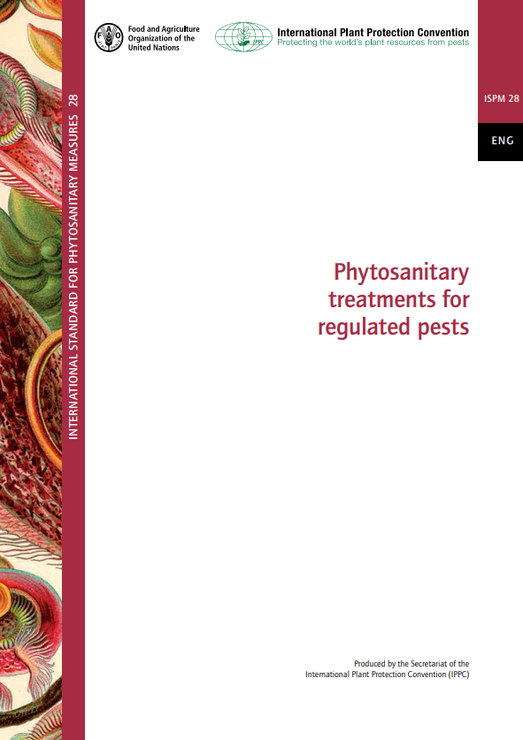
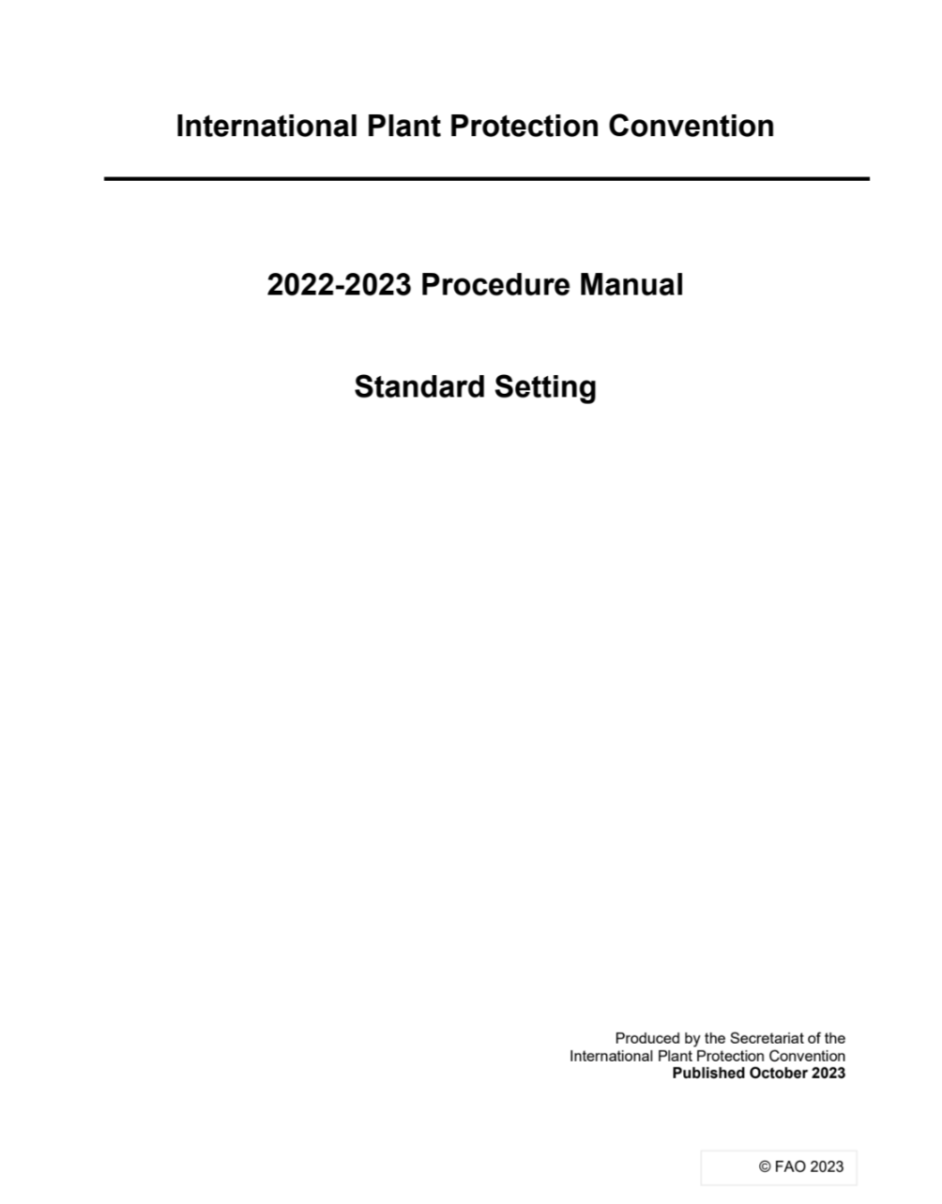
ISPM 28 - treatments evaluation
Typically focused on evaluation and adoption of treatments against particular pest or a commodity. It is a challenge to evaluate general treatment for number of potential pests in many commodities)
  Mid-2017, an application submitted by NZ MPI (NPPO); Insufficient data to make a decision. Since 2017, many studies have been conducted and published.
  NZ MPI continued to develop an updated submission. One of key issues was to solve is how to monitor treatment regime and proving a successful fumigation since EDN disappears fast after introduction.
  Australian NPPO recently took over to complete the submission
Most recent submissions includes
  Understanding CT (Concentration/Time) values do not fit to all fumigants.
  Submitting treatments for specific species/commodities individually in order to create generic treatments
Notes:
If you look annexes to ISPM 28 which describe adopted treatmetns..most are geared for singe pest , rarely Genus….

Slide 25
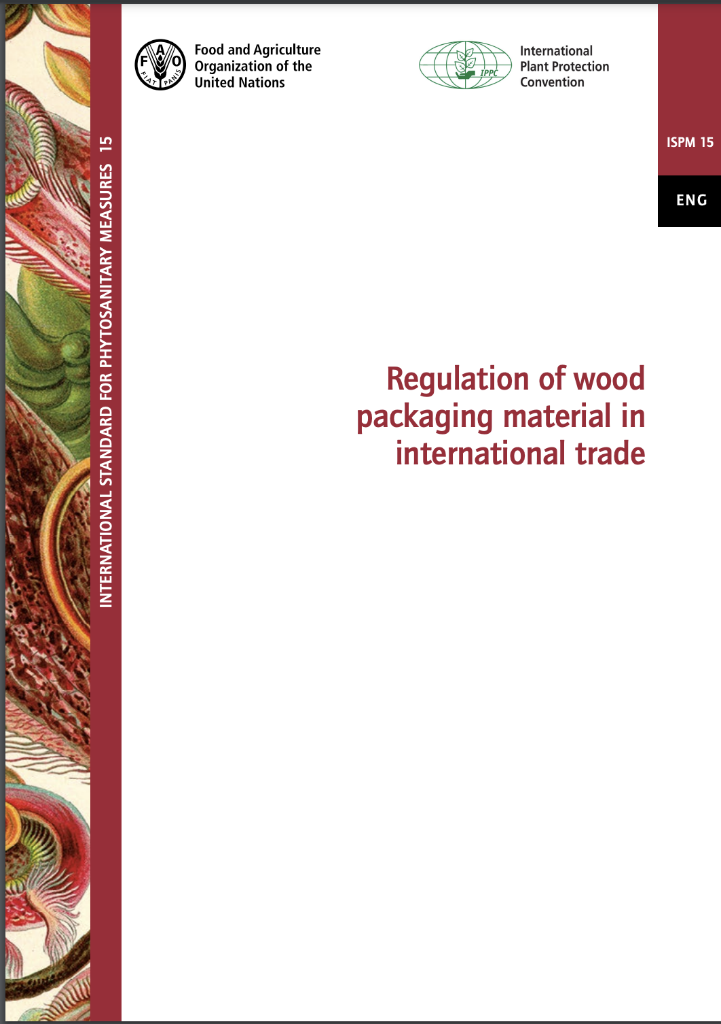
ISPM 15 - treatments evaluation
Specific for Wood packaging. Focused on evaluating and finding universal treatments that can significantly reduce risk of many different pests in many wood species and types used for packaging worldwide.
HT (56/30) adopted for ISPM 15 based on detailed science against pinewood nematode and their vectors. MeBr also listed (grandfathered); Dielectric heating 60/1 (DH) added in 2013 , supported by simpler evaluation process, based on efficacy against limited number of pests
Evaluation process for new ISPM 15 treatments has been developing over last 12 years . Evaluation bar significantly raised as it is needs to prove efficacy at high confidence against numerous potential pest groups and assurance that the required dose is delivered by proving it in the field test)
New wood product treatments are submitted to the TPPT to be considered for ISPM 28
Notes:
Meghan Oct 10-2024: Evaluation process for ISPm 15 new treatments has been on the SC List of Topics and remained there after the last CPM. Will be discussed at IFRQG.)

Slide 26
Inconvenient truth
The fumigants currently used: MeBr and SF are harmful to our planet while Phosphine is not efficient against pests in some key commodities
MeBr QPS use has remained relatively steady (e.g. wood products - over 50% of QPS use).
Governments turn to SF as only available fumigant alternative for wood (SF accepted under ISPM 28) , and consider phosphine.
QPS use of MeBr unregulated. Countries use and self-report MeBr consumption. No regulatory, economic or reputational disincentives for continued use or to develop and adopt alternatives.
We know EDN works and is broad spectrum, fast, easy to apply, large temperature range, no environmental issues.
Governments to consider and develop regulatory and economical incentives, address barriers, coordinate and speed up the regulatory process for scenarios and products where it makes sense (e.g. wood products, hay, soil treatments, ans some food commodities).
Notes:
Phosphine require long exposure in days for wood products, and not efficient against some key quarantine nematodes and pathogens, and some insects.
MeBr QPS use has remained relatively steady even while the world has eliminated (or is in the process of eliminating) nearly all other ozone depleting substances
QPS use of MeBr unregulated, countries use as much as they need and self-report annual consumption. No regulatory, economic or reputational disincentives for increased use or to develop and adopt alternatives.
EDN works: Do not need 24 hours for efficacy including time to lower the residual ppm for venting and buffer zones (target 12 hours only)
Since there is no available fumigant alternative MeBr use will continue.

Slide 27
Family tree - who works on alternatives to MeBr
NAPPO EG: Alternatives to MeBr
QUINTS (former QUADS) MeBr Alternatives Working Group)
Sharing data on alternatives to MeBr and fumigation for QPS use. The priority include EDN fumigation and Heat treatment for timber and forest products. Australia assembled the most comprehensive review of data on EDN
MBAO-Methyl Bromide Alternatives Outreach
Annual event held in the USA, to share info on ongoing research on MB alternatives ?
IFQRG: International Forest Quarantine Research Group (since 2004):
An independent science/ government/ industry/ regulatory group/platform, IPPC partner; analyze, synthesize and and carry scientific collaborative research on knowledge gaps identified by quarantine bodies, supports IPPC standards developments, provide carefully considered advice.
NAPPO EG: Forest Quarantine Research Group
Prioritize forest quarantine market access issues and research needs including alternatives to MB
PHYTOS NZ: Industry lead group for alternatives (STIMBR)
IPPC (TPPT-Technical Panel on phytosanitary treatments)
Other groups around NPPOs. IUFRO, Industry (Draslovka)
Notes:
International collaboration would help gather all necessary data and agencies to coordinate and specify what they need.
Canada is much participants in majority of these …..
NAPPO EG Objective: Development of a NAPPO Discussion Document to share information regarding alternative treatments for MeBr, with a possible goal of creating an agreed position aligned to international standards. Part of work includes : Identify priority MeBr alternatives and support promising ones, gaps and opportunities, Collating existing research and data sharing of alternative treatments, to identify policy-level factors that may affect the implementation of alternative treatments
There is interest and common goal for coordinations and data sharing for common goal….
“QUINTS” or use the overarching name “Global Alliance for Plant Health – Quint Collaboration “
The priority topic area include EDN fumigation and Heat treatment for timber and forest products and to an extent on other treatments and commodities (e.g agriculture)
IFQRG
IFQRG has had participation from over 200 delegates from 40 countries providing scientific input from academic, government, industry, and regulatory perspectives.
Canada is interested in research related to the use of EDN for the treatment of wood products, in particular for wood chips and bamboo
Ongoing interest to export wood chips from Canada to the EU and other countries worldwide. However, only limited phytosanitary treatments are accessible and economical.
Bamboo products are commonly treated with methyl bromide. Approving another fumigation option could reduce the global use of methyl bromide
Why should we collaborate?
Outcomes and information distributed amongst partners and strategically could help move things faster in regulatory context
NPPOs would benefit from a new treatment option. It would allow continued trade and thus support the economy
For exporters and importers of wood products, it would allow safe trade, new market access and business opportunities.
Facilitate the international acceptance of EDN by collaborators as a phytosanitary treatment for wood chips and bamboo.

Slide 28
Countries collaboration, potential outcomes
Collaborative research to fill key gaps; agreed test protocols; data assessment and data summary related to the use of EDN particularly for wood products, bamboo etc).
Information shared strategically, committed to a problem-solving process, could help move things faster in regulatory context, support acceptance of EDN internationally and by specific countries. Identify policy-level factors that may affect the implementation of alternative treatments and if they can be solved.
NPPOs would benefit from new treatment option allowing for safeguarding plant health, continued safe trade and support economy with reduced effect on climate.

