Slide 1
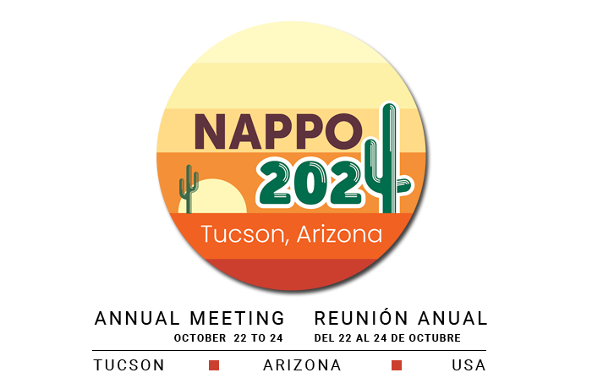


Introducing:
Juan A. Villanueva-Jimenez
General Director

Slide 2
Colegio de Postgraduados:
  Brief history
  Organization
Education
Research
Outreach
Plant Protection at Colpos
Collaboration Opportunities with NAPPO

Slide 3

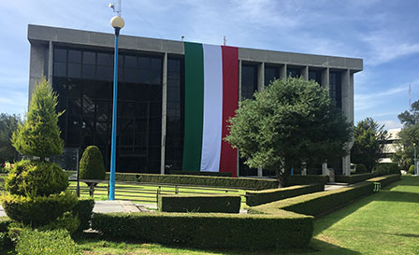
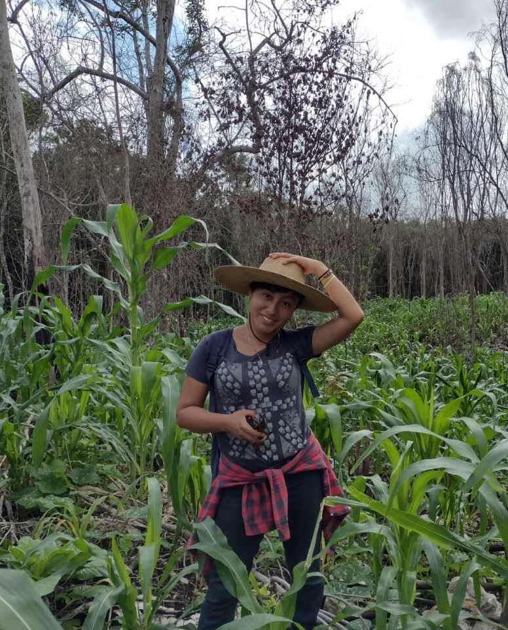
I want to express my gratitude to NAPPO representatives for this valuable opportunity.
Colegio de Postgraduados is a Public Decentralized Organization of the Agriculture Ministry (SADER)
and is widely recognized as a Public Research Center.

Slide 4
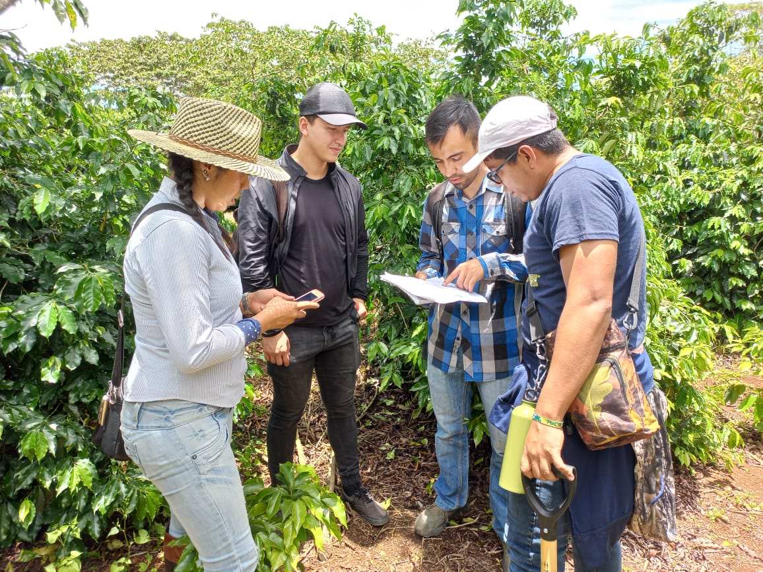
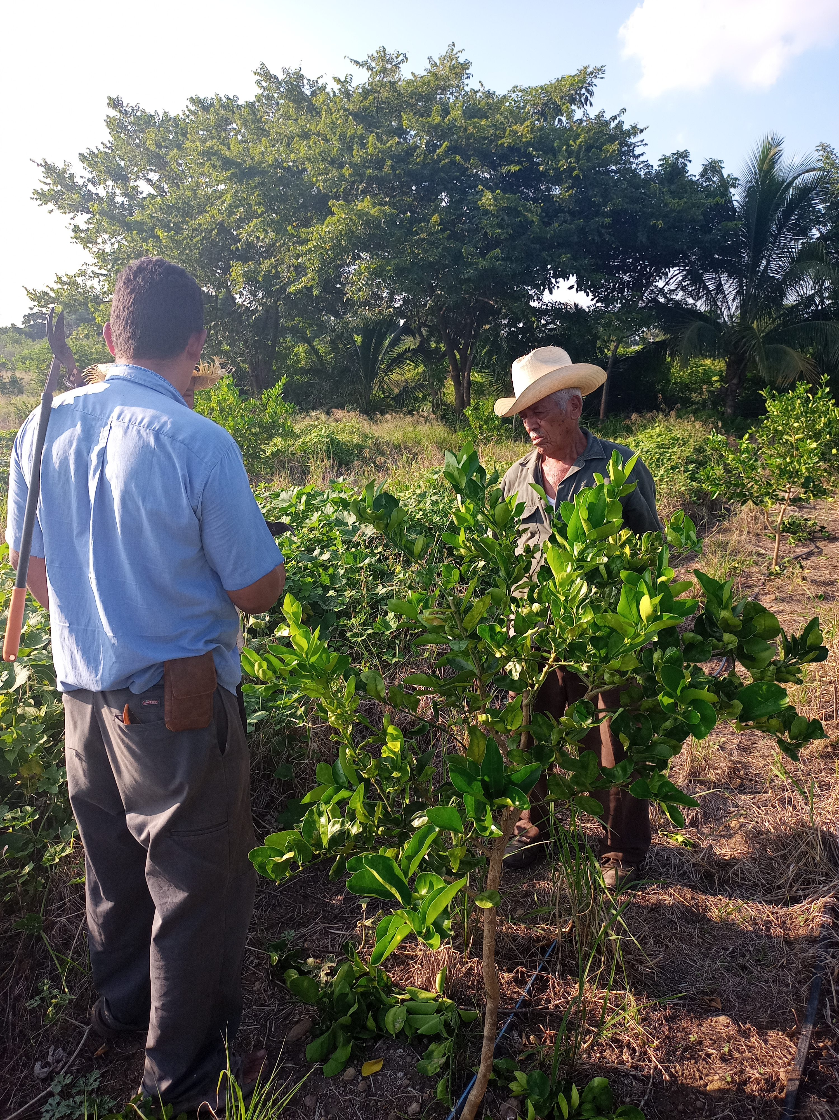
Our Mission
“Our mission is to enhance the quality of life for the population through innovative education, research, and outreach that strengthens the agri-food and environmental sectors.”

Slide 5
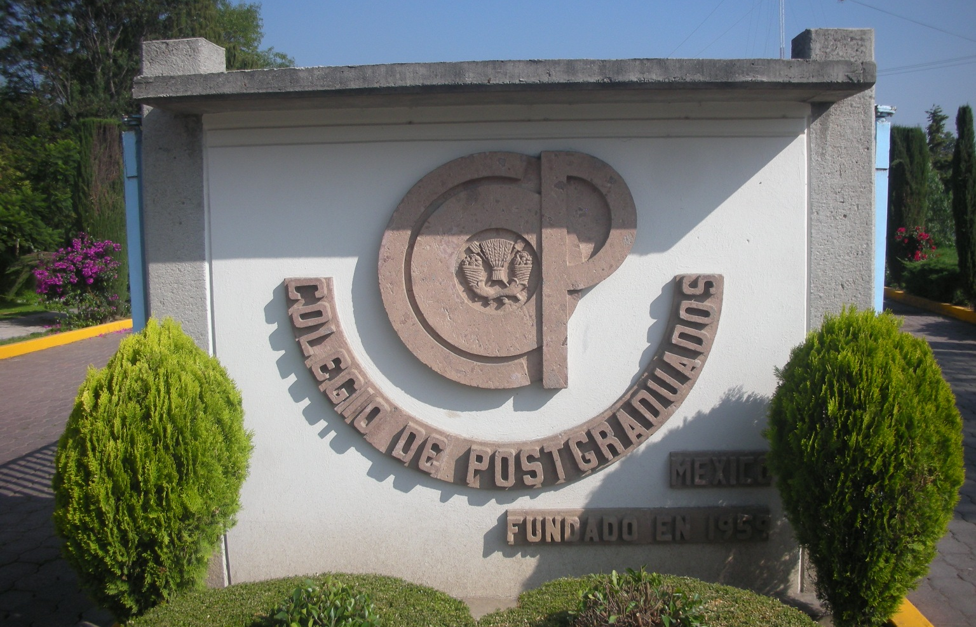
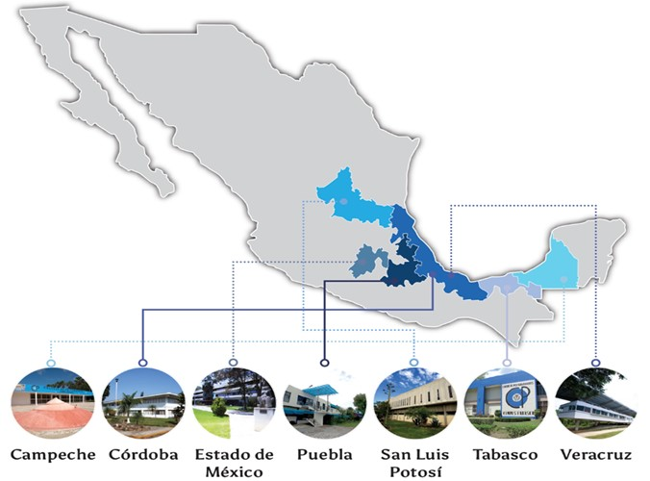
Colegio de Postgraduados has 7 Campus
The main one is called Campus Montecillo, in the State of Mexico, 60% of the activity happens there
Campus Puebla is the second in number of people and academic programs
Tabasco, Córdoba, San Luis Potosí, and Veracruz
Campeche is the newest Campus

Slide 6
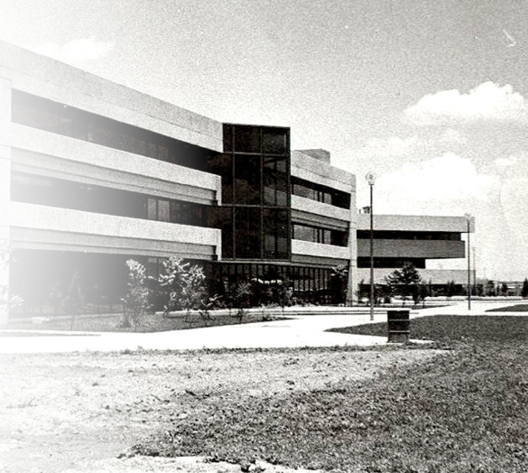
History
Colegio de Postgraduados was founded in 1959
It was a governmental initiative to establish an institution for the study of agricultural, forestry, and animal sciences at the graduate level and do research in these areas.
It was the first institution of its kind in Latin America
2007 marked the development of the first 5-year Strategic Plan, in line with the National Plan of Development and the Sectorial Program of the Ministry of Agriculture.
Our editorial house “Editorial Colegio de Postgraduados” began developing the “Basic Library of Agriculture” to cover the Spanish- speakers market in Latin America and Spain.

Slide 7
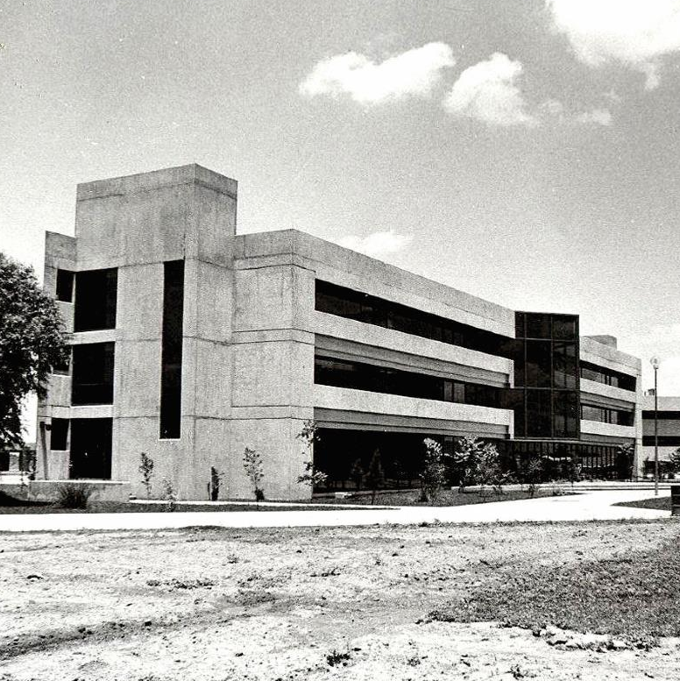
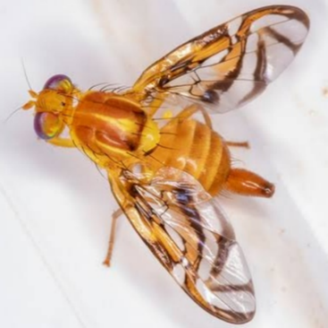
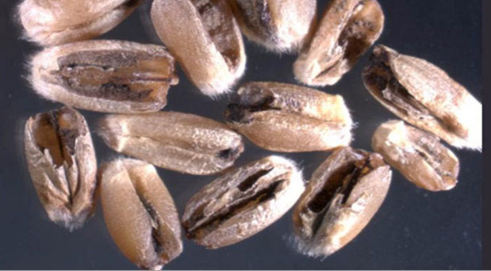
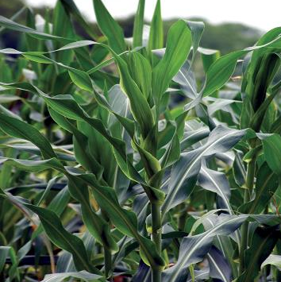
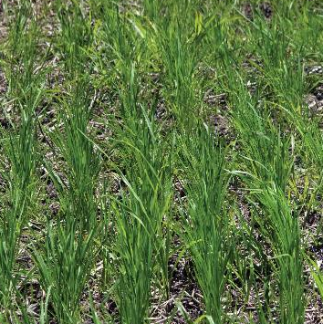
Pioneering Graduate Programs (1959)
ENTOMOLOGY
PHYTOPATHOLOGY
EDAPHOLOGY
(SOIL SCIENCES)
PLANT GENETICS

Slide 8
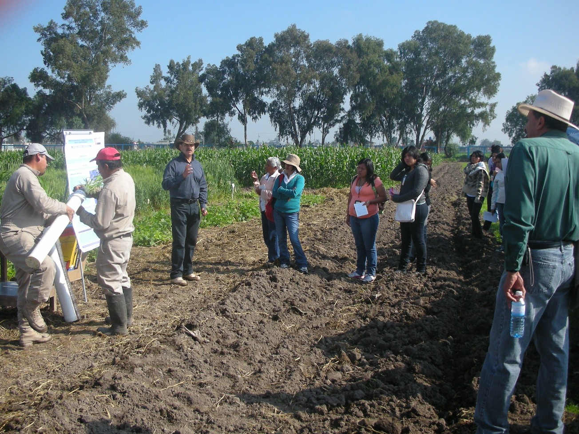
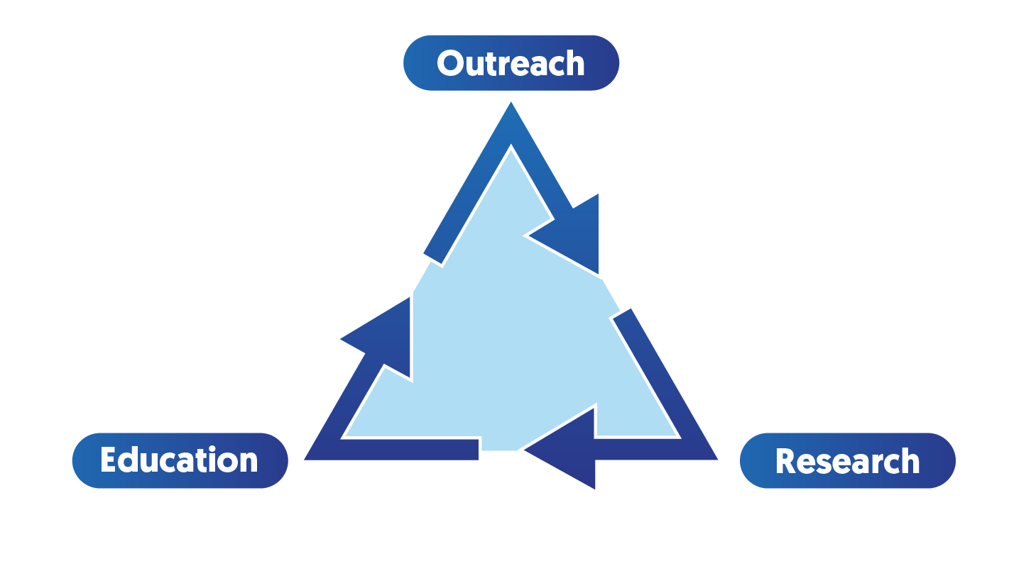
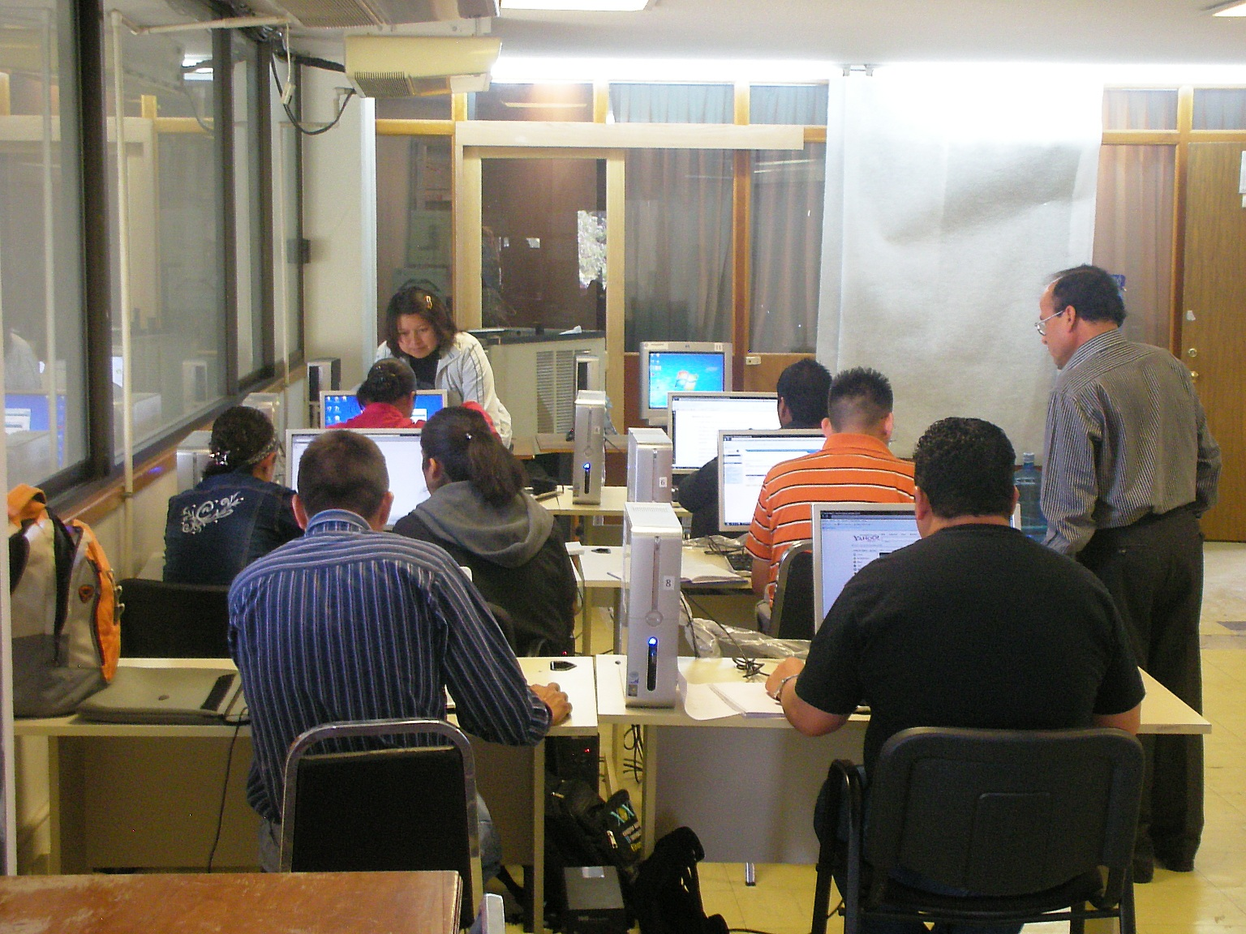
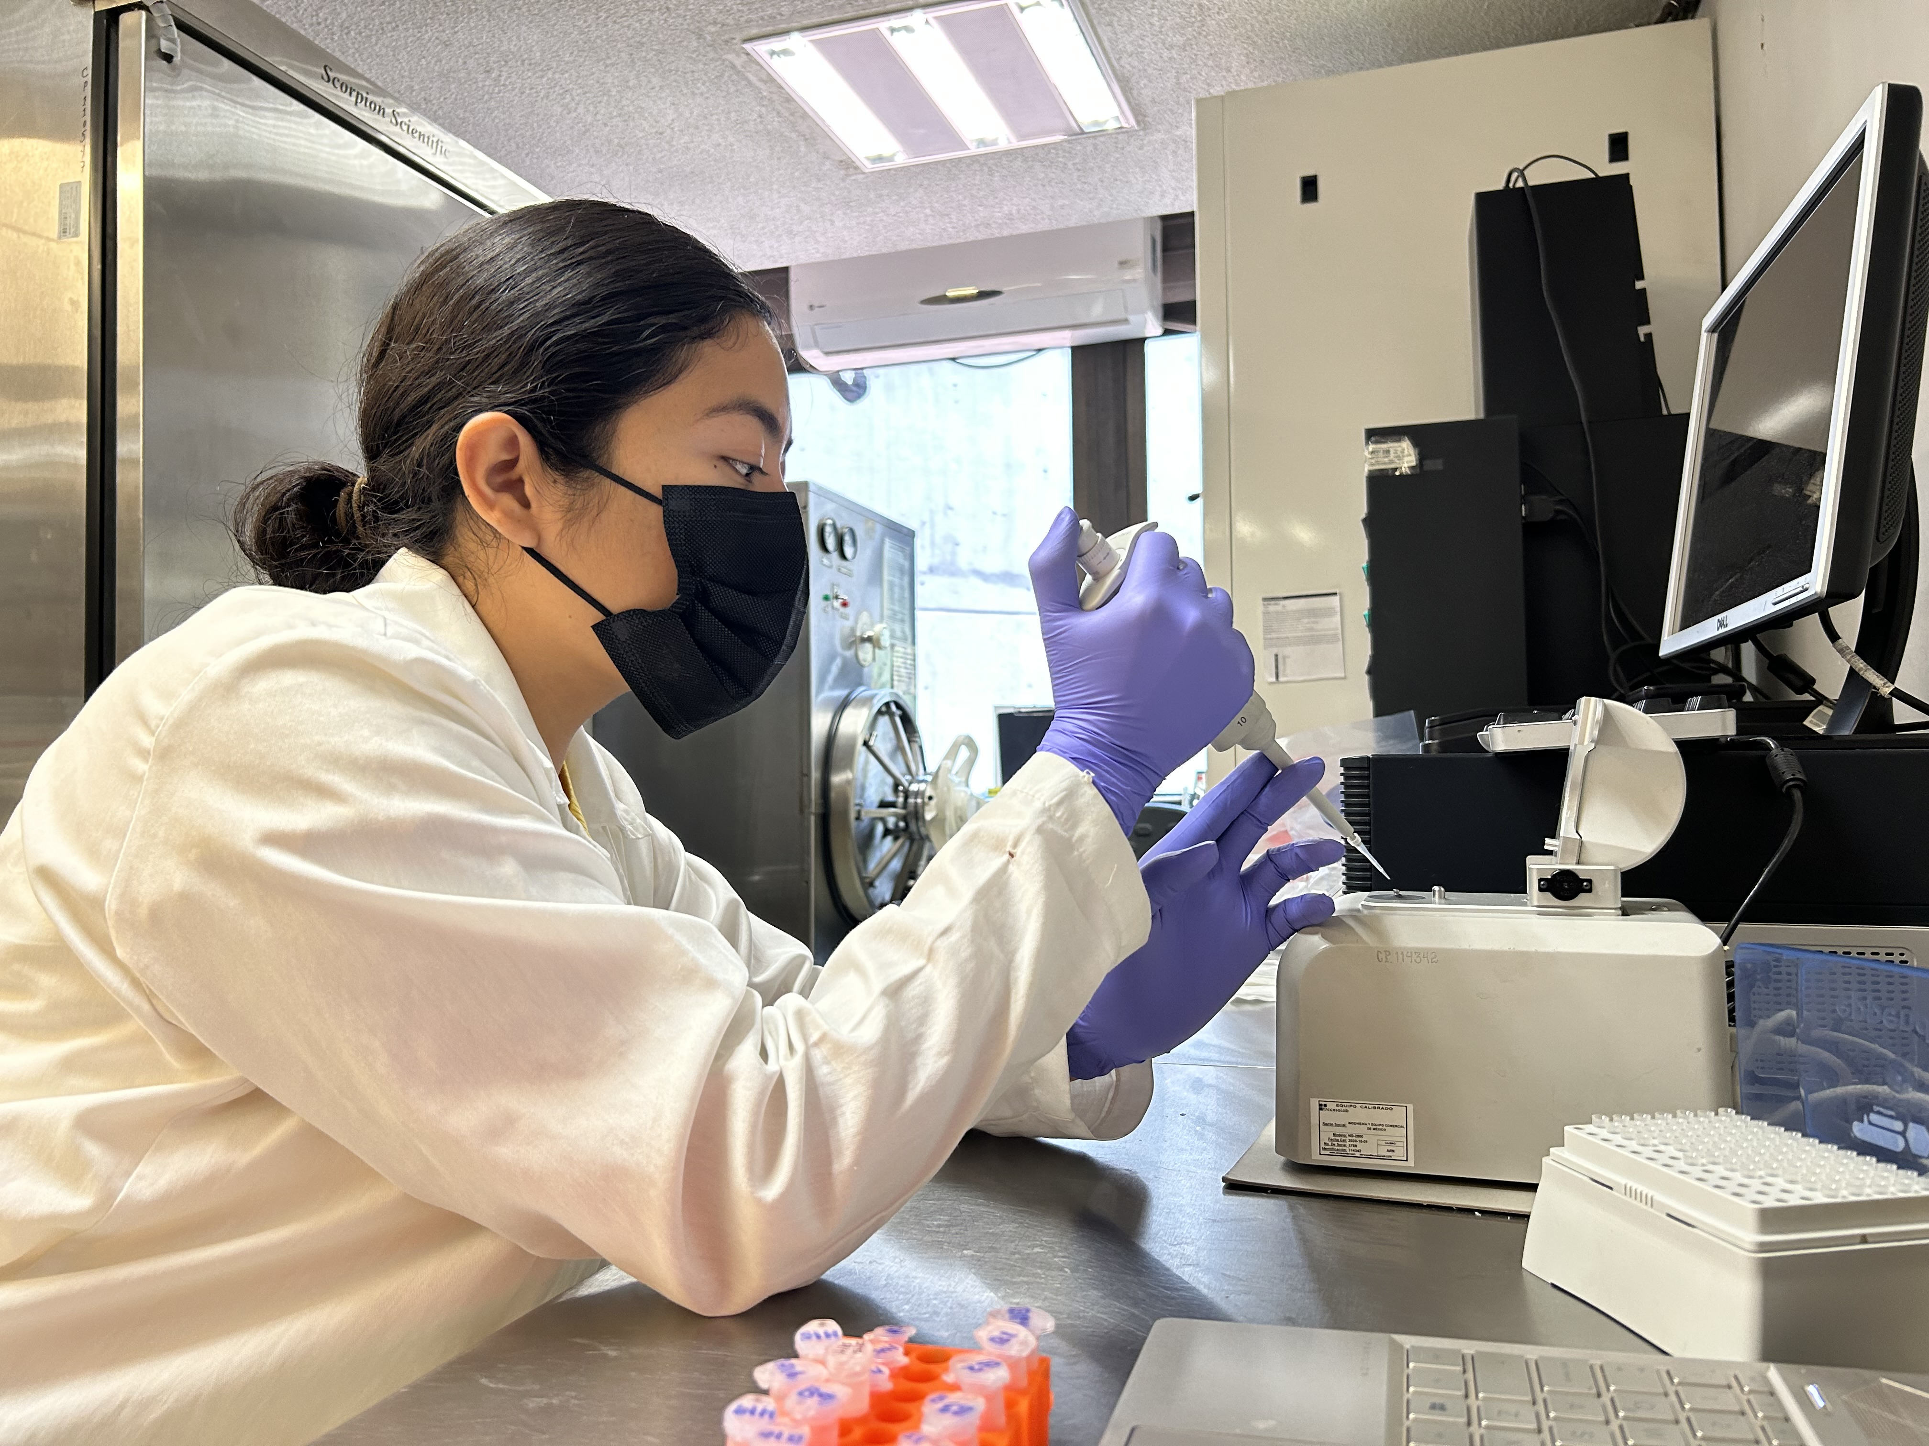
The three fundamental areas
of Colpos are:
Historically, plant protection specialists have participated as part of several NAPPO expert groups, such as:
1) Regulation of introduction of exotic species, acting as biological control agents
2) Methyl bromide alternatives

Slide 9
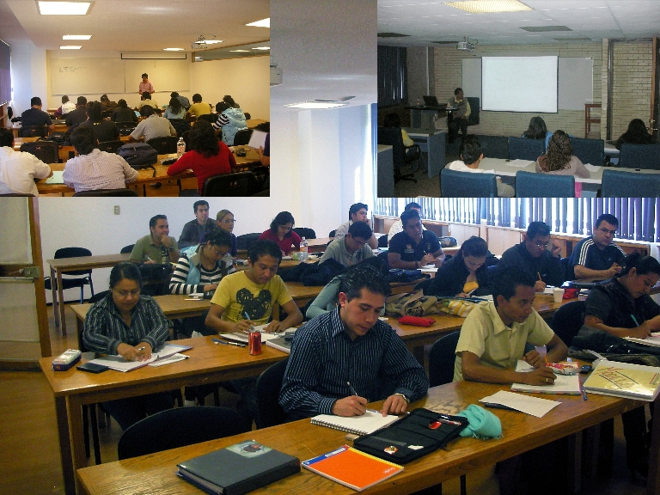
Education
1 Specialization, 19 Masters and 15 Doctoral programs are offered by our Institution
Majority of educational programs offer non-refundable scholarships paid by the Mexican Government
Main topics covered:
Plan protection, Agro-ecology
Genetics, Seed production,
Fruticulture, Botany, Forestry
Soil and Water sciences
Animal husbandry, Wildlife management
Innovation in natural resources
Tropical Agroecosystems
Rural development, Gender
Among others

Slide 10

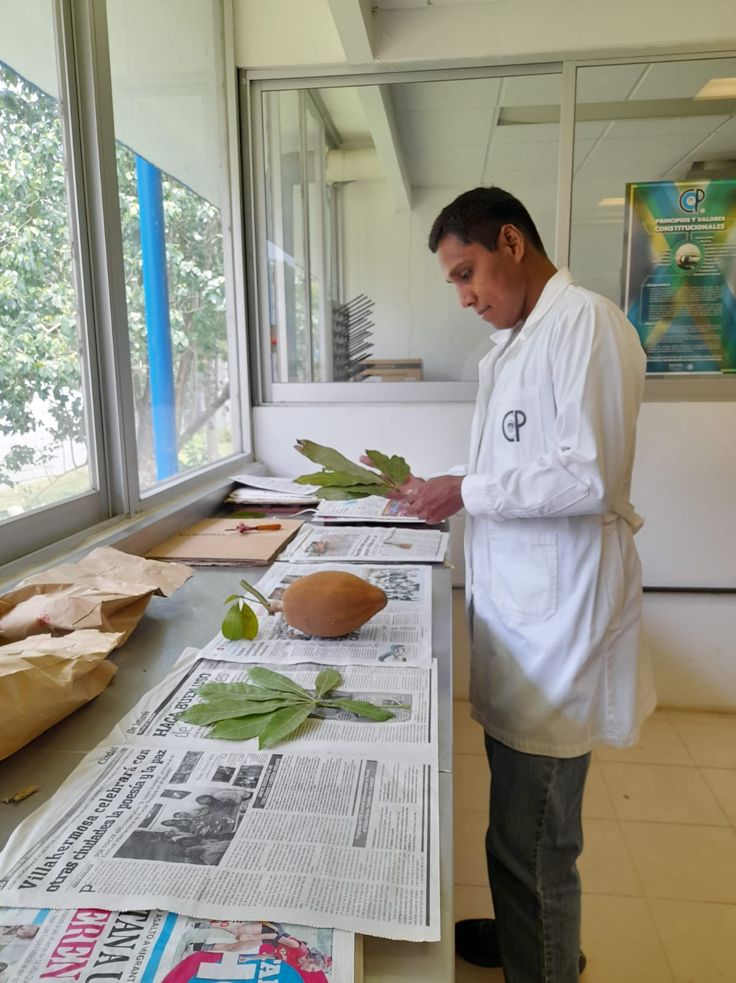
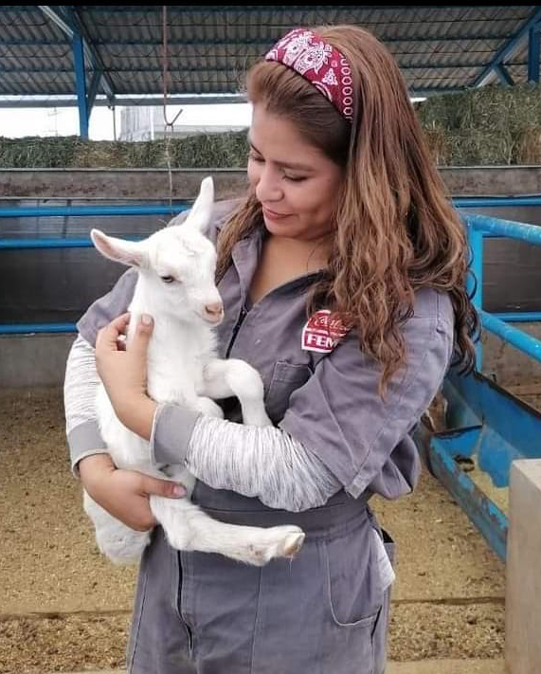
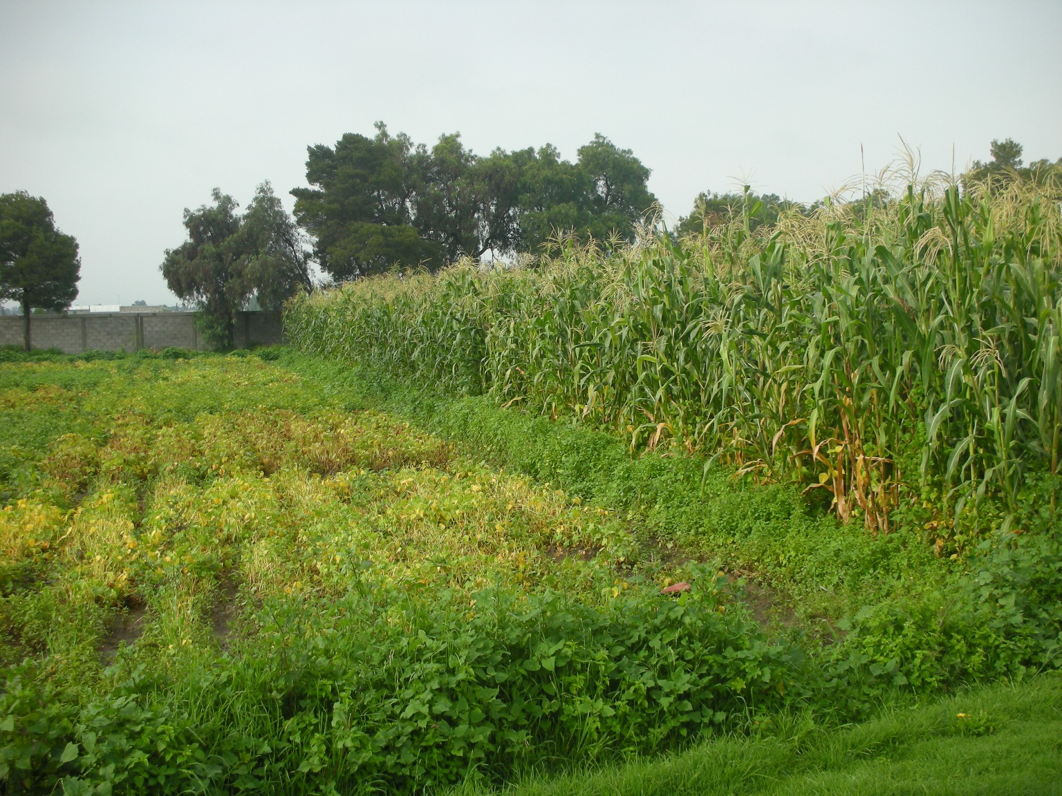
Research
Research organization is based on Lines of Generation
and Application of Knowledge (LGAC).
Currently, 64 LGACs group research teams focusing on specific topics.
1340 research projects are in progress, most associated to Master and Doctoral Thesis

Slide 11
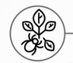
Papers published by importance of the topic
4th most important topic: Entomology & Phytopathology 10%
OTHERS:
AGRO-INDUSTRIAL PROCESSES, EDIBLE FUNGUS, CLIMATE AND ENERGY, AGROECOSYSTEMS, A QUACULTURE AND FISHERIES.

Slide 12
Relative importance of current research topics

Slide 13
Research topics of projects being at the Colegio de Postgraduados

Slide 14
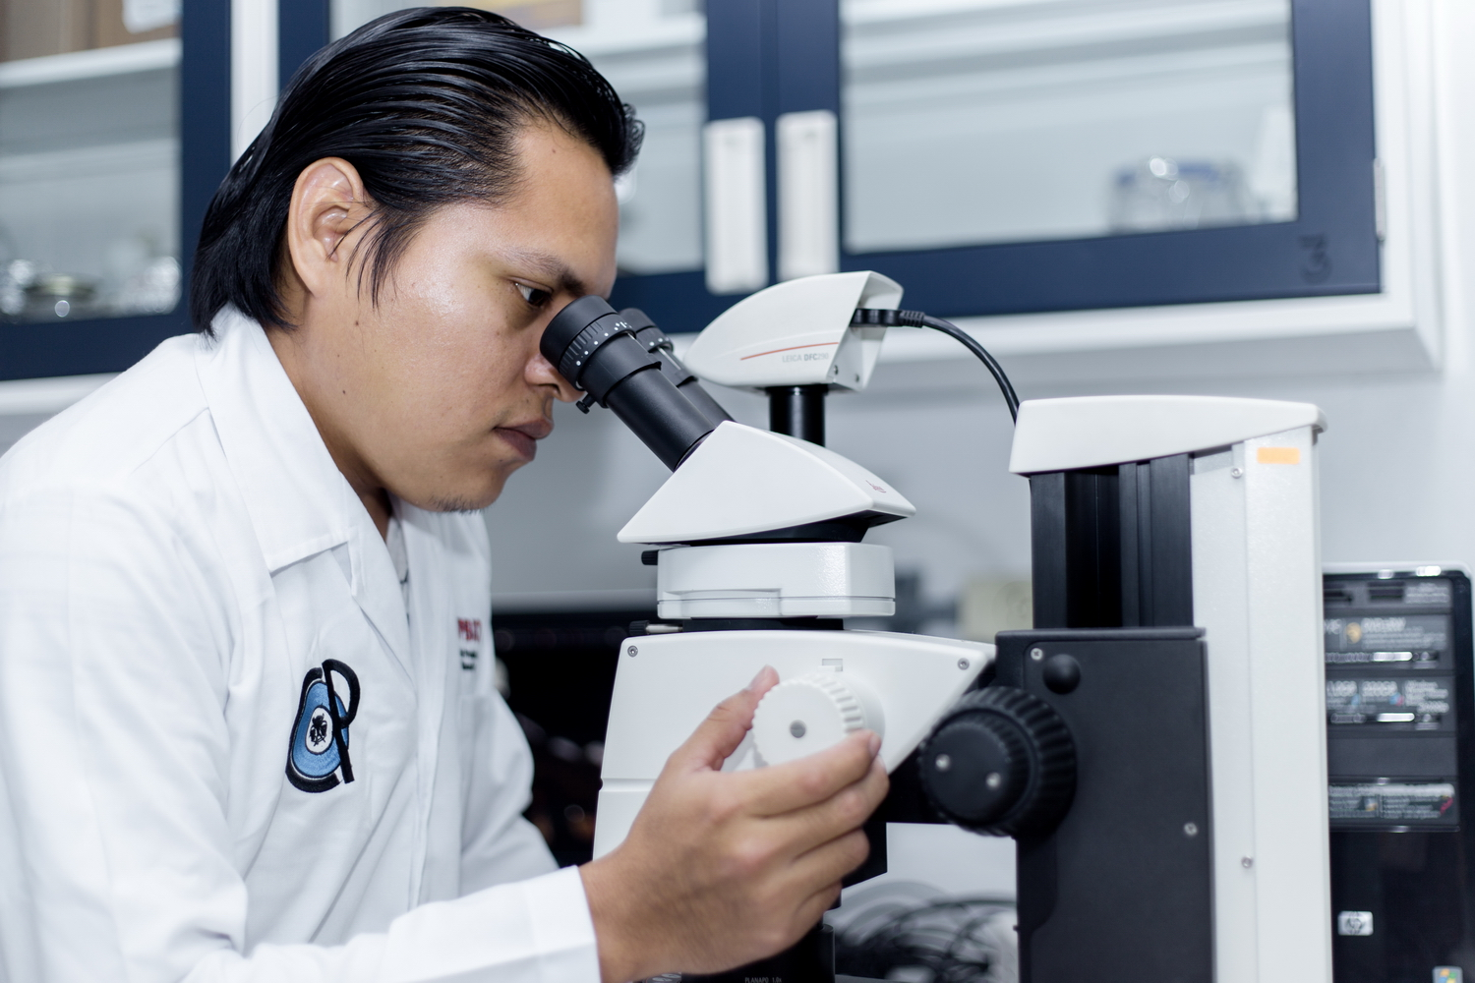
Classification of topics by Institutional Research Axes
RESEARCH INSTITUTIONAL AXES | NUMBER OF RESEARCH PROJECTS | PERCENTAGE | RESEARCH TOPICS
AGRICULTURE | 726 | 52 | INDUSTRIAL CROPS, LIVESTOCK PRODUCTION, FRUIT TREES AND BERRIES, ORNAMENTALS, BASIC GRAINS, AQUACULTURE AND FISHERIES, AGROECOSYSTEMS AND VEGETABLES, FOREST RESOURCES
ENVIRONMENT | 429 | 31 | WATER AND SOIL RESOURCE, CLIMATE AND ENERGY, EDIBLE FUNGI, WILDLIFE, ENTOMOLOGY & PHYTOPATOLOGY (PLANT PROTECTION)
SOCIETY | 242 | 17 | COMMUNITY DEVELOPMENT AND RURAL WELFARE, STATISTICS
TOTAL | 1,397 | 100%
7 %
91
research projects

Slide 15
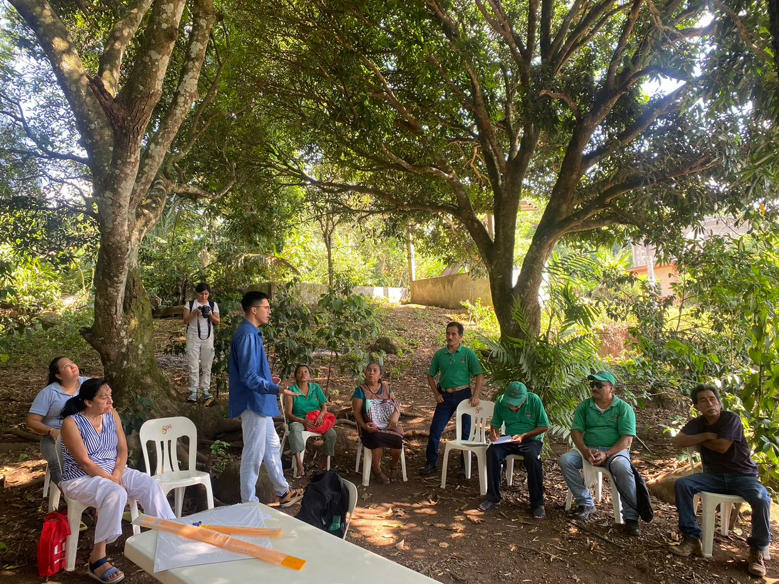
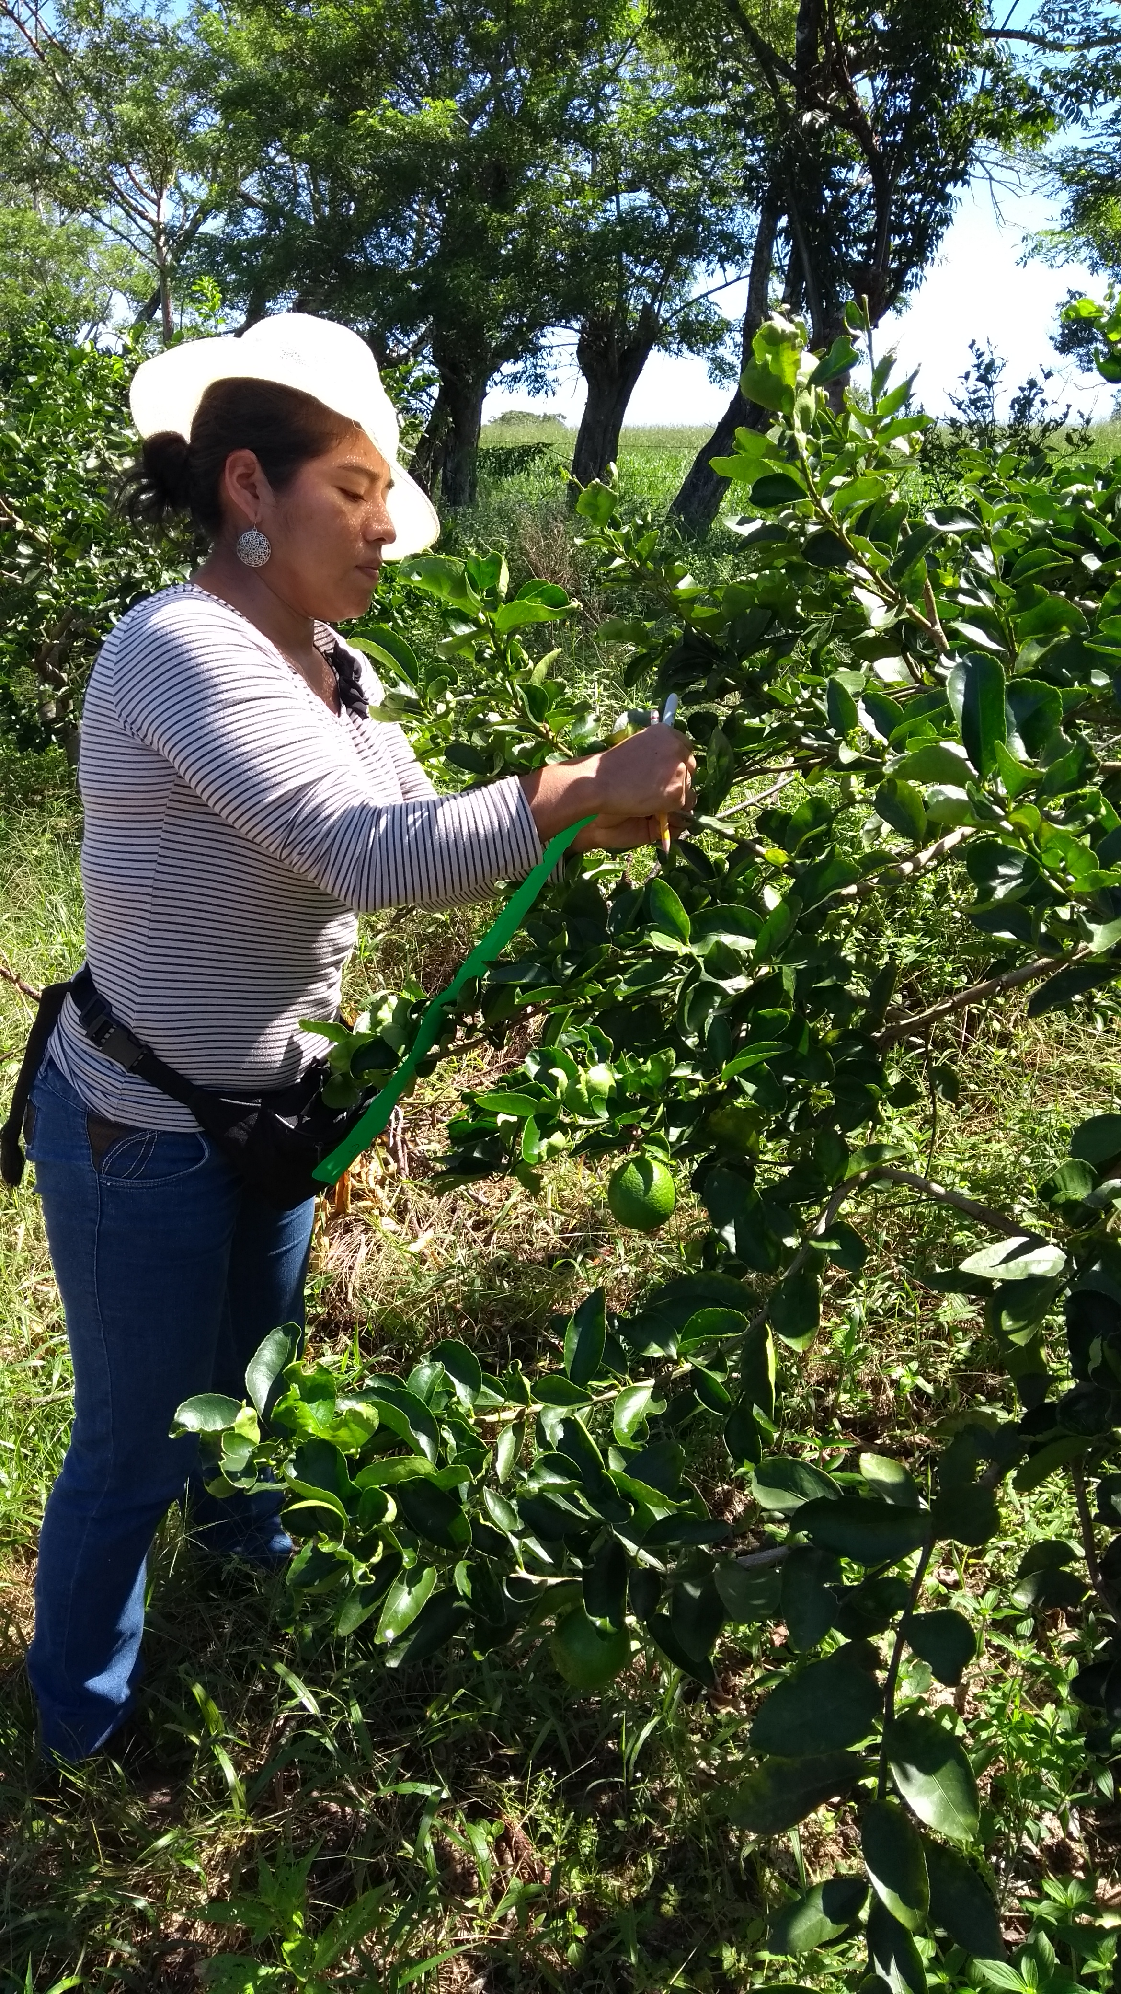
Outreach
We are focused on increasing the impact of our presence with growers in the field.
We are also looking actively to increase our international presence

Slide 16
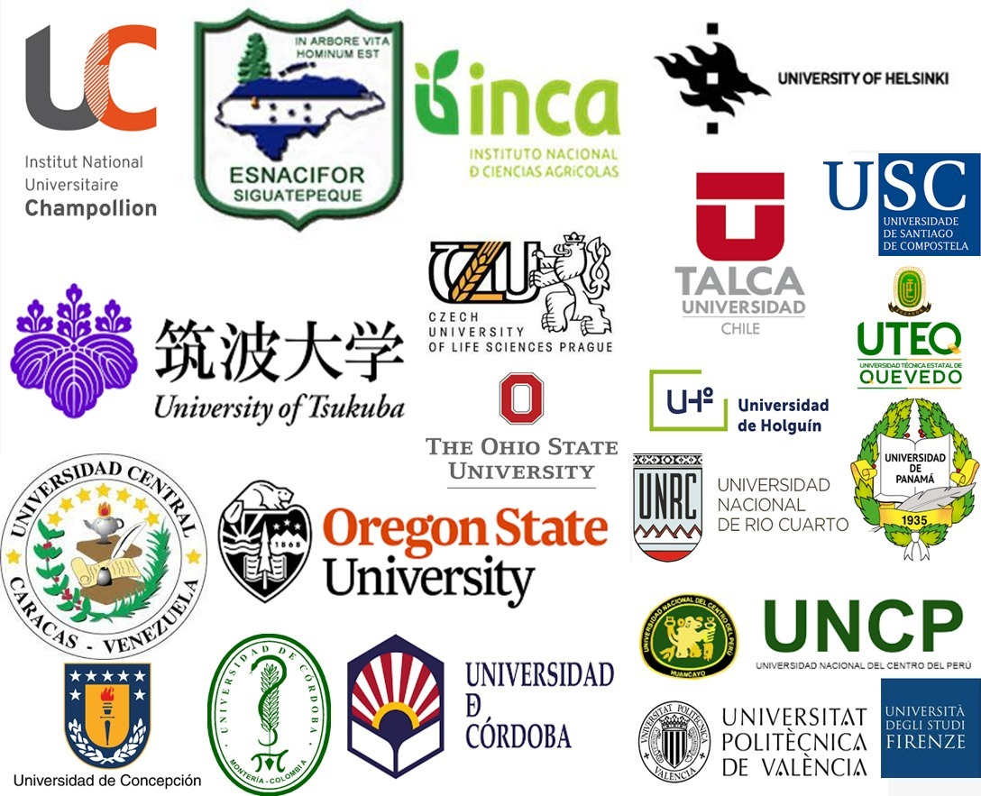
29 International MoU
1 | Carta Acuerdo de Compromiso Conjunto COLPOS - FAO - FGUPM
2 | Institute Champollion
3 | Escuela Nacional de Ciencias Forestales ESNACIFOR
4 | Instituto Nacional de Ciencias Agrícolas
5 | Universidad Nacional Pedro Ruiz Gallo
6 | Universidad de El Salvador
7 | Universidad de Tsukuba
8 | Universidad de Praga CULS
9 | Universidad Oregón State
10 | The Ohio State University
11 | Universidad Central de Venezuela
12 | Universidad de Concepción
13 | Universidad de Córdoba
14 | Universidad de Córdoba
15 | Universidad de Helsinky
16 | Universidad de Talca
17 | Universidad de Holguín
18 | Universidad Nacional Rio Cuarto
19 | Universidad Nacional del Centro de Perú
20 | Universidad Politécnica de Valencia
21 | Universidad Santiago de Compostela
22 | Universidad Técnica Estatal de Quevedo
23 | Colegio de Ingenieros Agrónomos de Guatemala
24 | Universidad de Panamá
25 | Universidad de Sevilla
26 | Universidad de la Cuenca del Plata
27 | Centro Agronómico Tropical de Investigación y
28 | Enseñanza CATIE Universidad de Florencia, Italia
29 | Universidad de Nebraska

Slide 17
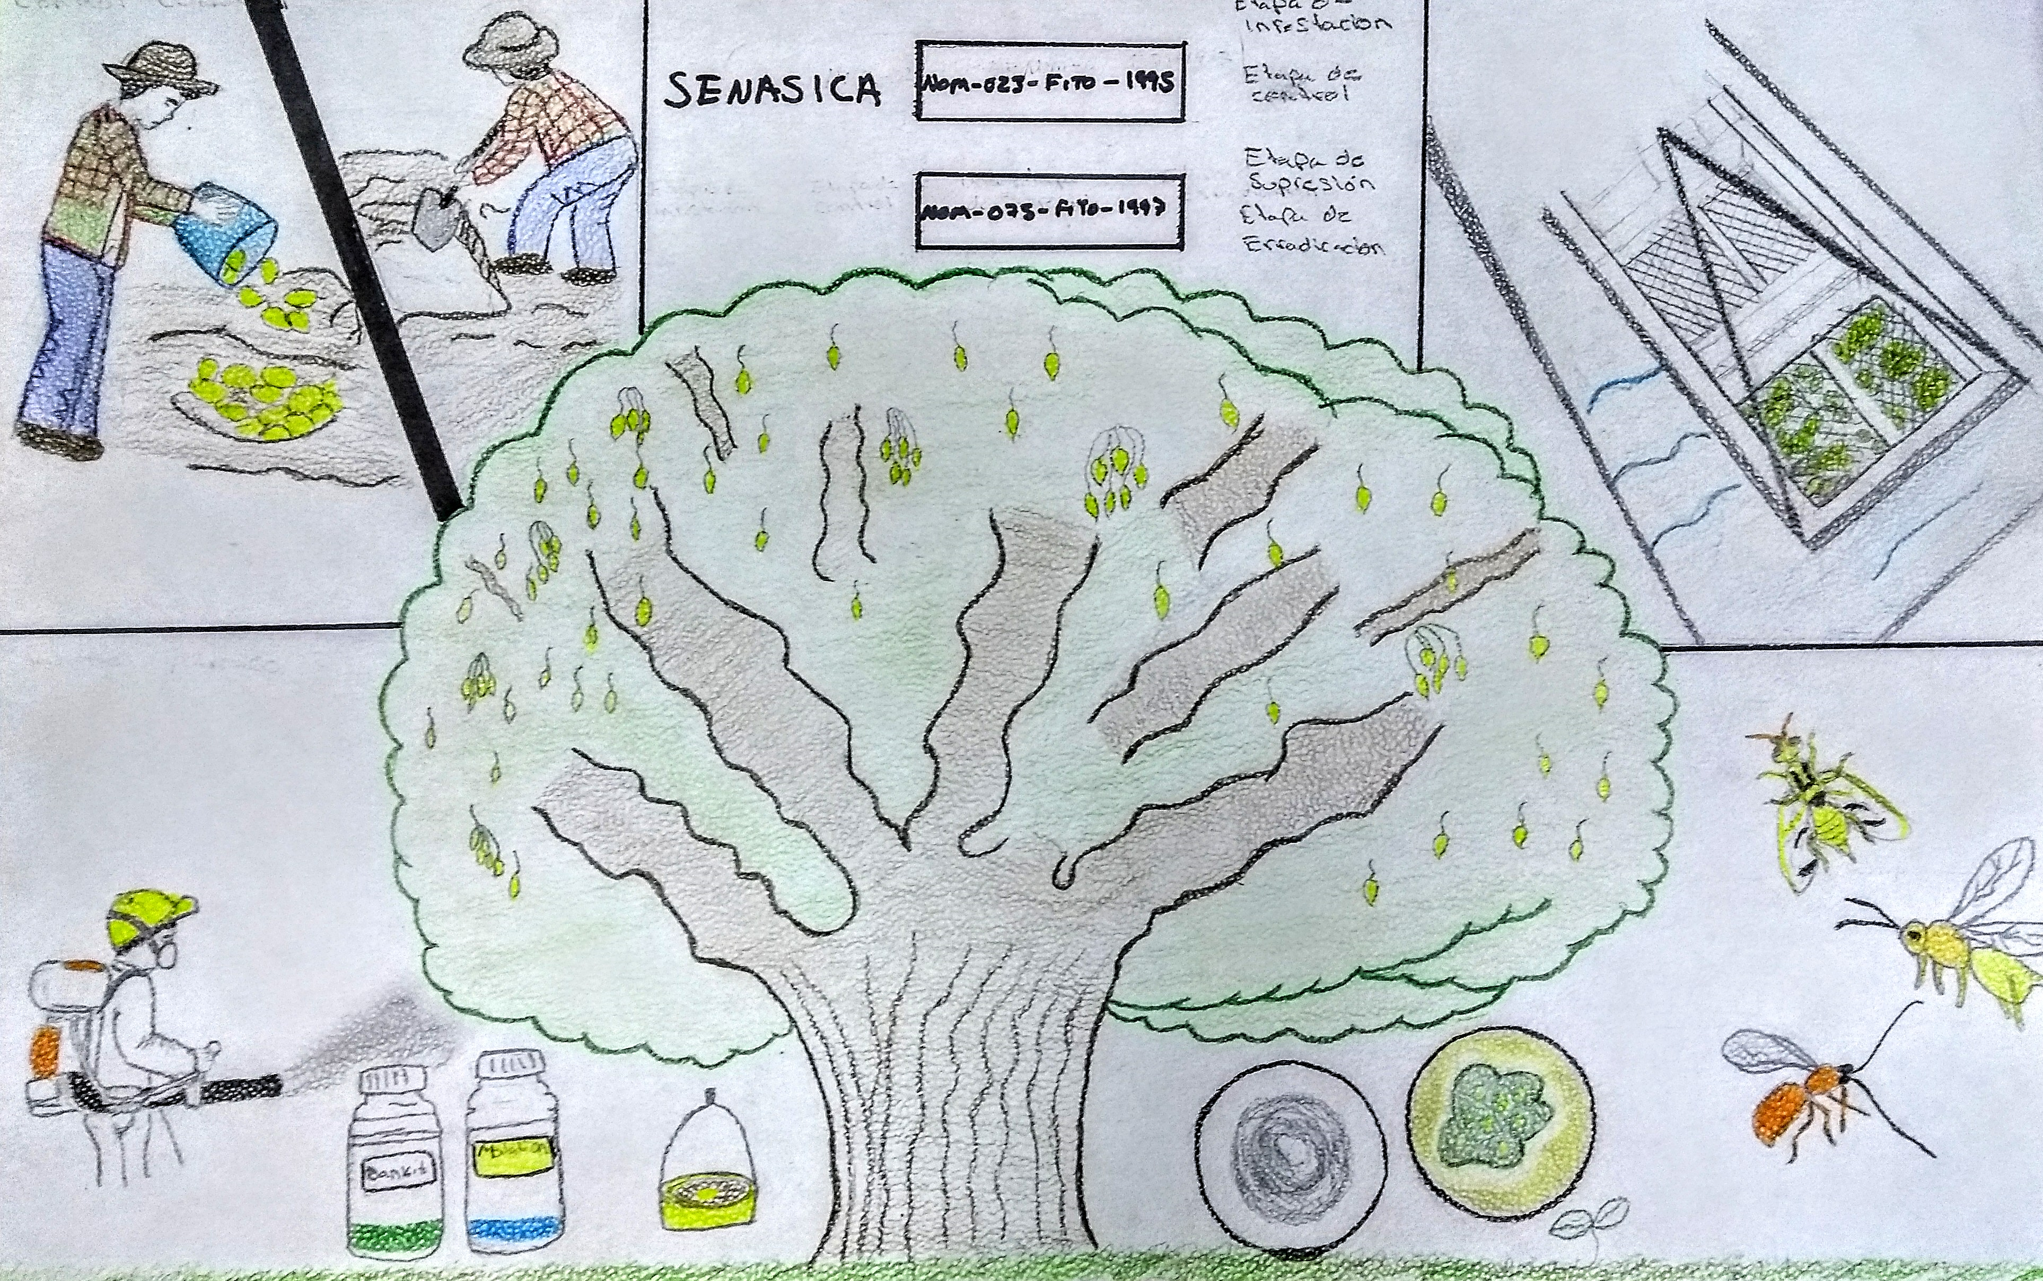
The ever-growing NAPPO agenda might be covered by collaborative research with Colpos and other actors, working at the same time with our own national agenda, such as:
Substitution of Highly Dangerous Pesticides, including methyl bromide and glyphosate
Climate change effect on demography, risk, and management of quarantine pests
Evaluation of the risk associated with eventual introductions of pests to the North American region, as related to international trade.
Available resources to study regional pests might be in place once Colegio and NAPPO collaborate in important topics
Funding can also be provided by the industry that receives the benefits of research, combined with our own funds.
Quarantine pests are a national priority.

Slide 18
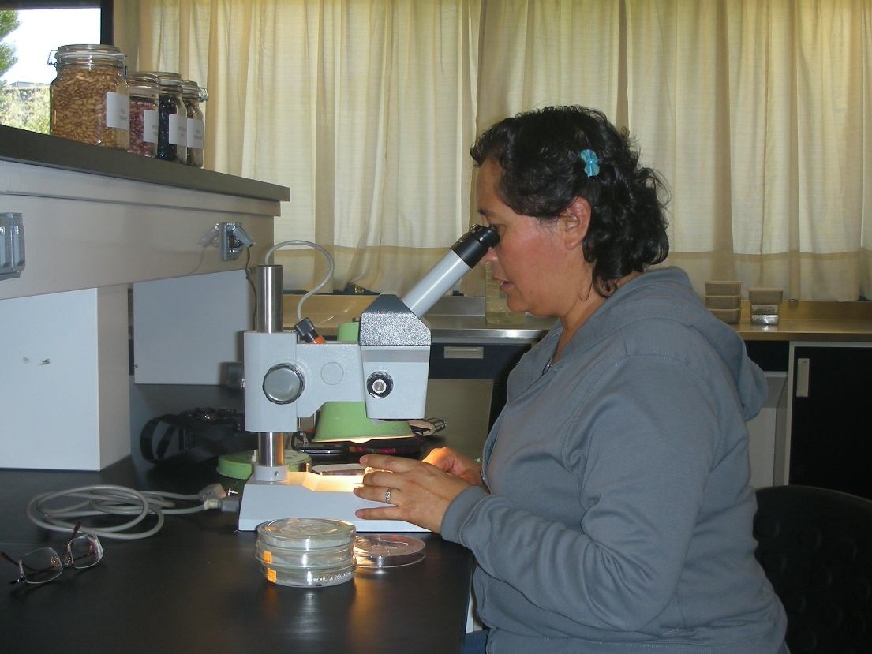
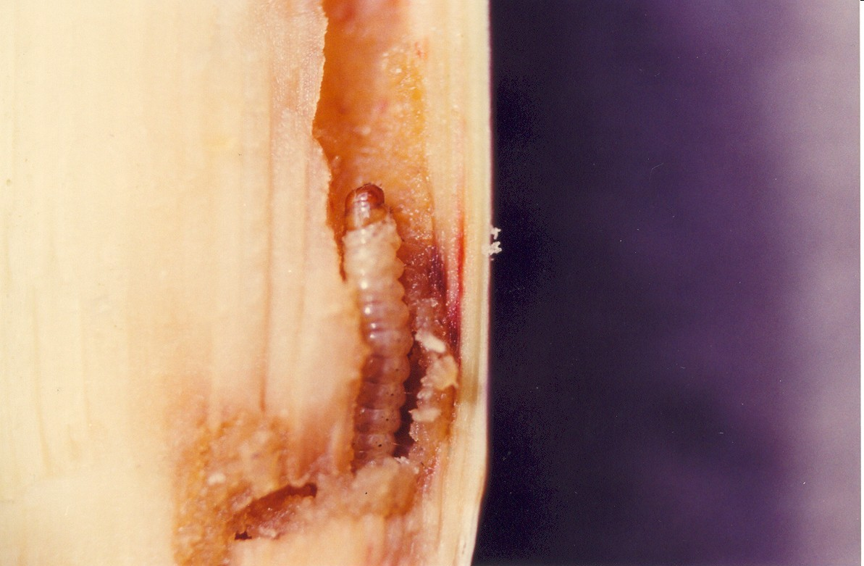
I ask this distinguished auditorium, NAPPO, and the participating industry, to take a moment to identify Colegio de Postgraduados as a long- term partner.
Based on our current capacities, we are willing to respond positively to the common needs identified by all participants.
We are particularly interested in moving our younger scientists through innovative processes in those topics relevant to North America in quarantine issues.

Slide 19
Topics to collaborate
Active participation in reviewing NAPPO Regional Standards for Phytosanitary Measures
Expert opinion on the importation or movement of biological control agents
Discuss, plan, and elaborate grants on pests of regional importance:
Avocado branch borer and the stone borers
Native and exotic fruit flies
Corn leafhopper
ID and risk analysis of intercepted pests in containers on the borderlines
Implement surveillance programs on specific pests and diseases to prevent their arrival.

Slide 20
Thank you for your attention
Juan A Villanueva-Jimenez, PhD
General Director
javj@colpos.mx
+52 595 95 20200 ext. 1001 to 1004

