Slide 1
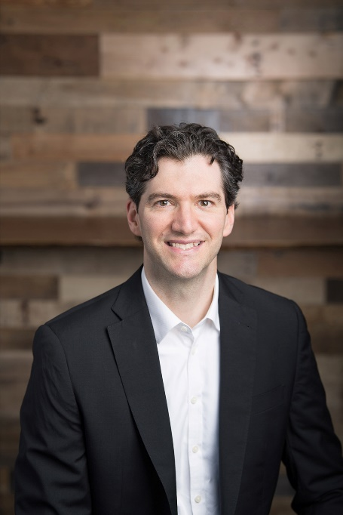
US IAG UPDATE
Brad Gething, PhD
NWPCA Vice President
of Science & Technology

Slide 2
My Background
BS in Chemical Engineering, MS and PhD in Materials
Joined NWPCA in 2013.
Prior to that worked as a graduate research assistant developing the dielectric heat treatment schedule for ISPM 15
Standing member - NAPPO Forestry Expert Working Group International Forestry Quarantine Research Group (IFQRG)
Member of IPPC WG on ISPM 15 guidance

Slide 3
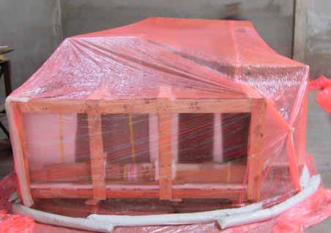
Methyl Bromide Alternative
Many industries continue to depend on Methyl Bromide to effectively eliminate phytosanitary risks.
Finding alternatives is important, but so is assurance that they are commercially viable.

Slide 4
System Approaches
ISPM 38 Annex
Seeds
Fruit Tree Protocol
Washington State → British Columbia

Slide 5
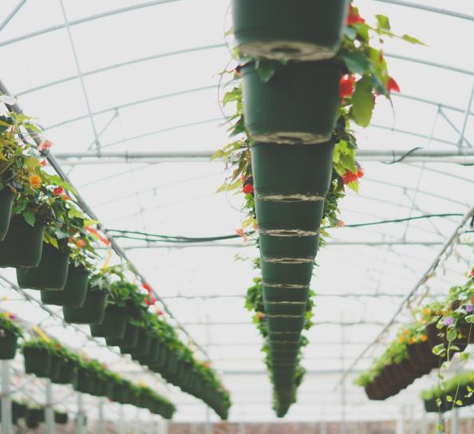
Greenhouse/Nursery
Areas of emphasis:
Box Tree Moth
Ralstonia
Farm Bill – Plant Protection Act

Slide 6
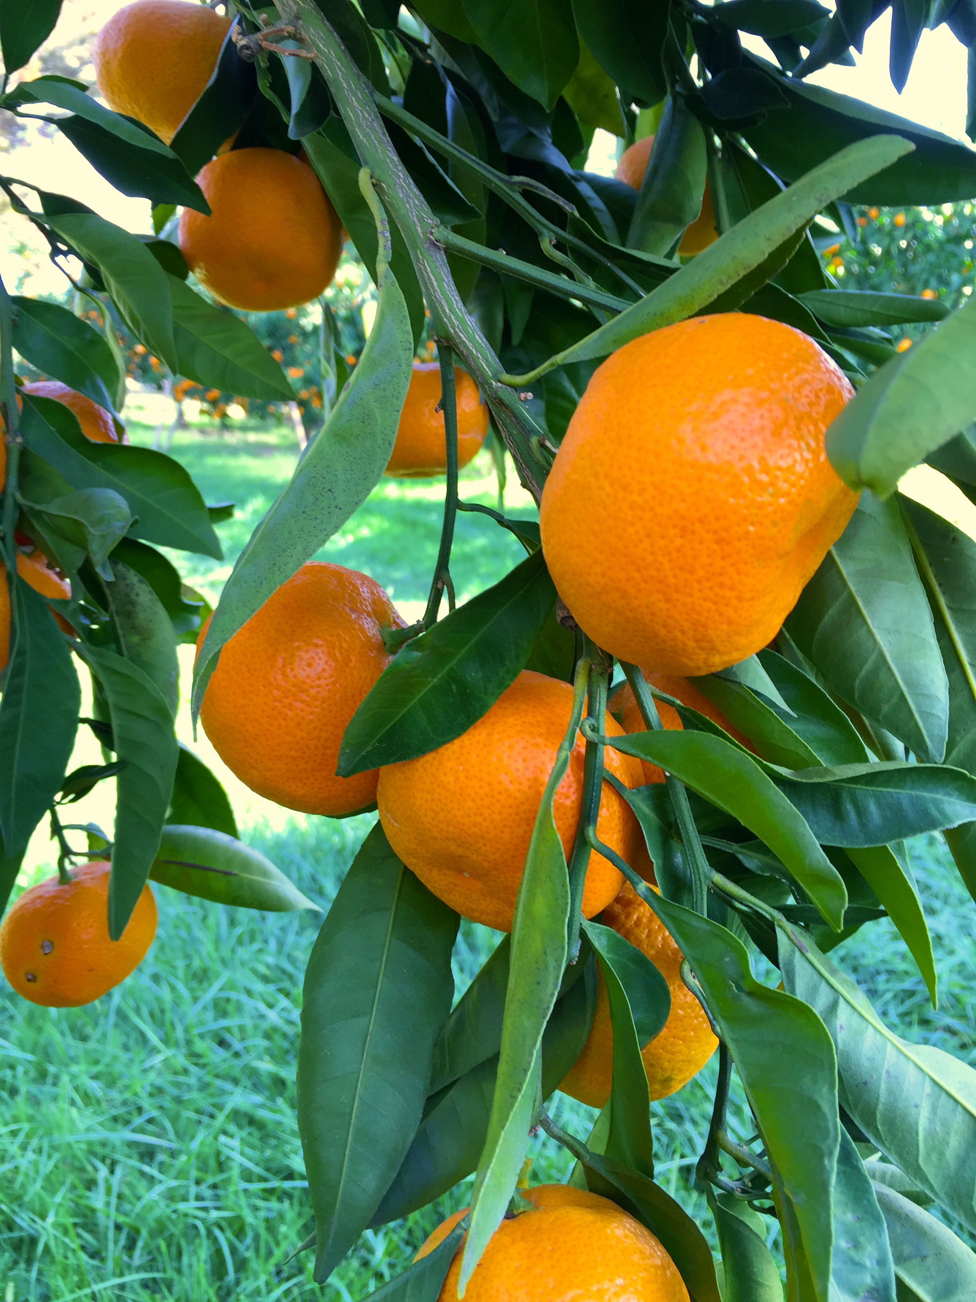
Citrus
Areas of emphasis:
-Citrus Leprosis Disease
-Citrus Greening Disease
Harmonization of maximum residue levels (MRLs) for pesticides

Slide 7
Seeds
Areas of emphasis:
Tomato brown rugose fruit virus (ToBRFV)
Corn seed to Chile
Industry Dynamics:
New regulation → Diagnostic Test → Attaining a phyto

Slide 8
Forestry
Continuous improvement of ISPM 15
-Confirmation of HT schedule (56ºC
for 30 minutes)
-Terminology
-Compliance Data

Slide 9
Recognition
Fan Wang-Cahill, USDA APHIS
Tyrone Jones, USDA APHIS
Jon Daniels, USDA APHIS
USDA APHIS export certification staff
OR & WA nursery certification staff
CFIA
Craig Regelbrugge, American Hort
Stephanie Dubon, USDA APHIS
All NAPPO Staff!!
Nedelka and Alonso

