Slide 1
NAPPO Strategic Plan
2022-2026
Stephanie Dubon
PPQ NAPPO Technical Director
October 22, 2024
2024 NAPPO Annual Meeting
Tucson, Arizona, USA

Slide 2

What is a Strategic Plan?
A document that outlines an organization’s goals, and the actions and resources needed to achieve those goals
It is the outcome of the strategic planning process, which helps organizations define their direction and allocate resources

Slide 3

History
2013 held a Strategic Review of NAPPO, which initiated a fresh look at NAPPO
  Strategic Goal Review
  Implementation Review
  Process Review
2013-2015 Plan
2016-2020 Plan
Covid – extended current plan
2022-2026 Plan

Slide 4
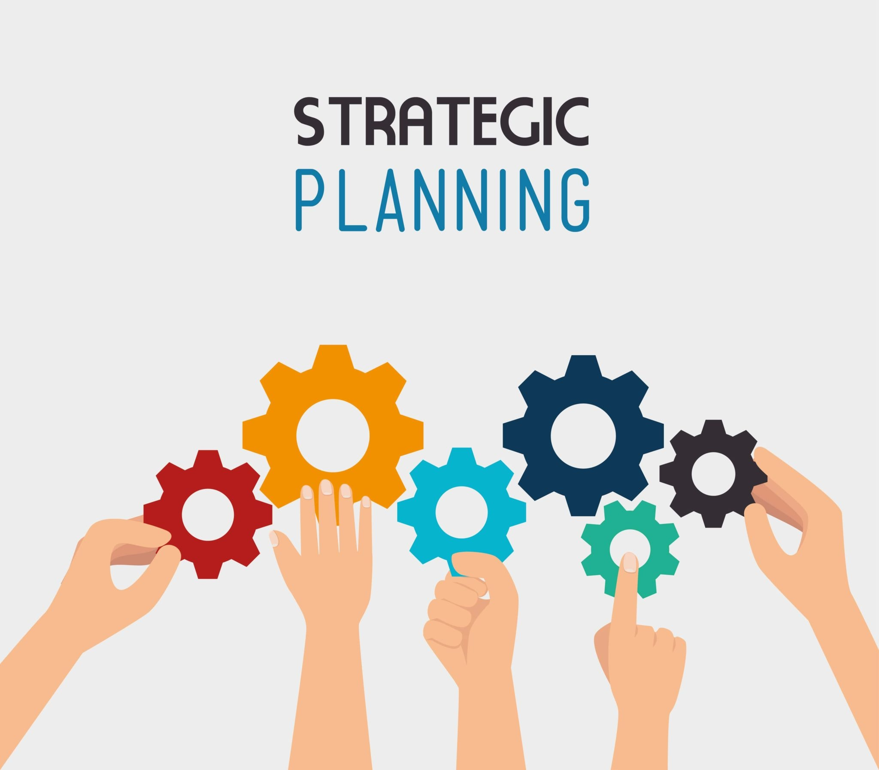
Preparations for the 2022-2026 Plan
How long would the plan be? 5 years? 10 years?
Who would develop the new plan? AMC? EC? Other?
Connection to the IPPC and the Strategic Framework 2020-2030
Outcomes of covid and trade and travel patterns had a large impact
Country Consultation – opportunity for all stakeholders to provide feedback

Slide 5
Current Strategic Plan 2022-2026
NAPPO Mission Statement
Provide a forum for public and private sectors in Canada, the United States, and Mexico to collaborate in the regional protection of agricultural, forest, other plant resources, and the environment, while facilitating safe trade.
Plant protection and trade facilitation are achieved through the development and implementation of science-based regional standards and other documents, ongoing dialogue and communication, and other plant protection activities directed towards preventing the introduction and spread of regulated plant pests.

Slide 6
Current Strategic Plan 2022-2026
NAPPO and its relationship to the International Plant Protection Convention (IPPC)
NAPPO is the regional plant protection organization (RPPO) for North America, established in accordance with the IPPC.
The NAPPO Strategic Plan is supportive of and consistent with the overarching objectives of the IPPC Strategic Framework (2020-2030).
In addition, the NAPPO Strategic Plan reflects the roles and functions of RPPOs as defined in Article IX of the Convention.

Slide 7
Current Strategic Plan 2022-2026
Identified Challenges and Opportunities
Responding and adapting to rapidly changing trade and travel patterns.
Addressing and responding to threats to biodiversity and the environment, including impacts of climate change.
Seeking new alternatives to traditional quarantine treatments such as methyl bromide (MeBr).
Staying informed of and adopting scientific advancements and technological innovations.
Improving stakeholder awareness and support for phytosanitary services through effective and targeted communications and training.

Slide 8
Current Strategic Plan 2022-2026
Strategic Goals
Protect North American plant resources, including the environment, from the introduction and spread of regulated plant pests.
Facilitate safe trade on the basis of science-based regional standards and harmonized phytosanitary measures.
Promote and maintain active industry and stakeholder engagement in NAPPO activities.
Contribute leadership in the international phytosanitary community.
Promote and maintain the robust scientific and technical basis of NAPPO activities.
Continue improving NAPPO communication and outreach.

Slide 9
NAPPO Strategic Plans over the last decade
Goals | 2013-2015 | 2016-2020 | 2022-2026
1. Protect North American plant resources, including the environment, from the introduction and spread of regulated plant pests. | X | X | X
2. Facilitate safe trade on the basis of science-based regional standards and harmonized phytosanitary measures. | X | X | X
3. Promote and maintain active industry and stakeholder engagement in NAPPO activities. | X | X | X

Slide 10
NAPPO Strategic Plans over the last decade
Goals | 2013-2015 | 2016-2020 | 2022-2026
4. Contribute leadership in the international phytosanitary community | X | X | X
5. Promote and maintain the robust scientific and technical basis of NAPPO activities | X | X | X
6. Continue improving NAPPO communication and outreach | X | X | X

Slide 11
NAPPO Strategic Plans over the last decade
 | 2013-2015 | 2016-2020 | 2022-2026
Adopt a focused, priority and project-driven approach, within available resources | X
Modernize the business practices of NAPPO | X

Slide 12
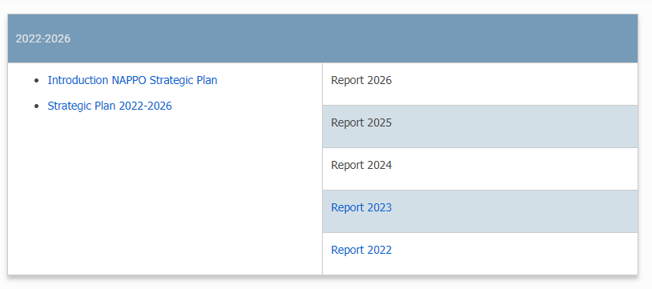
Annual Report on the Strategic Plan
https://nappo.org/english/governance/strategic-plan

Slide 13
Questions? / ¿Preguntas?

