Slide 1
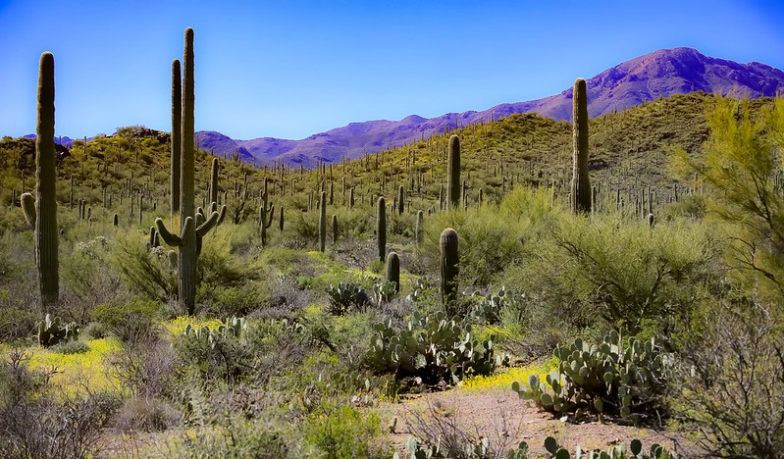
U.S. Experience with the Use of a Systems Approach for Import Purposes
The beauty of the Sonoran Desert. Tucson, Arizona.CC BY 2.0
Fresh Dragon Fruit Imports from Central America
NAPPO 2024 – Tucson, Arizona

Slide 2

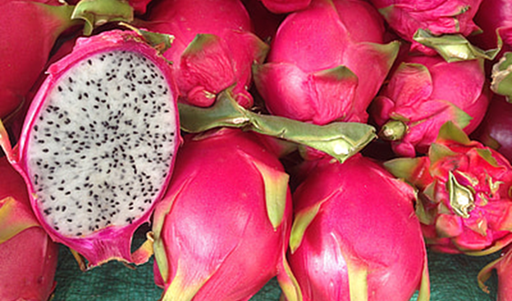
The United States uses
Multistep process for market access
ISPM standards
Stakeholder feedback on pest risk analysis (PRA)
PRA to develop risk management measures
Developing phytosanitary import requirements
© Raimond Spekking / CC BY-SA 4.0 (via Wikimedia Commons)
Key methodologies, frameworks, and strategies employed
PRA standards in ISPM 2, ISPM 11
Systems approach standards in ISPM 14 and ISPM 35 (fruit flies)
FAO/IAEA manual Trapping Guidelines for Area-wide Fruit Fly Programmes
Stakeholder/country consultation
Operational work plan
Creative Commons Zero - CC0

Slide 3
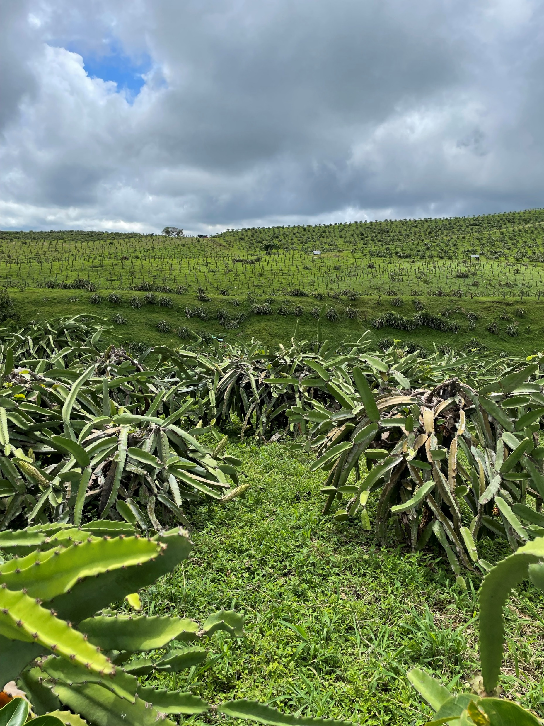
Overview of systems approach
Commercially produced fresh dragon fruit (Selenicereus spp.) from Central America to the continental United States
Pests that require risk mitigation measures:
Anastrepha ludens (Diptera: Tephritidae)
Ceratitis capitata (Diptera: Tephritidae)
PRA identified two quarantine pests that are highly likely to follow the import pathway
Photo by Marco Gonzalez – USDA_APHIS

Slide 4
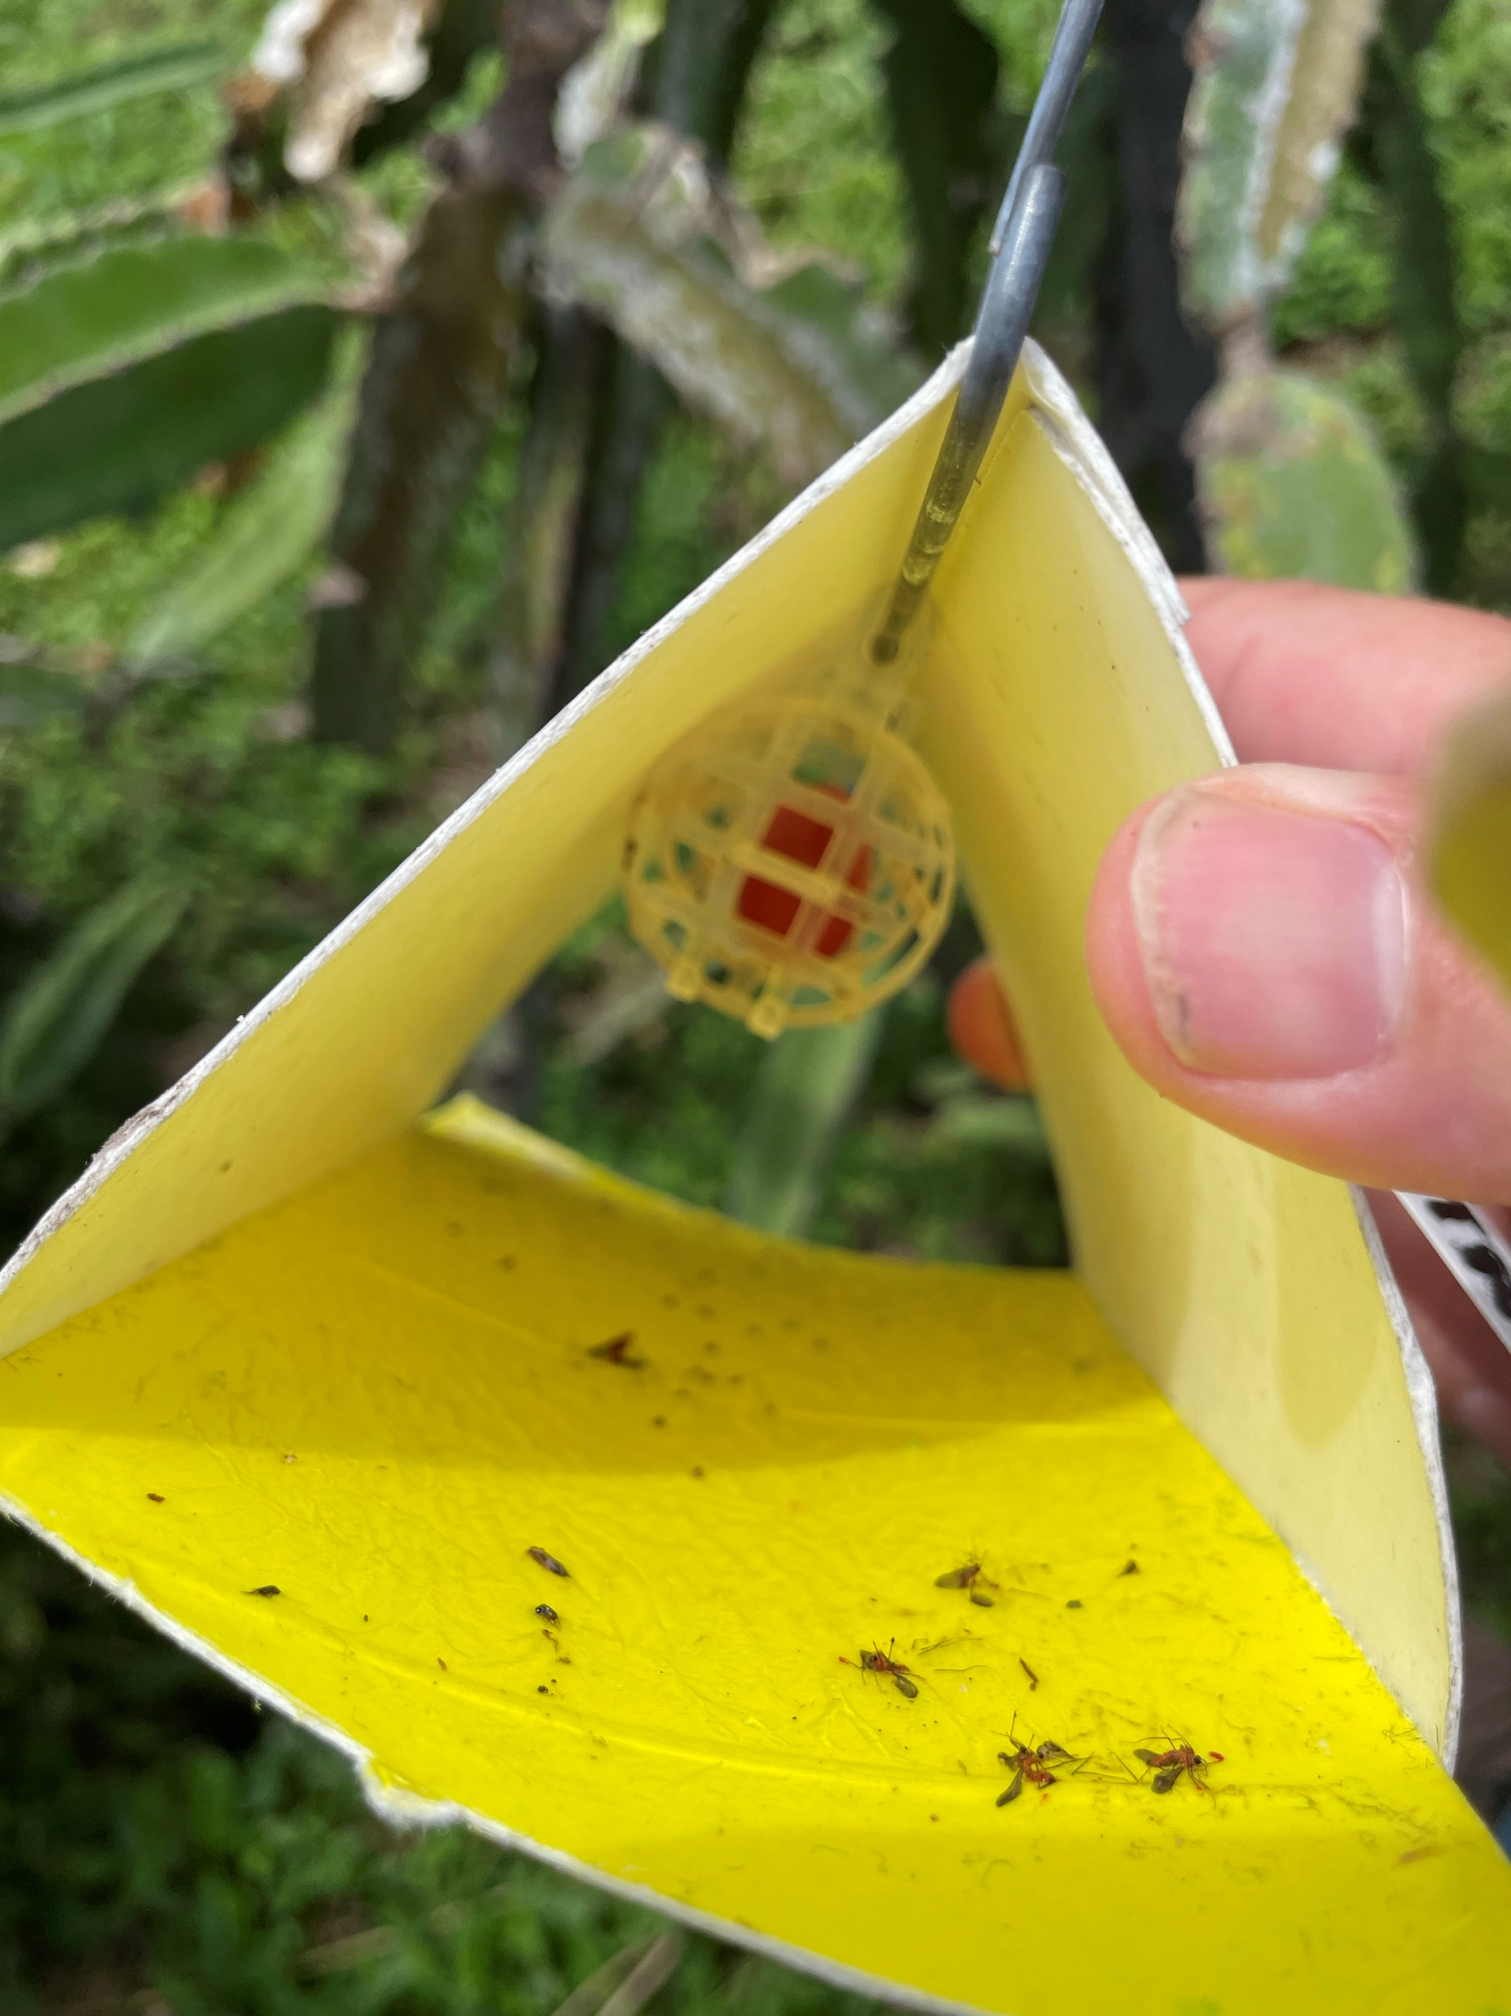
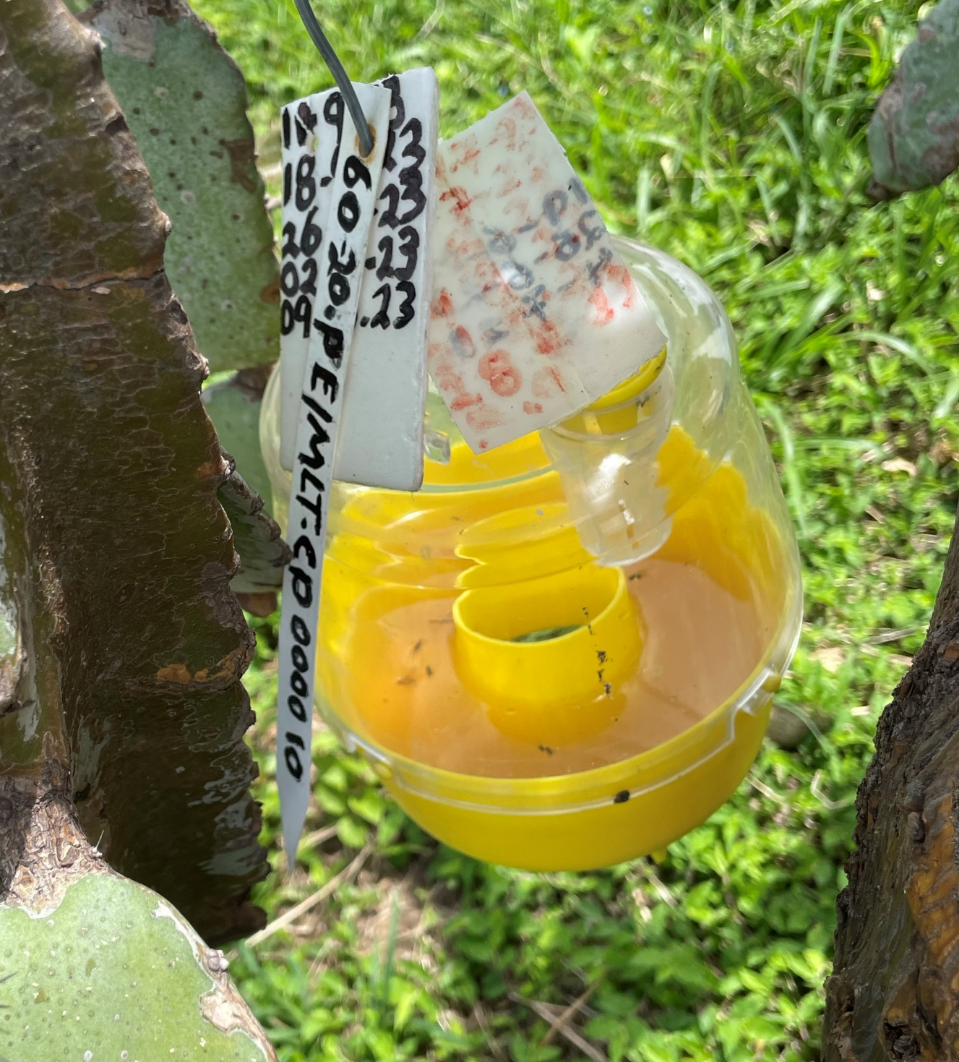
Mitigation measures in the systems approach
Commodities may require combined mitigation measures in pre-planting, pre-harvest, harvest, post-harvest, and transportation and distribution phases
Pre-harvest
NPPO approves and registers sites
Places of production with low pest prevalence
Crop must be unshaded during the day
Buffer area with non-host material
Field sanitation
Harvest
No fallen fruit packed
Traceability
Pest exclusion during transport
Photo by Marco Gonzalez – USDA_APHIS
Photo by Marco Gonzalez – USDA_APHIS

Slide 5
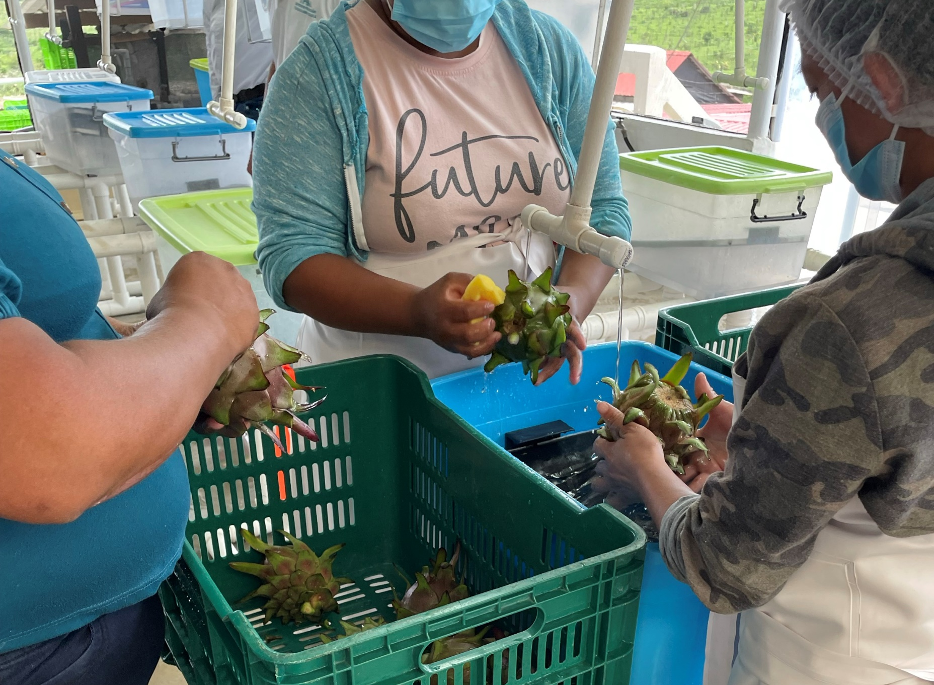
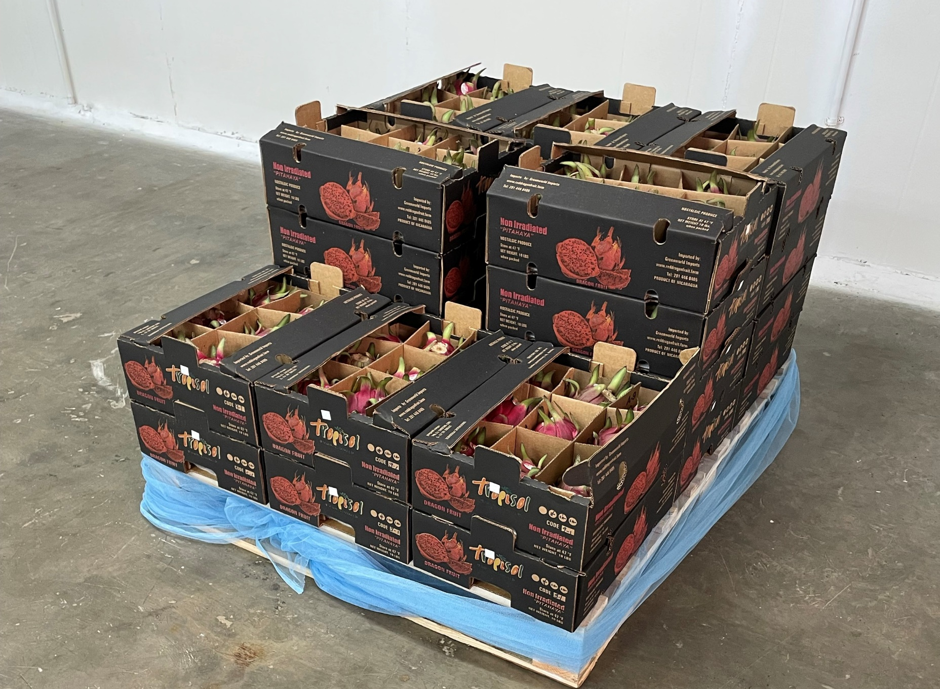
Mitigation measures in the systems approach (continued)
Post-harvest/ Transportation and Distribution
Packed within 24 hours of harvest
NPPO approves and registers packinghouse
Pest-exclusionary material and measures in packinghouse
Phytosanitary inspection and sampling
  Visual inspection for surface pests and damage
  Fruit cutting for detection of internal feeding pests
  Phytosanitary Certificate with additional declaration
Safeguarded until arrival in continental US
Photo by Marco Gonzalez – USDA_APHIS
Photo by Marco Gonzalez – USDA_APHIS

Slide 6
Analysis of successful outcomes and impacts
Monitoring of import data
  Pest interception data at the port of entry
  Other noncompliance issues
Pest detection data in exporting country
Audits (site visits and records review)
Current status of the Central American dragon fruit program
Since 2019:
  <1% Action rate for quarantine pests
  Zero interceptions of target pests

Slide 7

Sunset from Gates Pass, Eric McCarthy CC BY-SA 2.0
Thank you
Justin Wall
United States Department of Agriculture
Animal and Plant Health Inspection Service
Plant Protection and Quarantine
justin.b.wall@usda.gov

