Slide 1
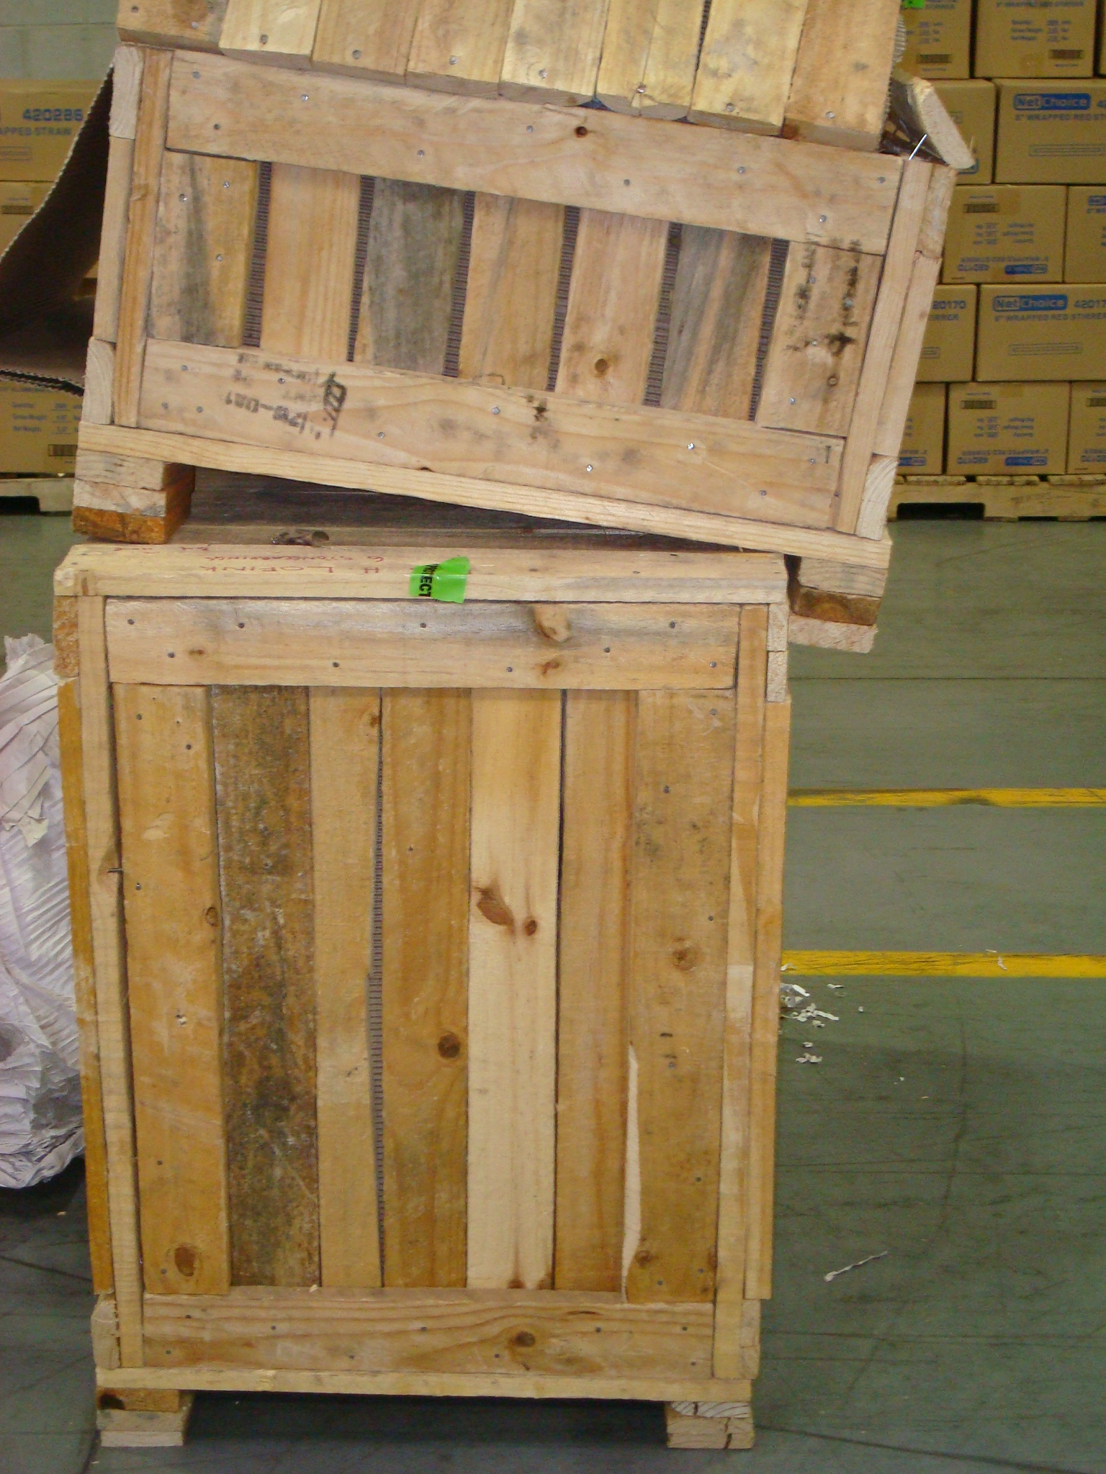
Evaluating the risk associated with different of types of wood packaging material – Opportunities to improve ISPM 15 compliance
Notes:
Two possible title slides

Slide 2
f
2024 NAPPO Forestry Expert Group Members
Meghan Noseworthy (NRC)
Arvind Vasudevan (CFIA)
Shamina Maccum (CFIA)
Chuck Dentelbeck (Industry)
Eric Allen
Marcel Dawson
Canada
Jason Allen (APHIS)
Ronald Mack (APHIS)
Tyrone Jones (APHIS)
Greg Helmbrecht (NPB)
Brad Gething (Industry)
Faith Campbell (Industry)
Leigh Greenwood (Industry)
David Kretschmann (Industry)
USA
Maria Eugenia Guerrero Alarcón
Gustavo Hernández Sánchez
Ana Lilia Montealegre
(SEMARNAT)
Mexico

Slide 3
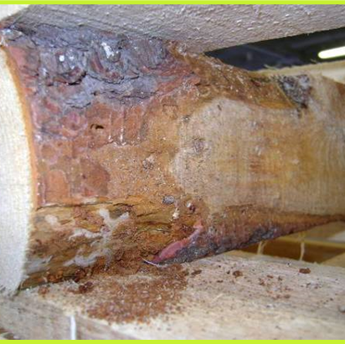
Evaluation Significance
Identify specific problematic WPM categories in which resources can be focused to maximize ISPM 15 compliance.

Slide 4
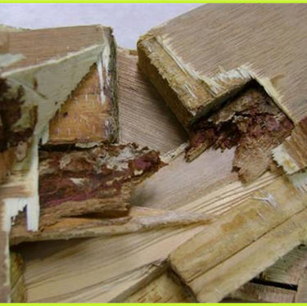
Purpose:
Evaluate the challenges associated with different categories of WPM

Slide 5
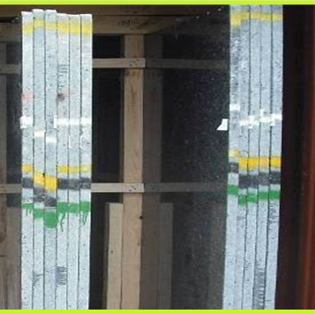
Procedure
REVIEW
Literature
WPM categories
Estimates of global volumes
Production process
Import data
attributes that increase risk

Slide 6
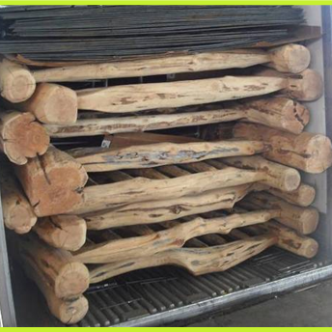
Conclusions
RECOMMENDATIONS:
Treatment and process improvements
NPPO harmonization of WPM categories.

Slide 7
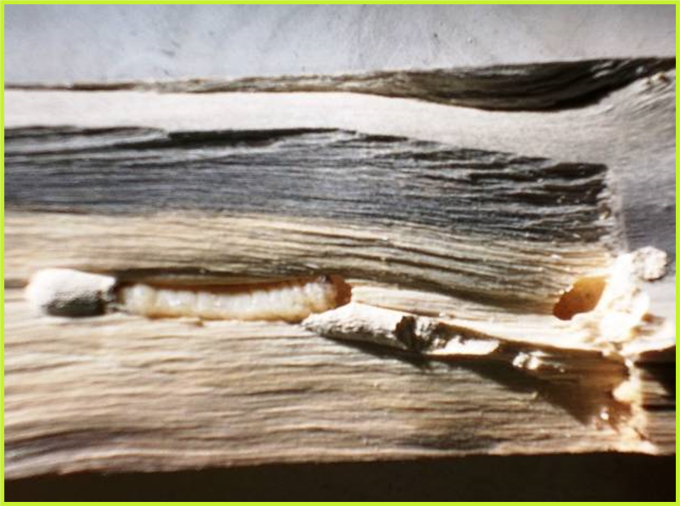
Next Steps
Continue accumulating data
Evaluate the resulting information

Slide 8
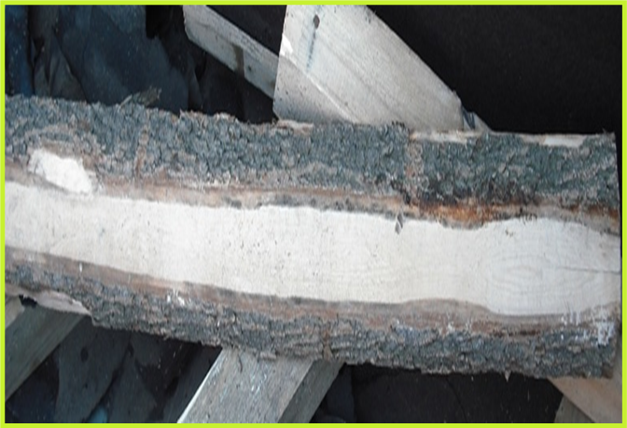
Thanks and Acknowledgements
The expert working group
NAPPO Secretariat
Nedelka Marin-Martinez
Alonso Suazo

