Slide 1




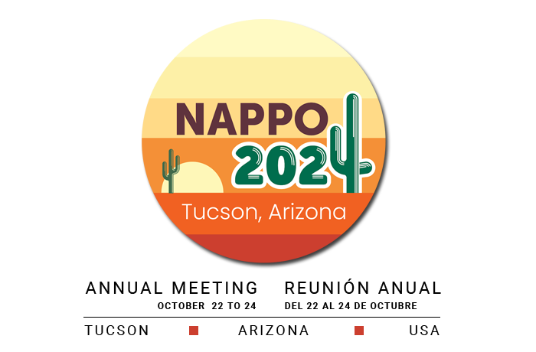
Meghan Noseworthy
Canadian Forest Service
47th NAPPO Annual Meeting
Project Report 2024
Testing the heat treatment dose for wood product pests in North America
Water bath ring study
Notes:
This is a brand-new project to the NAPPO work program so this report is more of a description of the project, including some background information, the justification for the project, the scope and deliverables

Slide 2
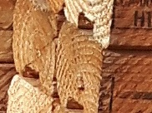
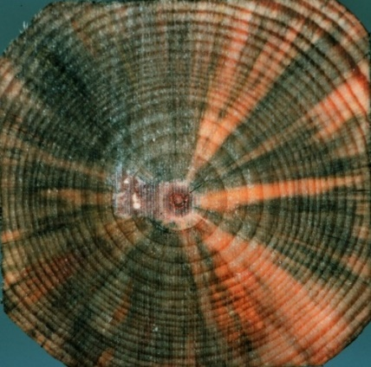
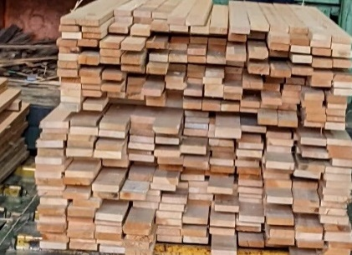
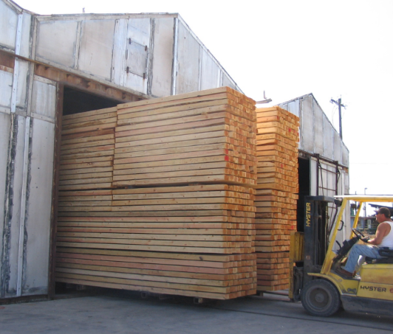
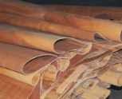
Background, justification and scope
Plant protection guidelines require scientific data
Heat treatment is a common measure
Quantification of species-specific lethal time-temperature regimes
Challenges with studies to date:
    Wood characteristics
    Dimension, moisture, density
    Accuracy
    Application, measurement
Notes:
It is well known that phytosanitary guidelines and treatments used to ensure that we don’t spread pests on traded commodities needs to be based in science. Many phytosanitary standards or guidelines both new and existing phytosanitary treatments and guidelines outlined in RSPM and ISPMs require data to support them. Scientific data also provides continued confidence in current standards.
2. One of the most widely used treatment types for forest products is heat treatment. There are many ways to apply heat treatment to wood products but conventional heat is the most universal and readily available types of heat.
3. Quantification of the lethal temperature and duration to kill, inactivate or devitalize wood pests will provide confidence in heat treatment
4. It is challenging to produce heat treatment experiments that are consistent across different types of wood commodities or reproducible because there are many variables to consider when applying heat to wood such as:
The characteristics of the wood can vary such as density , initial moisture and dimensions
The method used to measure the transfer of heat throughout the wood and the accuracy of these measurements can vary

Slide 3
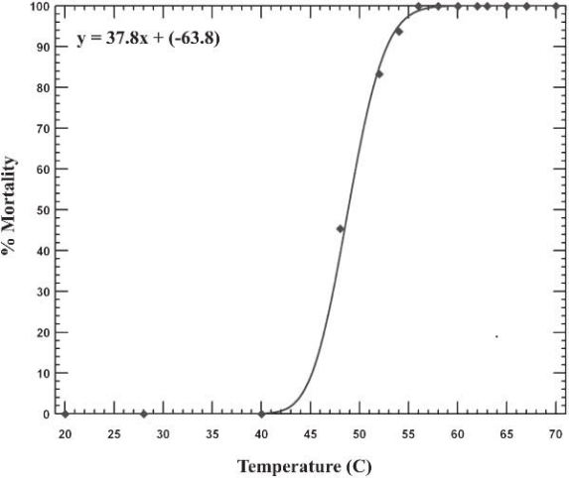
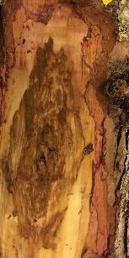
Background, justification and scope
Range of results
Lack of harmony in heat treatment used globally
Recommendation to use controlled in vitro experiment:
    Target minimum lethal dose
    Test wide range of pests from different climates
    Provide confidence in heat treatment
Dose delivery considerations – kiln schedules
Notes:
5 & 6. This range of parameters which are difficult to control can lead to variability in the results and thus a lack of agreement and harmony in the use of heat treatment used globally.
7. In order to remove some of these variables and still determine the parameters necessary to address pest risk in wood products an in vitro application was recommended where
8. Removing variables that are difficult to control is possible by applying heat in an in vitro setting – simply put this means applying heat to pests isolated from their usual biological surroundings so that we can apply and measure the effect of heat and determine
the minimum dose which is the minimum temperature and minimum time to kill pests.
It is possible test a wide variety of pests and specific life stages from a variety of environmental conditions
This method allows us to test a large number of pests with good replication and gives us confidence in the results
9. The information gathered from determining the specific lethal dose using in vitro testing needs to be paired with delivery specifications which simply put means showing that a kiln schedule effectively applies heat in such a way that it reaches the core and is delivered throughout the profile of a wood product
Figure: Graph on the right is the dose response of pinewood nematode to heat which formed the basis of treating wood packaging material to 56 degrees Celcius for 30 minutes and formed the basis for ISPM 15

Slide 4
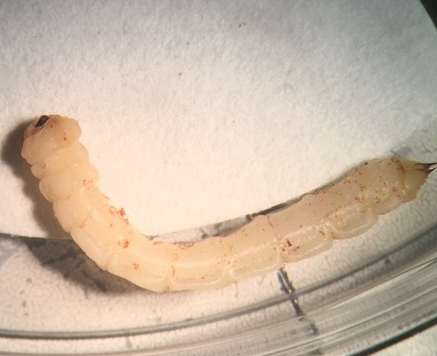
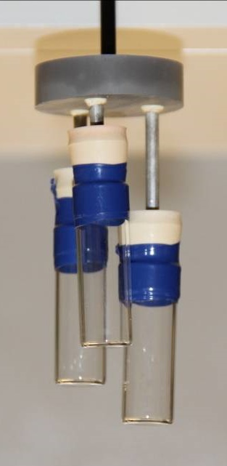





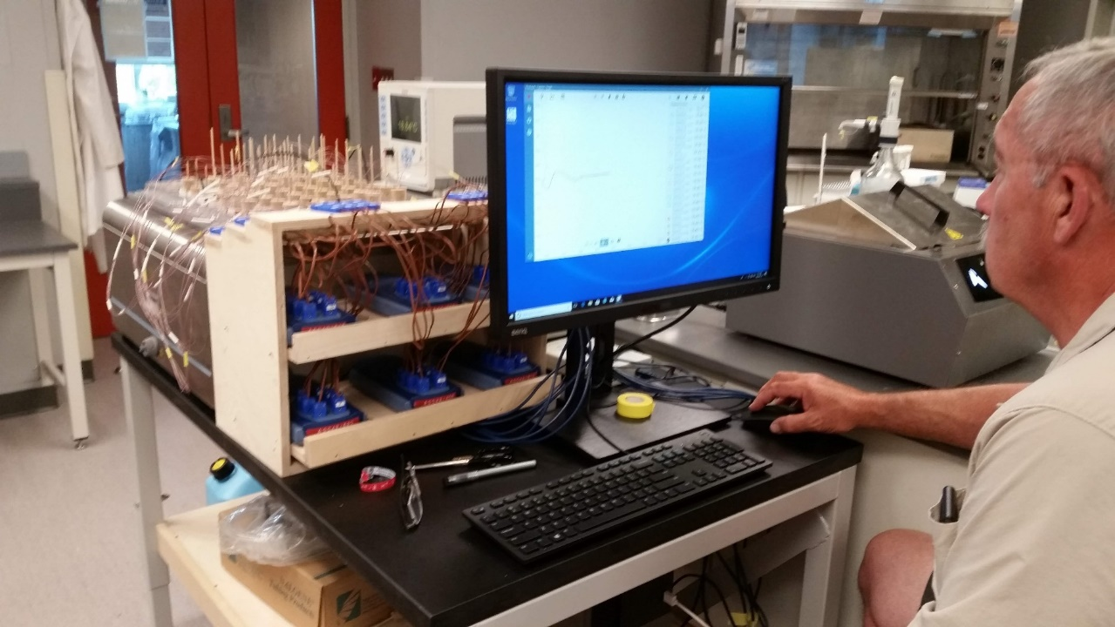
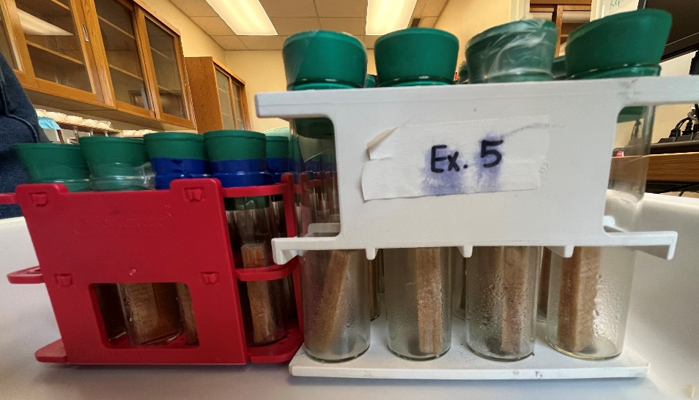
Heat treatment water bath
in vitro and in wood testing
Highly controlled heat application
High resolution and accuracy
In vitro and in vivo (in wood)
Ring study – test organisms in their native range
Notes:
This is the water bath pictured on the bottom right-hand photo with the designer of the bath, the late Lee Humble calibrating with thermocouples in every treatment position.
Using the heat treatment water bath we can
1. Control the heat application with precision
2. Measure and record the temperature applied with high resolution and accuracy at a rate in keeping with commercial kilns without exceeding the target temperature
3. In addition to testing pests in vitro we can test organisms in wood blocks such as fungi and nematodes
- Assemblies of test subjects in vials can be removed individually or in groups to look at different durations of heat application and target the lethal dose (top right is photo of test vials with varying depths to promote water and heat circulation consistency of heat application.
4. And by creating a ring study with water baths located in different areas of North America forestry pests can be tested in their native range to avoid unnecessary movement certification and quarantine laboratory conditions which reduces risk as well

Slide 5


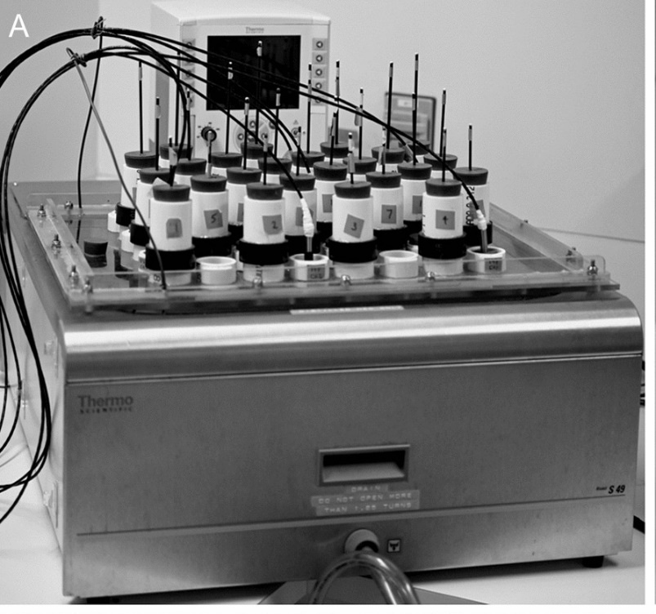
Testing the heat treatment dose for wood product pests in North America
Water bath ring study– Expert group
Grupo de expertos
Meghan Noseworthy (NRCan)
Eric Zarrazin (CFIA/ ACIA)
Chuck Dentelbeck (CLSAB)
Adnan Uzunovic (Can Wood)
Eric Allen (retired/ jubilado)
Canada
Tyrone Jones (USDA - APHIS)
Baode Wang (USDA - APHIS)
Brad Gething (NWPCA)
USA
Notes:
As mentioned this is a new group, these are the expert group members identified for this project currently
This is a another photo of the bath with a run in process. The black wires are attached to eight platinum resistance thermometers in place to record the temperature throughout the bath every few seconds.

Slide 6
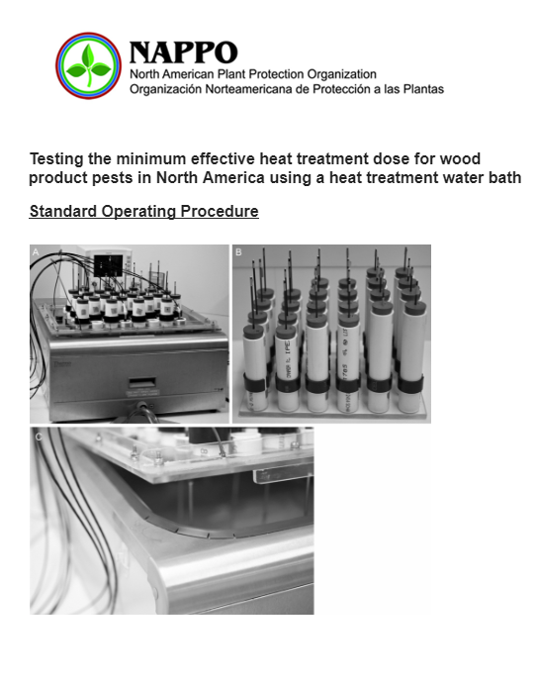
Project Objectives
Objetivo del proyecto
Develop a standard operating procedure
Develop a standardized analysis and methods
Create a prioritized list of pests to test
Discuss results
Document methodology, analyses, results - NAPPO S&T Doc
Notes:
The project objectives are:
To develop a standard operating procedure for building the bath, testing and recording the results treatment experiments
To develop a standardized method to collect, analyze and illustrate the results
To create a prioritized list of pests to test (such as those that have moved in trade)
To plan and discuss results of water bath heat treatment experiments
To document the methodology, analyses and results in a NAPPO S&T Doc

Slide 7





Project benefits to NPPOs and Industry
Beneficios del proyecto para las ONPF y la industria
Provide consensus and help to harmonize heat treatment guidance
Recognition of minimum lethal dose will:
  Support current standards
  Reduce over-treatment schedules
  Reduce the cost to industry
  Reduce carbon emissions and protect the environment
Notes:
The project benefits to regulators and industry include:
1. Providing an opportunity to gain consensus on the efficacy of heat treatment for forest pests in wood commodities and help to harmonize heat treatment guidance
2. Recognition of minimum lethal dose will:
Support current heat treatment standards
Reduce over-treatment schedules
Reduce the cost to industry
Reduce carbon emissions and protect the environment

Slide 8


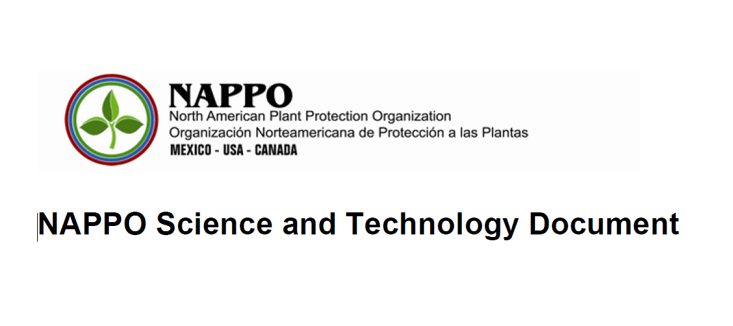
Accomplishments
Logros
Project Submission (June 2024)
Project on the work program (August 2024)
Confirmation of expert group members (October 2024)
Presentación del proyecto (junio del 2024)
Proyecto sobre el programa de trabajo (agosto del 2024)
Confirmación de los miembros del grupo de expertos (octubre 2024)

Slide 9
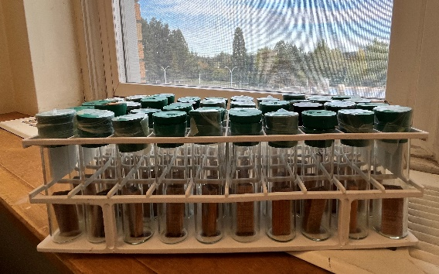

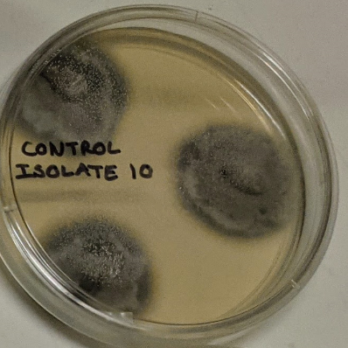
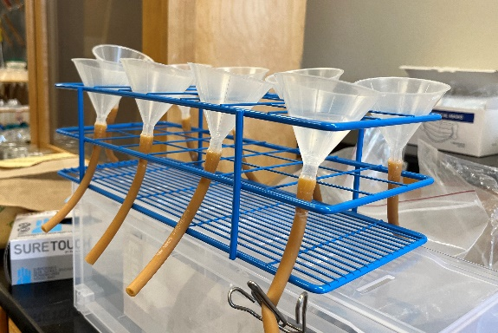
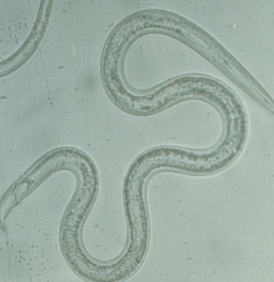
Pending Deliverables
Standard operating procedure/ manual
Testing protocols and data collection
Methods for analysis and reporting
Prioritized list of organisms to test in the water bath
Describe confirmatory testing
Document methodology, analyses, results - NAPPO S&T Document
Notes:
The pending deliverables are basically the work objectives:
To create a standard operating procedure or manual
To develop testing protocols and data collection methods
To develop a method for analysis and reporting
To create a prioritized list of organisms to test
To describe confirmatory testing which should be conducted – in wood in commercial setting tests to validate the delivery of heat to pests
To document the methodology, analyses and results in a NAPPO S&T document

Slide 10

Thanks & Acknowledgements
Agradecimientos y reconocimientos
Expert group members
NAPPO Executive Committee for their support
NAPPO Secretariat
NAPPO AMC
NAPPO Forest Quarantine Research Group
Miembros del grupo de expertos
Comité Ejecutivo de la NAPPO por su apoyo
Secretaría de la NAPPO
CCM de la NAPPO
NAPPO grupo de investigación de cuarentena forestal

