Slide 1

2024 NAPPO Seeds Pilot Project Updates
Alonso Suazo
47th NAPPO Annual Meeting
Tucson, AZ

Slide 2
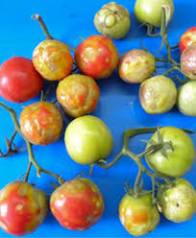
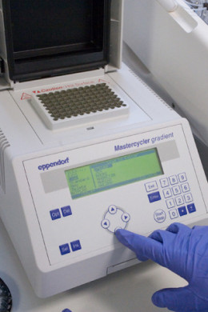
Harmonization of diagnostic protocols for seed pests - ToBRFV
  Model for regional harmonization
    ToBRFV - quarantine pest for all NAPPO countries
    Host commodities - fruit, seeds and plants of tomato and pepper - heavily traded in our region
    Immediate benefits to regional trade
      Alleviating delays/costs resulting from conflicting seed test results
      Avoid unnecessary retesting
Source: CABI digital library

Slide 3
Updates
Protocols
-Five PCR-based protocols selected (3 Standard PCR and 2 real-time PCR)
-All protocols validated
Experimental Design
-9 laboratories selected (2 in Canada, 4 in the United States and 3 in Mexico)
-Experimental design completed
Logistics
-All logistical aspects for the ring test were considered
-Instructions for participating labs were prepared and shared
-Data entry to the APHIS PPQ portal
-Q&A sessions completed
-3 Standard Operating Procedures established
Ring test completed. Data from all 9 laboratories was collected and analyzed.

Slide 4
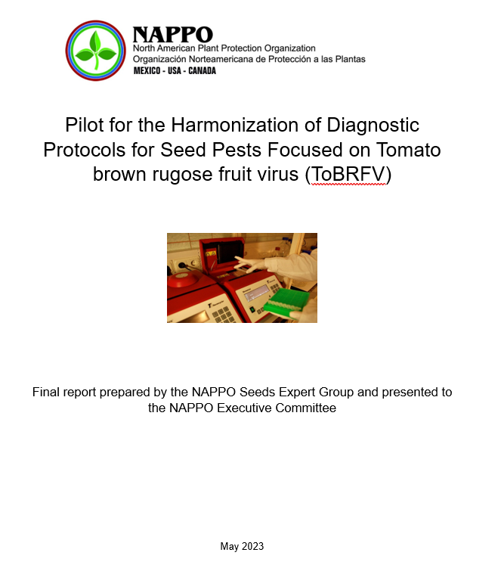
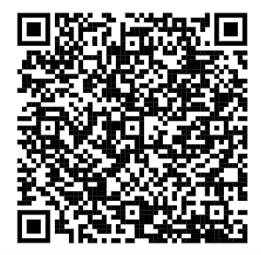
Parameters evaluated
Limit of detection
Specificity
Sensitivity
Precision
Linearity and accuracy
Likelihood ratios

Slide 5
Protocols tested
Code | Protocol | Type
A | California Department of Ag. (CDFA) | cPCR
B | ISHI-Veg⁽¹⁾ | RT-PCR
C | USDA-APHIS-PPQ | RT-PCR
D | USDA-APHIS-PPQ | cPCR
E | SENASICA | cPCR
⁽¹⁾: International Seed Initiative for Vegetable Crops / National Seed Health System

Slide 6
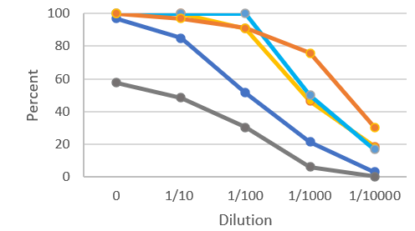
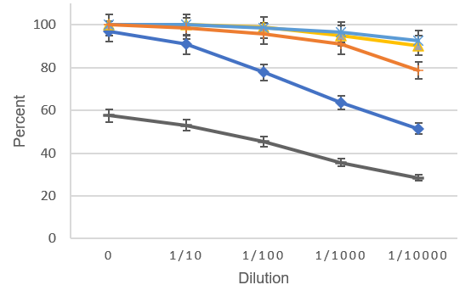
Results
Limit of detection (LOD)
Sensitivity
C
C
D
B
B
D
A
E
A
E
Percentage of samples containing detectable target (ToBRFV) at a given concentration.
0% (no virus present) to 100% (all samples containing target are detectable at the specified concentration)
Measurement of true positives over the range of samples tested (percent detection of ToBRFV positive material)

Slide 7
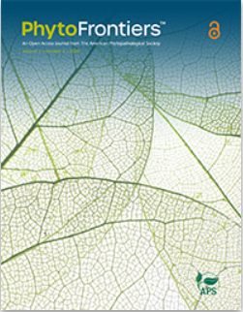
Next steps
The manuscript “Pilot for harmonization of diagnostic protocols for tomato brown rugose fruit virus (ToBRFV) in tomato and pepper seeds” was submitted for publication in the journal “PhytoFrontiers”.
The decision sheet will be signed by the NAPPO Executive Committee when the manuscript is published.

Slide 8
Recommendations (from EG final report)
Based on analysis of the ring test data, protocols A (CDFA), B (ISHI-Veg/NSHS), C ( USDA-APHIS-RT PCR), and D (USDA-APHIS- cPCR) produced comparable results and could be used interchangeably for the detection of ToBRFV in tomato and pepper seeds. They provide a choice between 2 real-time PCR and 2 conventional PCR methodologies.
Protocols B, C, and D performed optimally in relation to all assayed parameters and variables evaluated.
Furthermore, protocols B, C and D could be recognized by all three NAPPO member countries for phytosanitary testing of seeds for the presence of ToBRFV.
This will facilitate safe and expeditious trade of tomato and pepper seeds in our region and avoid unnecessary retesting by exporting and importing countries.
The experimental design used in this study can serve as a model for future studies to evaluate other diagnostic protocols for the detection of other seed-transmitted pests of regulatory significance.

Slide 9
Thank you!

