Slide 1
Draft Annex to ISPM 38: Design and use of systems approaches for phytosanitary certification of seeds to ISPM 38 (International movement of seeds)
Marina Zlotina, UADA-APHIS-PPQ-IPMSP
October 23, 2024
Tucson, AZ

Slide 2
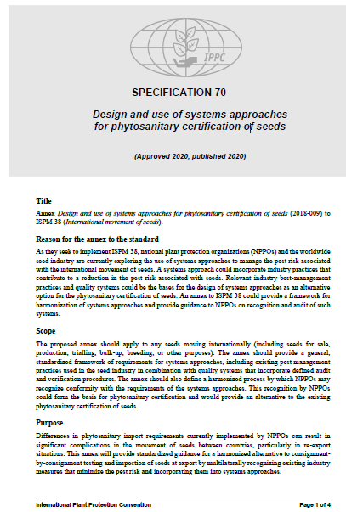
History of development
Topic added to LOT 2018
Specification approved 2020
    Spec_70_RevISPM38_En_2020-12-02.pdf (ippc.int)
EWG produced the first draft in 2021
      Report_EWG_SA_2021_Oct_2022-01-05.pdf (ippc.int)
The draft was presented to the Standards Committee (SC) in May 2022, November 2023, May 2023; SC identified major conceptual issues and formed a Small Group to address them.
      Report_SC_2022_May_2022-06_24.pdf (ippc.int)
      Report_SC_2022_Nov_2023-02_01.pdf (ippc.int)
      Report_SC-7_2023_May.pdf (ippc.int)
SC approved draft for the first consultation in May 2024.

Slide 3
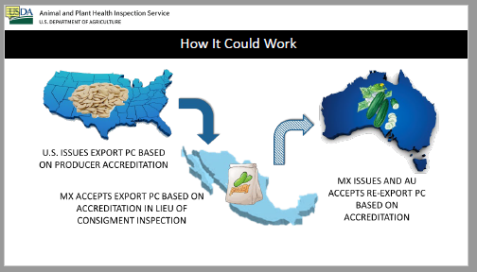
Reasons for the Annex
Trade in seeds is global with production processes in different parts of the world.
NPPOs are exploring the use of systems approaches (SAs) to manage the pest risk associated with seeds.
A SA developed by NPPOs could incorporate industry practices that contribute to a pest risk reduction in seeds.
A SA can serve as an alternative option for the phytosanitary certification of seeds.

Slide 4
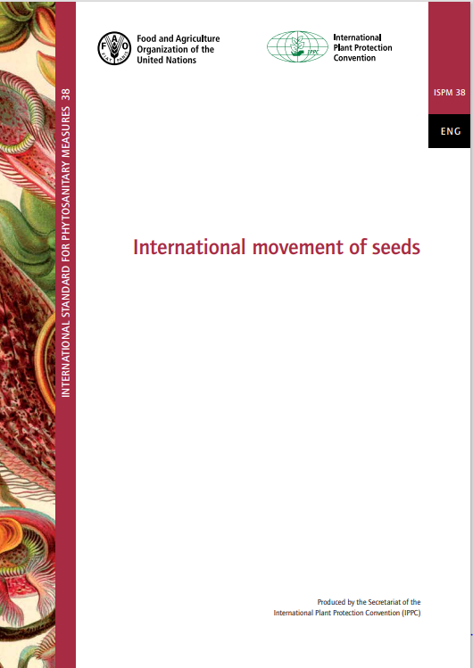
Background and Scope
The Annex is intended as a general framework on designing SAs and setting requirements for using such SAs; it is intended to be applied to any seed.
The framework should provide guidance to NPPOs in recognizing existing seed industry practices and QMS as a part of SAs reducing pest risk.
NPPOs would certify seed based on the confidence in the risk management measures applied during the production process.

Slide 5
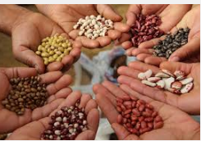
Important considerations for the Systems Approaches for seeds
SA is an additional option for phytosanitary certification that meets the phytosanitary import requirements of all the NPPOs involved along the seed supply chain.
Production practices used by participating entities may be included by NPPOs in the SAs if they effectively reduce pest risks.
SA for seeds can be used to manage pest groups rather than individual pests (concept used in ISPM 36).
NPPOs can always use testing to verify that regulated pests were eliminated from the seed supply chain.

Slide 6
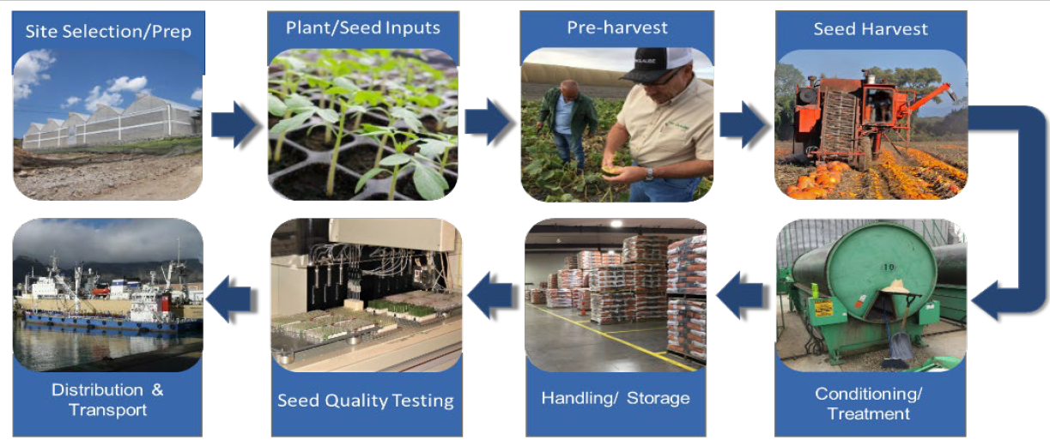
Critical Control Points (CCP)
NPPOs are responsible for identifying the CCPs at which measures could be applied.
NPPOs should evaluate risk management options and production practices for potential inclusion as integrated measures into a SA.
Number of CCPs along the seed supply chain could vary depending on seed commodity, and usually applied at pre-planting, production, post-harvest, distribution and transport stages.
NPPOs of the exporting countries should monitor the SA using audits and other verification means to ensure that the system is functioning satisfactorily.

Slide 7
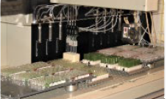


Performance criteria for seed entities
Establishing performance criteria for seed entities is required prior to the entity entering the agreement to participate in a SA.
The entity should meet the performance criteria for each measure associated with the SA.
The entity should have a well implemented and approved QMS, including, at minimum, quality policy, SOPs, systems for training, auditing, issuing corrective actions, record keeping, continuous improvement.
The most effective production practices of the entity should be evaluated and approved by the NPPO developing the SA for their further integration in the SA.

Slide 8

Consultation 2024 and Next steps
Consultation 2024
Areas of concerns
Next steps

Slide 9
Questions?

